Slide 1

Result
Sep. 23th

Slide 2

CNN Model
batch-size：64
learning rate：0.01

Slide 3
Epoch1:
Test set: Average loss: 0.4183, Accuracy: 8491/10693 (79%), Positive accuracy: 3128/4501 (69%), Negative accuracy: 5363/6192 (87%), f1 score: 0.7933
Epoch2:
Test set: Average loss: 0.3449, Accuracy: 9098/10693 (85%), Positive accuracy: 3800/4501 (84%), Negative accuracy: 5298/6192 (86%), f1 score: 0.8447
Epoch3
Test set: Average loss: 0.3173, Accuracy: 9218/10693 (86%), Positive accuracy: 3724/4501 (83%), Negative accuracy: 5494/6192 (89%), f1 score: 0.8588
Epoch4:
Test set: Average loss: 0.3141, Accuracy: 9238/10693 (86%), Positive accuracy: 3929/4501 (87%), Negative accuracy: 5309/6192 (86%), f1 score: 0.8575
Epoch5:
Test set: Average loss: 0.3059, Accuracy: 9242/10693 (86%), Positive accuracy: 3674/4501 (82%), Negative accuracy: 5568/6192 (90%), f1 score: 0.8627
Epoch6:
Test set: Average loss: 0.3027, Accuracy: 9268/10693 (87%), Positive accuracy: 3808/4501 (85%), Negative accuracy: 5460/6192 (88%), f1 score: 0.8624
Epoch7:
Test set: Average loss: 0.3030, Accuracy: 9236/10693 (86%), Positive accuracy: 3670/4501 (82%), Negative accuracy: 5566/6192 (90%), f1 score: 0.8621
Epoch8:
Test set: Average loss: 0.3002, Accuracy: 9276/10693 (87%), Positive accuracy: 3763/4501 (84%), Negative accuracy: 5513/6192 (89%), f1 score: 0.864
Epoch9:
Test set: Average loss: 0.3011, Accuracy: 9246/10693 (86%), Positive accuracy: 3706/4501 (82%), Negative accuracy: 5540/6192 (89%), f1 score: 0.8623
Epoch10:
Test set: Average loss: 0.2997, Accuracy: 9266/10693 (87%), Positive accuracy: 3753/4501 (83%), Negative accuracy: 5513/6192 (89%), f1 score: 0.8633
2 layers of Convolution,
channels are 32, 64, filter size is 3
2 layers of fully connected with 3136, 128

Slide 4

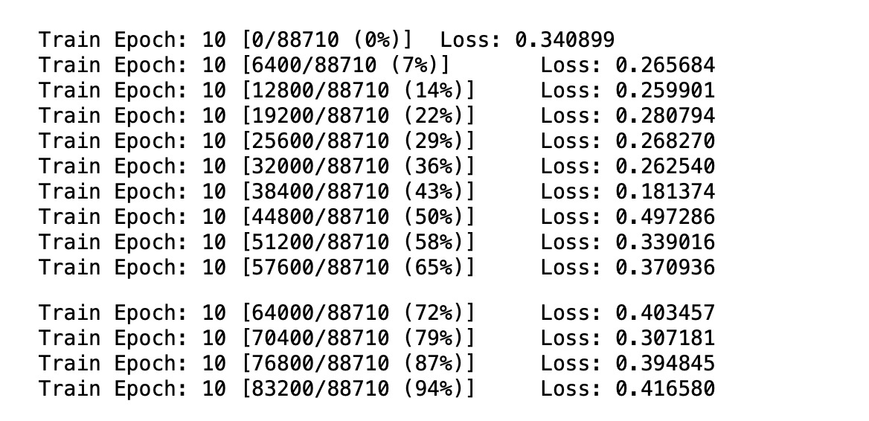

Slide 5
Epoch1:
Epoch2:
Test set: Average loss: 0.4455, Accuracy: 8218/10693 (77%), Positive accuracy: 4400/4501 (98%), Negative accuracy: 3818/6192 (62%), f1 score: 0.7794
Epoch3
Test set: Average loss: 0.2958, Accuracy: 9198/10693 (86%), Positive accuracy: 3882/4501 (86%), Negative accuracy: 5316/6192 (86%), f1 score: 0.8539
Epoch4:
Test set: Average loss: 0.2933, Accuracy: 9201/10693 (86%), Positive accuracy: 3844/4501 (85%), Negative accuracy: 5357/6192 (87%), f1 score: 0.8548
Epoch5:
Test set: Average loss: 0.2868, Accuracy: 9228/10693 (86%), Positive accuracy: 3808/4501 (85%), Negative accuracy: 5420/6192 (88%), f1 score: 0.8582
Epoch6:
Test set: Average loss: 0.3000, Accuracy: 9235/10693 (86%), Positive accuracy: 3463/4501 (77%), Negative accuracy: 5772/6192 (93%), f1 score: 0.8691
Epoch7:
Test set: Average loss: 0.2890, Accuracy: 9261/10693 (87%), Positive accuracy: 3583/4501 (80%), Negative accuracy: 5678/6192 (92%), f1 score: 0.8676
Epoch8:
Test set: Average loss: 0.2850, Accuracy: 9245/10693 (86%), Positive accuracy: 3783/4501 (84%), Negative accuracy: 5462/6192 (88%), f1 score: 0.8604
Epoch9:
Test set: Average loss: 0.2922, Accuracy: 9260/10693 (87%), Positive accuracy: 3521/4501 (78%), Negative accuracy: 5739/6192 (93%), f1 score: 0.8698
Epoch10:
Test set: Average loss: 0.2840, Accuracy: 9268/10693 (87%), Positive accuracy: 3702/4501 (82%), Negative accuracy: 5566/6192 (90%), f1 score: 0.8648
Test set: Average loss: 0.4934, Accuracy: 7921/10693 (74%), Positive accuracy: 3705/4501 (82%), Negative accuracy: 4216/6192 (68%), f1 score: 0.7347
5 layers of Convolution,
channels are 16,32, 64, 128,256, filter size is 3
2 layers of fully connected with 4096, 1024

Slide 6
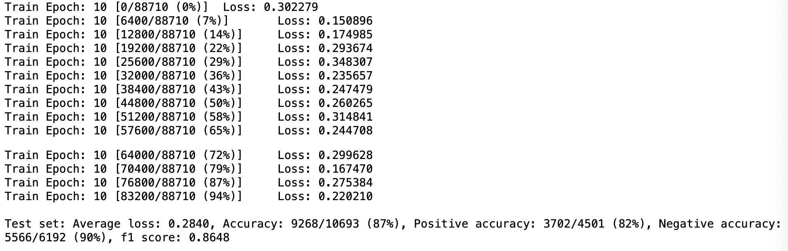

Slide 7
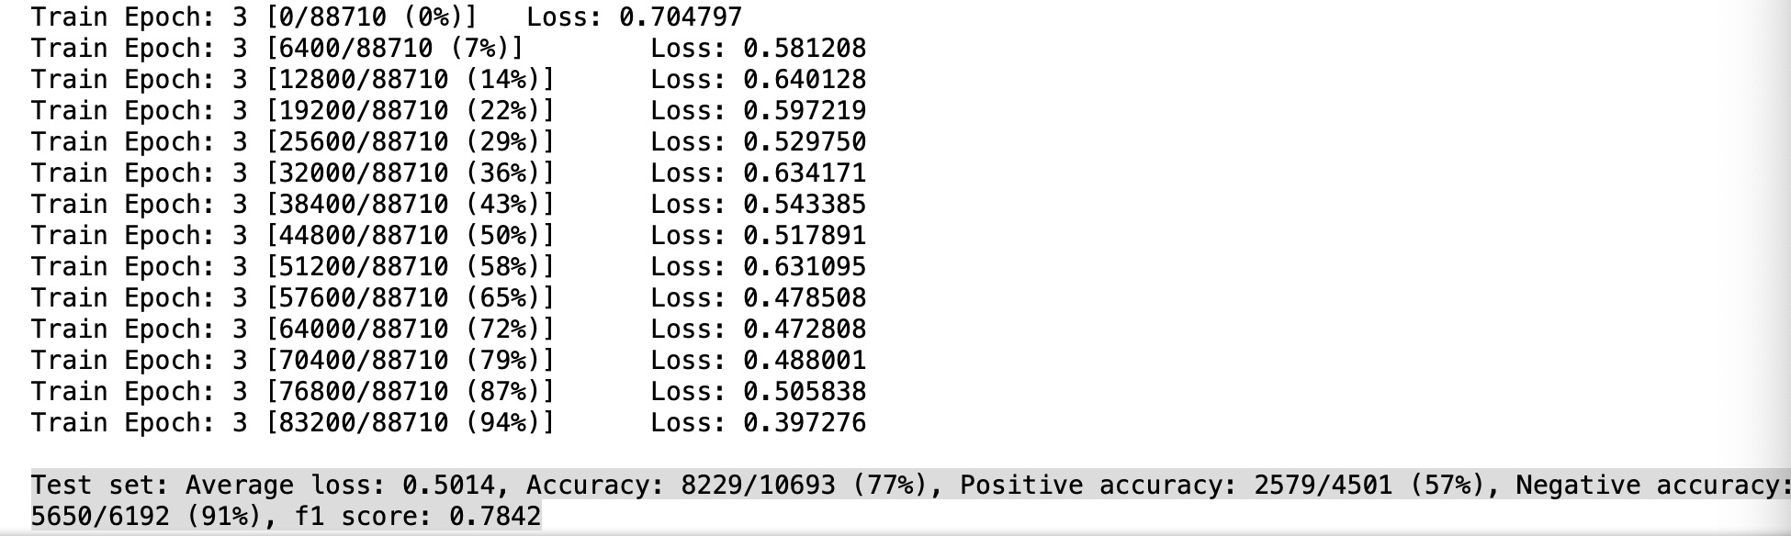
2 layers of convolution, channels are 32,64, filter size is 3
7 layers of fully connected with 3136,1024,512,128,64,32
EPCOCH1: Test set: Average loss: 0.6762, Accuracy: 6192/10693 (58%), Positive accuracy: 0/4501 (0%), Negative accuracy: 6192/6192 (100%), f1 score: nan
Epoch2: Test set: Average loss: 0.6387, Accuracy: 6192/10693 (58%), Positive accuracy: 0/4501 (0%), Negative accuracy: 6192/6192 (100%), f1 score: nan
Epoch3: Test set: Average loss: 0.5014, Accuracy: 8229/10693 (77%), Positive accuracy: 2579/4501 (57%), Negative accuracy: 5650/6192 (91%), f1 score: 0.7842

Slide 8
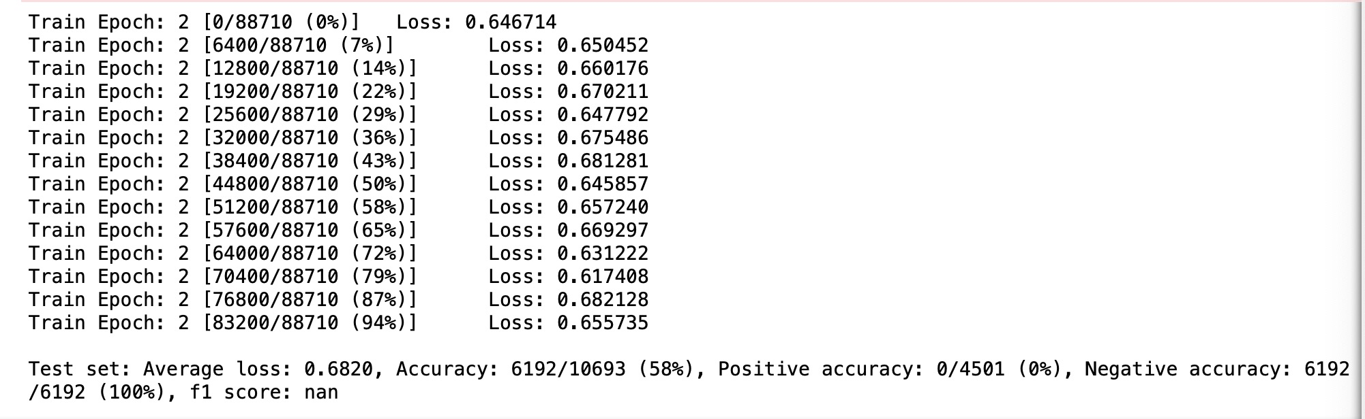
5 layers of convolution, channels are 16,32,64,128,256, filter size is 3
7 layers of fully connected with 4096,1024,512,128,64,32
Epoch1: Test set: Average loss: 0.6806, Accuracy: 6192/10693 (58%), Positive accuracy: 0/4501 (0%), Negative accuracy: 6192/6192 (100%), f1 score: nan
Epoch2: Test set: Average loss: 0.6820, Accuracy: 6192/10693 (58%), Positive accuracy: 0/4501 (0%), Negative accuracy: 6192/6192 (100%), f1 score: nan

Slide 9
Epoch1:
Epoch2:
Test set: Average loss: 0.3752, Accuracy: 8820/10693 (82%), Positive accuracy: 2989/4501 (66%), Negative accuracy: 5831/6192 (94%), f1 score: 0.8403
Epoch3
Test set: Average loss: 0.3122, Accuracy: 9253/10693 (87%), Positive accuracy: 3871/4501 (86%), Negative accuracy: 5382/6192 (87%), f1 score: 0.8597
Epoch4:
Test set: Average loss: 0.3058, Accuracy: 9220/10693 (86%), Positive accuracy: 3641/4501 (81%), Negative accuracy: 5579/6192 (90%), f1 score: 0.8611
Epoch5:
Test set: Average loss: 0.3018, Accuracy: 9242/10693 (86%), Positive accuracy: 3688/4501 (82%), Negative accuracy: 5554/6192 (90%), f1 score: 0.8623
Epoch6:
Test set: Average loss: 0.3020, Accuracy: 9229/10693 (86%), Positive accuracy: 3648/4501 (81%), Negative accuracy: 5581/6192 (90%), f1 score: 0.8619
Epoch7:
Test set: Average loss: 0.3001, Accuracy: 9232/10693 (86%), Positive accuracy: 3690/4501 (82%), Negative accuracy: 5542/6192 (90%), f1 score: 0.8611
Epoch8:
Test set: Average loss: 0.2989, Accuracy: 9228/10693 (86%), Positive accuracy: 3794/4501 (84%), Negative accuracy: 5434/6192 (88%), f1 score: 0.8584
Epoch9:
Test set: Average loss: 0.2984, Accuracy: 9235/10693 (86%), Positive accuracy: 3718/4501 (83%), Negative accuracy: 5517/6192 (89%), f1 score: 0.8608
Epoch10:
Test set: Average loss: 0.2991, Accuracy: 9226/10693 (86%), Positive accuracy: 3684/4501 (82%), Negative accuracy: 5542/6192 (90%), f1 score: 0.8606
Test set: Average loss: 0.4041, Accuracy: 8614/10693 (81%), Positive accuracy: 3332/4501 (74%), Negative accuracy: 5282/6192 (85%), f1 score: 0.8018
2 layers of convolution, channels are 32,64, filter size is 7
2 layers of fully connected with 3136, 128

Slide 10
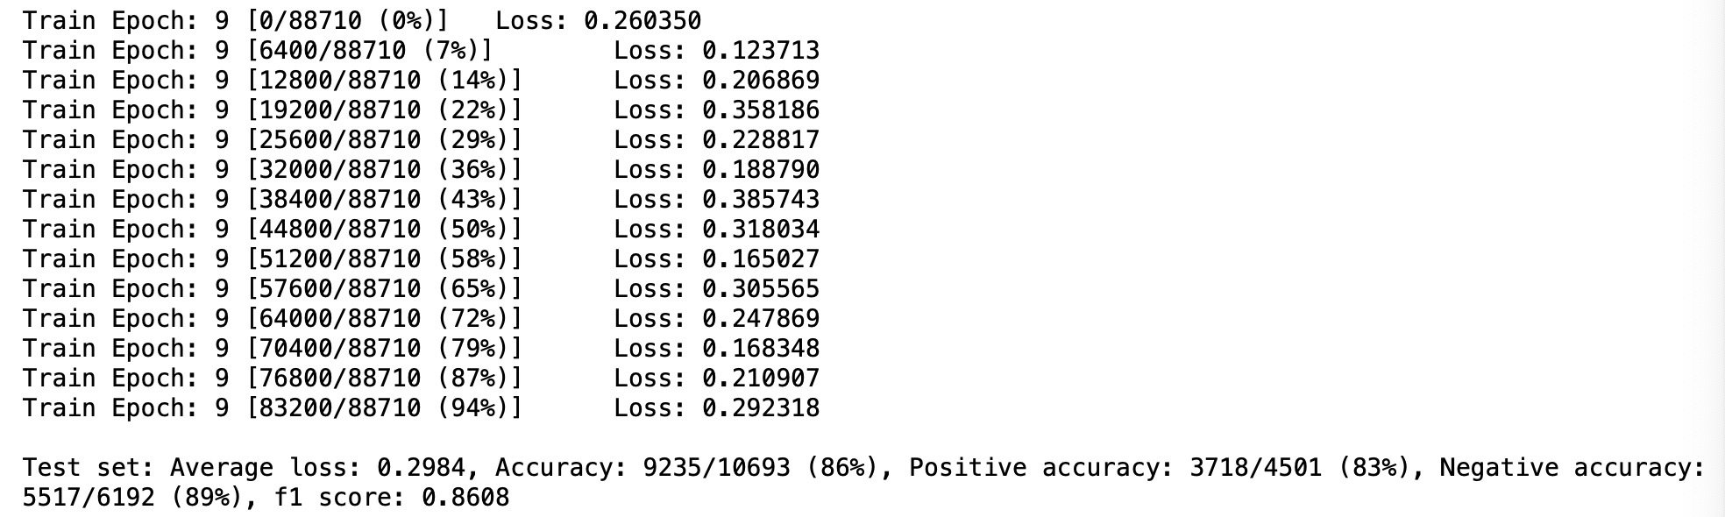

Slide 11
Epoch1:
Test set: Average loss: 0.4183, Accuracy: 8491/10693 (79%), Positive accuracy: 3128/4501 (69%), Negative accuracy: 5363/6192 (87%), f1 score: 0.7933
Epoch2:
Test set: Average loss: 0.3449, Accuracy: 9098/10693 (85%), Positive accuracy: 3800/4501 (84%), Negative accuracy: 5298/6192 (86%), f1 score: 0.8447
Epoch3
test set: Average loss: 0.3173, Accuracy: 9218/10693 (86%), Positive accuracy: 3724/4501 (83%), Negative accuracy: 5494/6192 (89%), f1 score: 0.8588
Epoch4:
Test set: Average loss: 0.3141, Accuracy: 9238/10693 (86%), Positive accuracy: 3929/4501 (87%), Negative accuracy: 5309/6192 (86%), f1 score: 0.8575
Epoch5:
Test set: Average loss: 0.3059, Accuracy: 9242/10693 (86%), Positive accuracy: 3674/4501 (82%), Negative accuracy: 5568/6192 (90%), f1 score: 0.8627
Epoch6:
Test set: Average loss: 0.3027, Accuracy: 9268/10693 (87%), Positive accuracy: 3808/4501 (85%), Negative accuracy: 5460/6192 (88%), f1 score: 0.8624
Epoch7:
Test set: Average loss: 0.3030, Accuracy: 9236/10693 (86%), Positive accuracy: 3670/4501 (82%), Negative accuracy: 5566/6192 (90%), f1 score: 0.8621
Epoch8:
Test set: Average loss: 0.3002, Accuracy: 9276/10693 (87%), Positive accuracy: 3763/4501 (84%), Negative accuracy: 5513/6192 (89%), f1 score: 0.8642
Epoch9:
Test set: Average loss: 0.3011, Accuracy: 9246/10693 (86%), Positive accuracy: 3706/4501 (82%), Negative accuracy: 5540/6192 (89%), f1 score: 0.8623
Epoch10:
Test set: Average loss: 0.2997, Accuracy: 9266/10693 (87%), Positive accuracy: 3753/4501 (83%), Negative accuracy: 5513/6192 (89%), f1 score: 0.8633
2 layers of convolution, channels are 32,64, filter size is 3
2 layers of fully connected with 3136, 128
batch size: 1024

Slide 12
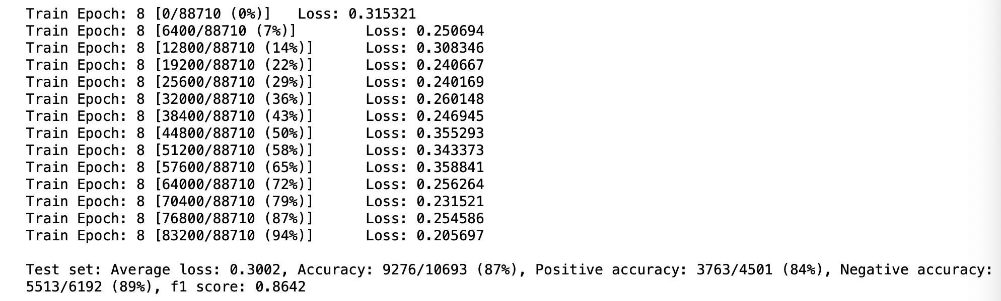

Slide 13
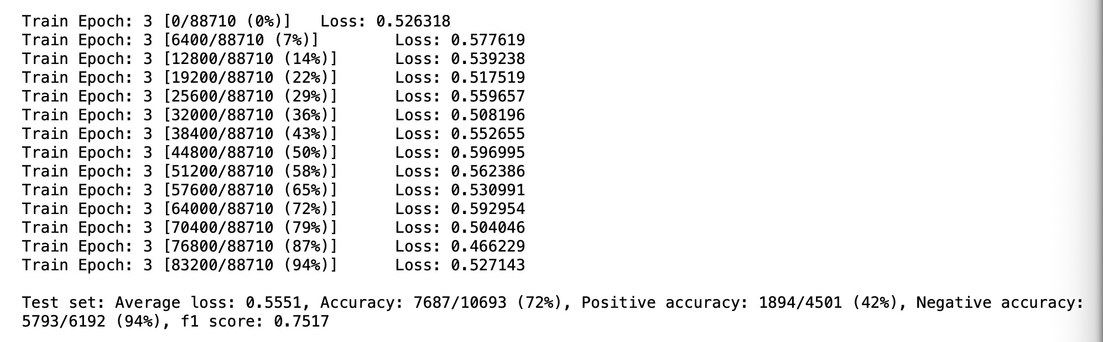
2 layers of convolution, channels are 32,64, filter size is 3
2 layers of fully connected with 3136, 128
Learning rate: 0.001
EPCOCH1: Test set: Average loss: 0.6242, Accuracy: 6192/10693 (58%), Positive accuracy: 0/4501 (0%), Negative accuracy: 6192/6192 (100%), f1 score: nan
Epoch2: Test set: Average loss: 0.5837, Accuracy: 6997/10693 (65%), Positive accuracy: 889/4501 (20%), Negative accuracy: 6108/6192 (99%), f1 score: 0.7446
Epoch3: Test set: Average loss: 0.5551, Accuracy: 7687/10693 (72%), Positive accuracy: 1894/4501 (42%), Negative accuracy: 5793/6192 (94%), f1 score: 0.7517

Slide 14
Gabor Model
batch-size：64
learning rate：0.01

Slide 15
model =GaborConvPC(19, 1, 6, 4).to(device)
Epoch1:
Test set: Average loss: 0.3727, Accuracy: 8965/10693 (84%), Positive accuracy: 3514/4501 (78%), Negative accuracy: 5451/6192 (88%)
Epoch2:
Test set: Average loss: 0.3754, Accuracy: 8914/10693 (83%), Positive accuracy: 3311/4501 (74%), Negative accuracy: 5603/6192 (90%)
Epoch3
Test set: Average loss: 0.3663, Accuracy: 8978/10693 (84%), Positive accuracy: 3336/4501 (74%), Negative accuracy: 5642/6192 (91%)
Epoch4:
Test set: Average loss: 0.3487, Accuracy: 9057/10693 (85%), Positive accuracy: 3596/4501 (80%), Negative accuracy: 5461/6192 (88%)
Epoch5:
Test set: Average loss: 0.3618, Accuracy: 8991/10693 (84%), Positive accuracy: 3348/4501 (74%), Negative accuracy: 5643/6192 (91%)
Epoch6:
Test set: Average loss: 0.3611, Accuracy: 8930/10693 (84%), Positive accuracy: 3612/4501 (80%), Negative accuracy: 5318/6192 (86%)
Epoch7:
Test set: Average loss: 0.3520, Accuracy: 9014/10693 (84%), Positive accuracy: 3508/4501 (78%), Negative accuracy: 5506/6192 (89%)
Epoch8:
Test set: Average loss: 0.3353, Accuracy: 9149/10693 (86%), Positive accuracy: 3609/4501 (80%), Negative accuracy: 5540/6192 (89%)
Epoch9:
Test set: Average loss: 0.3465, Accuracy: 9074/10693 (85%), Positive accuracy: 3446/4501 (77%), Negative accuracy: 5628/6192 (91%)
Epoch10:
Test set: Average loss: 0.3379, Accuracy: 9133/10693 (85%), Positive accuracy: 3577/4501 (79%), Negative accuracy: 5556/6192 (90%)

Slide 16
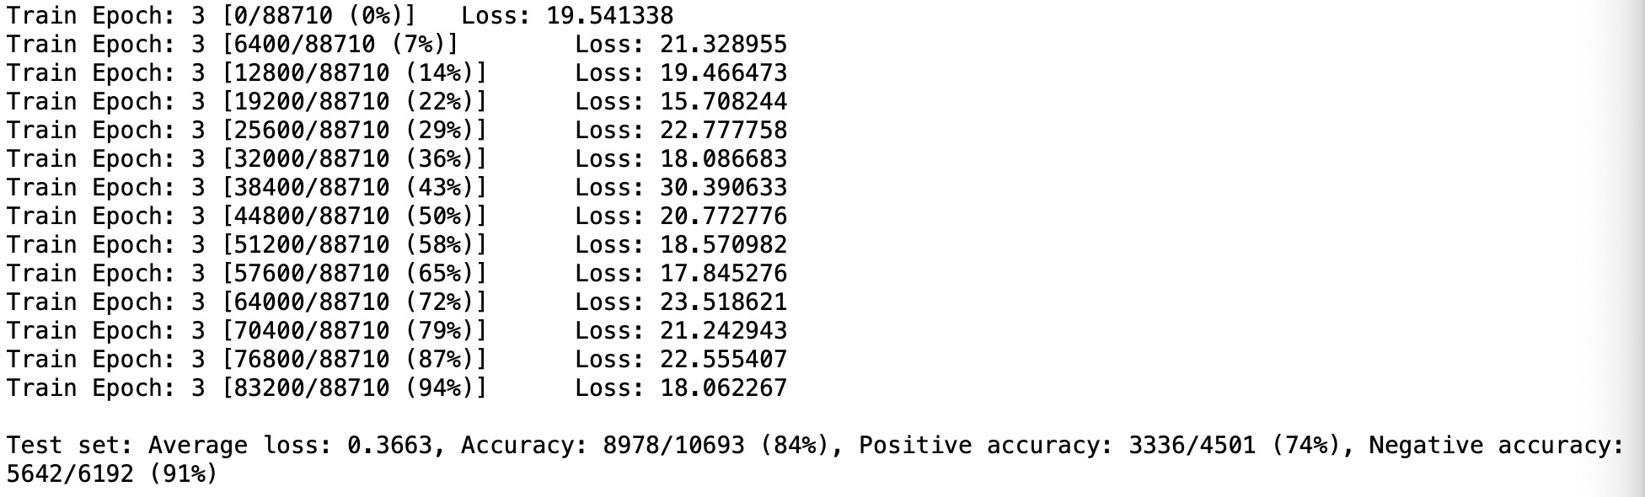

Slide 17
model =GaborConvPC(19, 1, 8, 4).to(device)
Epoch1:
Test set: Average loss: 0.3598, Accuracy: 9023/10693 (84%), Positive accuracy: 3624/4501 (81%), Negative accuracy: 5399/6192 (87%)
Epoch2:
Test set: Average loss: 0.3691, Accuracy: 8923/10693 (83%), Positive accuracy: 3325/4501 (74%), Negative accuracy: 5598/6192 (90%)
Epoch3
Test set: Average loss: 0.3428, Accuracy: 9104/10693 (85%), Positive accuracy: 3563/4501 (79%), Negative accuracy: 5541/6192 (89%)
Epoch4:
Test set: Average loss: 0.3378, Accuracy: 9107/10693 (85%), Positive accuracy: 3520/4501 (78%), Negative accuracy: 5587/6192 (90%)
Epoch5:
Test set: Average loss: 0.3634, Accuracy: 9022/10693 (84%), Positive accuracy: 3967/4501 (88%), Negative accuracy: 5055/6192 (82%)
Epoch6:
Test set: Average loss: 0.3265, Accuracy: 9163/10693 (86%), Positive accuracy: 3575/4501 (79%), Negative accuracy: 5588/6192 (90%)
Epoch7:
Test set: Average loss: 0.3549, Accuracy: 9025/10693 (84%), Positive accuracy: 3373/4501 (75%), Negative accuracy: 5652/6192 (91%)
Epoch8:
Test set: Average loss: 0.3387, Accuracy: 9064/10693 (85%), Positive accuracy: 3458/4501 (77%), Negative accuracy: 5606/6192 (91%)
Epoch9:
Test set: Average loss: 0.3492, Accuracy: 9008/10693 (84%), Positive accuracy: 3413/4501 (76%), Negative accuracy: 5595/6192 (90%)
Epoch10:
Test set: Average loss: 0.3341, Accuracy: 9100/10693 (85%), Positive accuracy: 3640/4501 (81%), Negative accuracy: 5460/6192 (88%)

Slide 18
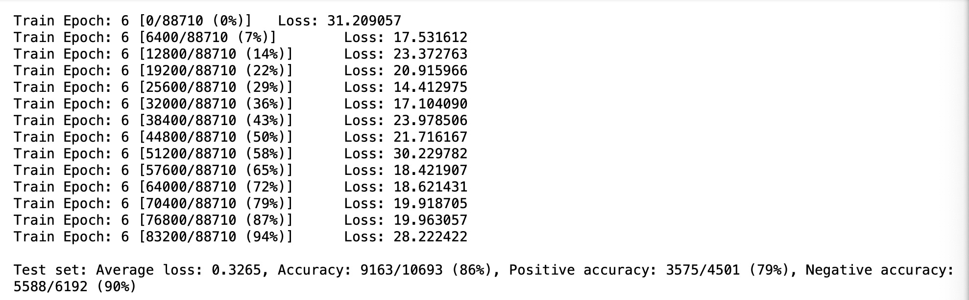

Slide 19
model =GaborConvPC(19, 1, 10, 4).to(device)
Epoch1:
Test set: Average loss: 0.3896, Accuracy: 8854/10693 (83%), Positive accuracy: 3402/4501 (76%), Negative accuracy: 5452/6192 (88%)
Epoch2:
Test set: Average loss: 0.3922, Accuracy: 8844/10693 (83%), Positive accuracy: 3342/4501 (74%), Negative accuracy: 5502/6192 (89%)
Epoch3
Test set: Average loss: 0.3643, Accuracy: 9010/10693 (84%), Positive accuracy: 3483/4501 (77%), Negative accuracy: 5527/6192 (89%)
Epoch4:
Test set: Average loss: 0.3618, Accuracy: 9008/10693 (84%), Positive accuracy: 3605/4501 (80%), Negative accuracy: 5403/6192 (87%)
Epoch5:
Test set: Average loss: 0.4113, Accuracy: 8632/10693 (81%), Positive accuracy: 3527/4501 (78%), Negative accuracy: 5105/6192 (82%)
Epoch6:
Test set: Average loss: 0.3650, Accuracy: 8989/10693 (84%), Positive accuracy: 3722/4501 (83%), Negative accuracy: 5267/6192 (85%)
Epoch7:
Test set: Average loss: 0.3621, Accuracy: 9041/10693 (85%), Positive accuracy: 3437/4501 (76%), Negative accuracy: 5604/6192 (91%)
Epoch8:
Test set: Average loss: 0.3801, Accuracy: 8924/10693 (83%), Positive accuracy: 3414/4501 (76%), Negative accuracy: 5510/6192 (89%)
Epoch9:
Test set: Average loss: 0.3597, Accuracy: 9001/10693 (84%), Positive accuracy: 3659/4501 (81%), Negative accuracy: 5342/6192 (86%)
Epoch10:
Test set: Average loss: 0.3653, Accuracy: 9010/10693 (84%), Positive accuracy: 3793/4501 (84%), Negative accuracy: 5217/6192 (84%)
Notes:
Test set: Average loss: 0.3653, Accuracy: 9010/10693 (84%), Positive accuracy: 3793/4501 (84%), Negative accuracy: 5217/6192 (84%)

Slide 20
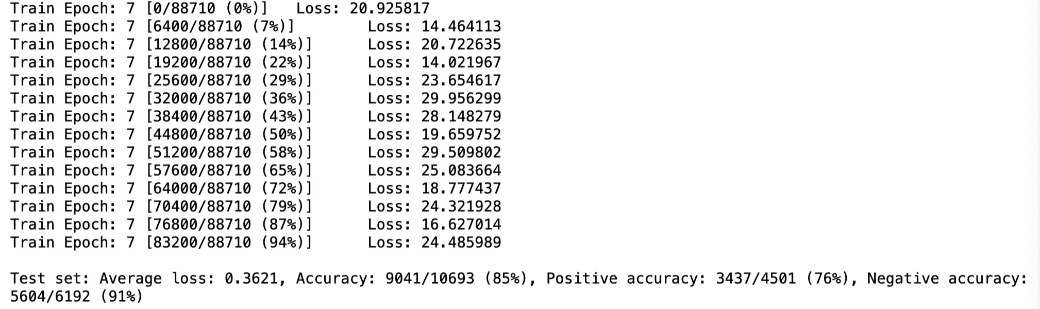

Slide 21
model =GaborConvPC(19, 1, 8, 6).to(device)
Epoch1:
Test set: Average loss: 0.4738, Accuracy: 8587/10693 (80%), Positive accuracy: 2594/4501 (58%), Negative accuracy: 5993/6192 (97%)
Epoch2:
Test set: Average loss: 0.3106, Accuracy: 9208/10693 (86%), Positive accuracy: 3733/4501 (83%), Negative accuracy: 5475/6192 (88%)
Epoch3
Test set: Average loss: 0.3052, Accuracy: 9227/10693 (86%), Positive accuracy: 3556/4501 (79%), Negative accuracy: 5671/6192 (92%)
Epoch4:
Test set: Average loss: 0.3047, Accuracy: 9229/10693 (86%), Positive accuracy: 3534/4501 (79%), Negative accuracy: 5695/6192 (92%)
Epoch5:
Test set: Average loss: 0.3557, Accuracy: 8977/10693 (84%), Positive accuracy: 4088/4501 (91%), Negative accuracy: 4889/6192 (79%)
Epoch6:
Test set: Average loss: 0.2978, Accuracy: 9258/10693 (87%), Positive accuracy: 3571/4501 (79%), Negative accuracy: 5687/6192 (92%)
Epoch7:
Test set: Average loss: 0.2941, Accuracy: 9241/10693 (86%), Positive accuracy: 3784/4501 (84%), Negative accuracy: 5457/6192 (88%)
Epoch8:
Test set: Average loss: 0.2937, Accuracy: 9265/10693 (87%), Positive accuracy: 3684/4501 (82%), Negative accuracy: 5581/6192 (90%)
Epoch9:
Test set: Average loss: 0.2905, Accuracy: 9251/10693 (87%), Positive accuracy: 3704/4501 (82%), Negative accuracy: 5547/6192 (90%)
Epoch10:
Test set: Average loss: 0.2903, Accuracy: 9306/10693 (87%), Positive accuracy: 3640/4501 (81%), Negative accuracy: 5666/6192 (92%)

Slide 22
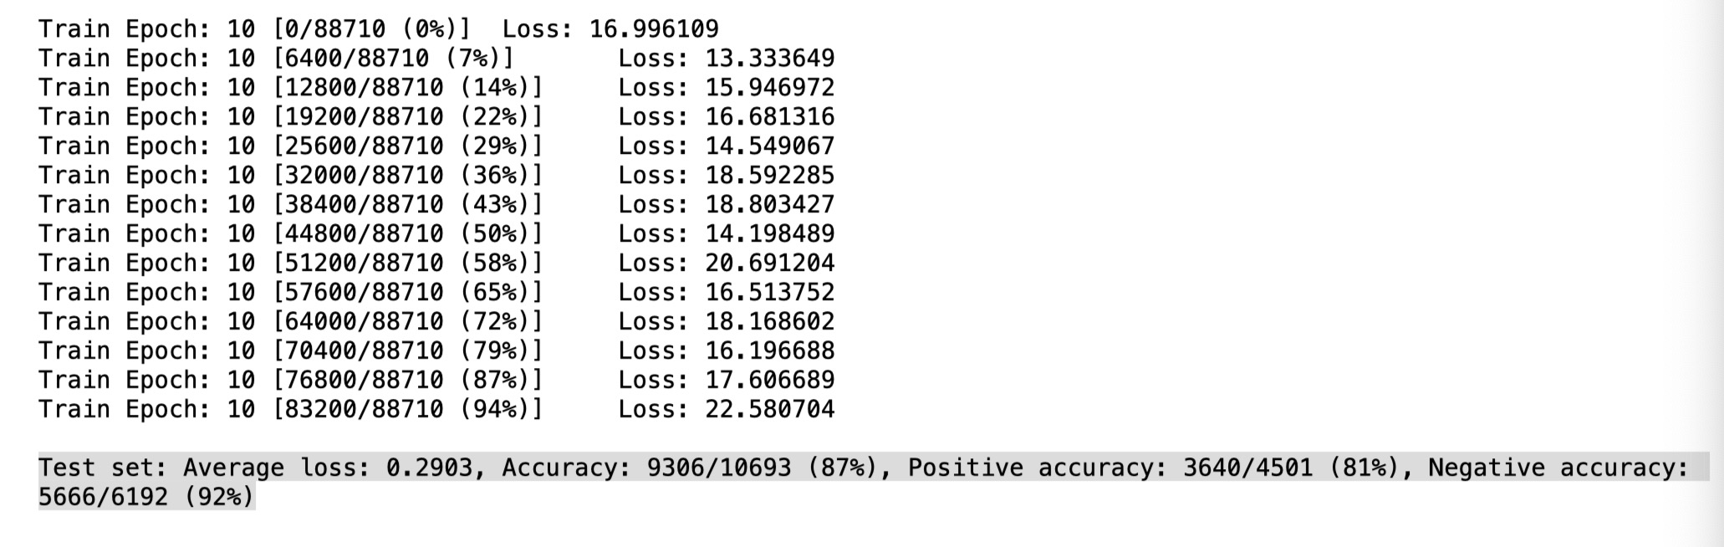

Slide 23
model =GaborConvPC(19, 1, 8, 8).to(device)
Epoch1:
Test set: Average loss: 0.3495, Accuracy: 9067/10693 (85%), Positive accuracy: 3450/4501 (77%), Negative accuracy: 5617/6192 (91%)
Epoch2:
Test set: Average loss: 0.3876, Accuracy: 8710/10693 (81%), Positive accuracy: 4045/4501 (90%), Negative accuracy: 4665/6192 (75%)
Epoch3
Test set: Average loss: 0.3074, Accuracy: 9226/10693 (86%), Positive accuracy: 3595/4501 (80%), Negative accuracy: 5631/6192 (91%)
Epoch4:
Test set: Average loss: 0.3288, Accuracy: 9143/10693 (86%), Positive accuracy: 3409/4501 (76%), Negative accuracy: 5734/6192 (93%)
Epoch5:
Test set: Average loss: 0.3036, Accuracy: 9225/10693 (86%), Positive accuracy: 3864/4501 (86%), Negative accuracy: 5361/6192 (87%)
Epoch6:
Test set: Average loss: 0.3003, Accuracy: 9219/10693 (86%), Positive accuracy: 3645/4501 (81%), Negative accuracy: 5574/6192 (90%)
Epoch7:
Test set: Average loss: 0.2897, Accuracy: 9313/10693 (87%), Positive accuracy: 3679/4501 (82%), Negative accuracy: 5634/6192 (91%)
Epoch8:
Test set: Average loss: 0.3035, Accuracy: 9217/10693 (86%), Positive accuracy: 3889/4501 (86%), Negative accuracy: 5328/6192 (86%)
Epoch9:
Test set: Average loss: 0.3080, Accuracy: 9222/10693 (86%), Positive accuracy: 3402/4501 (76%), Negative accuracy: 5820/6192 (94%)
Epoch10:
Test set: Average loss: 0.2987, Accuracy: 9232/10693 (86%), Positive accuracy: 3875/4501 (86%), Negative accuracy: 5357/6192 (87%)

Slide 24


Slide 25
model =GaborConvPC(19, 1, 8, 10).to(device)
Epoch1:
Test set: Average loss: 0.3705, Accuracy: 8963/10693 (84%), Positive accuracy: 3117/4501 (69%), Negative accuracy: 5846/6192 (94%)
Epoch2:
Test set: Average loss: 0.3174, Accuracy: 9185/10693 (86%), Positive accuracy: 3757/4501 (83%), Negative accuracy: 5428/6192 (88%)
Epoch3
Test set: Average loss: 0.3065, Accuracy: 9223/10693 (86%), Positive accuracy: 3755/4501 (83%), Negative accuracy: 5468/6192 (88%)
Epoch4:
Test set: Average loss: 0.2968, Accuracy: 9275/10693 (87%), Positive accuracy: 3676/4501 (82%), Negative accuracy: 5599/6192 (90%)
Epoch5:
Test set: Average loss: 0.2970, Accuracy: 9242/10693 (86%), Positive accuracy: 3705/4501 (82%), Negative accuracy: 5537/6192 (89%)
Epoch6:
Test set: Average loss: 0.3034, Accuracy: 9241/10693 (86%), Positive accuracy: 3505/4501 (78%), Negative accuracy: 5736/6192 (93%)
Epoch7:
Test set: Average loss: 0.2934, Accuracy: 9262/10693 (87%), Positive accuracy: 3707/4501 (82%), Negative accuracy: 5555/6192 (90%)
Epoch8:
Test set: Average loss: 0.2959, Accuracy: 9253/10693 (87%), Positive accuracy: 3879/4501 (86%), Negative accuracy: 5374/6192 (87%)
Epoch9:
Test set: Average loss: 0.2848, Accuracy: 9288/10693 (87%), Positive accuracy: 3742/4501 (83%), Negative accuracy: 5546/6192 (90%)
Epoch10:
Test set: Average loss: 0.3103, Accuracy: 9092/10693 (85%), Positive accuracy: 3893/4501 (86%), Negative accuracy: 5199/6192 (84%)

Slide 26
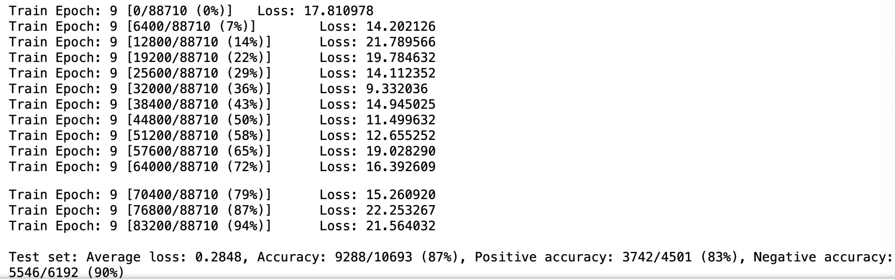

Slide 27
model =GaborConvPC(19, 1, 8, 10).to(device) learning rate = 0.001
Epoch1:
Test set: Average loss: 0.6744, Accuracy: 6192/10693 (58%), Positive accuracy: 0/4501 (0%), Negative accuracy: 6192/6192 (100%)
Epoch2:
Test set: Average loss: 0.5852, Accuracy: 7371/10693 (69%), Positive accuracy: 1390/4501 (31%), Negative accuracy: 5981/6192 (97%)
Epoch3
Test set: Average loss: 0.4641, Accuracy: 8498/10693 (79%), Positive accuracy: 3210/4501 (71%), Negative accuracy: 5288/6192 (85%)
Epoch4:
Test set: Average loss: 0.4014, Accuracy: 8910/10693 (83%), Positive accuracy: 3432/4501 (76%), Negative accuracy: 5478/6192 (88%)
Epoch5:
Test set: Average loss: 0.3683, Accuracy: 9036/10693 (85%), Positive accuracy: 3452/4501 (77%), Negative accuracy: 5584/6192 (90%)
Epoch6:
Test set: Average loss: 0.3556, Accuracy: 9020/10693 (84%), Positive accuracy: 3254/4501 (72%), Negative accuracy: 5766/6192 (93%)
Epoch7:
Test set: Average loss: 0.3251, Accuracy: 9158/10693 (86%), Positive accuracy: 3486/4501 (77%), Negative accuracy: 5672/6192 (92%)
Epoch8:
Test set: Average loss: 0.3182, Accuracy: 9222/10693 (86%), Positive accuracy: 3754/4501 (83%), Negative accuracy: 5468/6192 (88%)
Epoch9:
Test set: Average loss: 0.3097, Accuracy: 9236/10693 (86%), Positive accuracy: 3754/4501 (83%), Negative accuracy: 5482/6192 (89%)
Epoch10:
Test set: Average loss: 0.3109, Accuracy: 9213/10693 (86%), Positive accuracy: 3773/4501 (84%), Negative accuracy: 5440/6192 (88%)

Slide 28
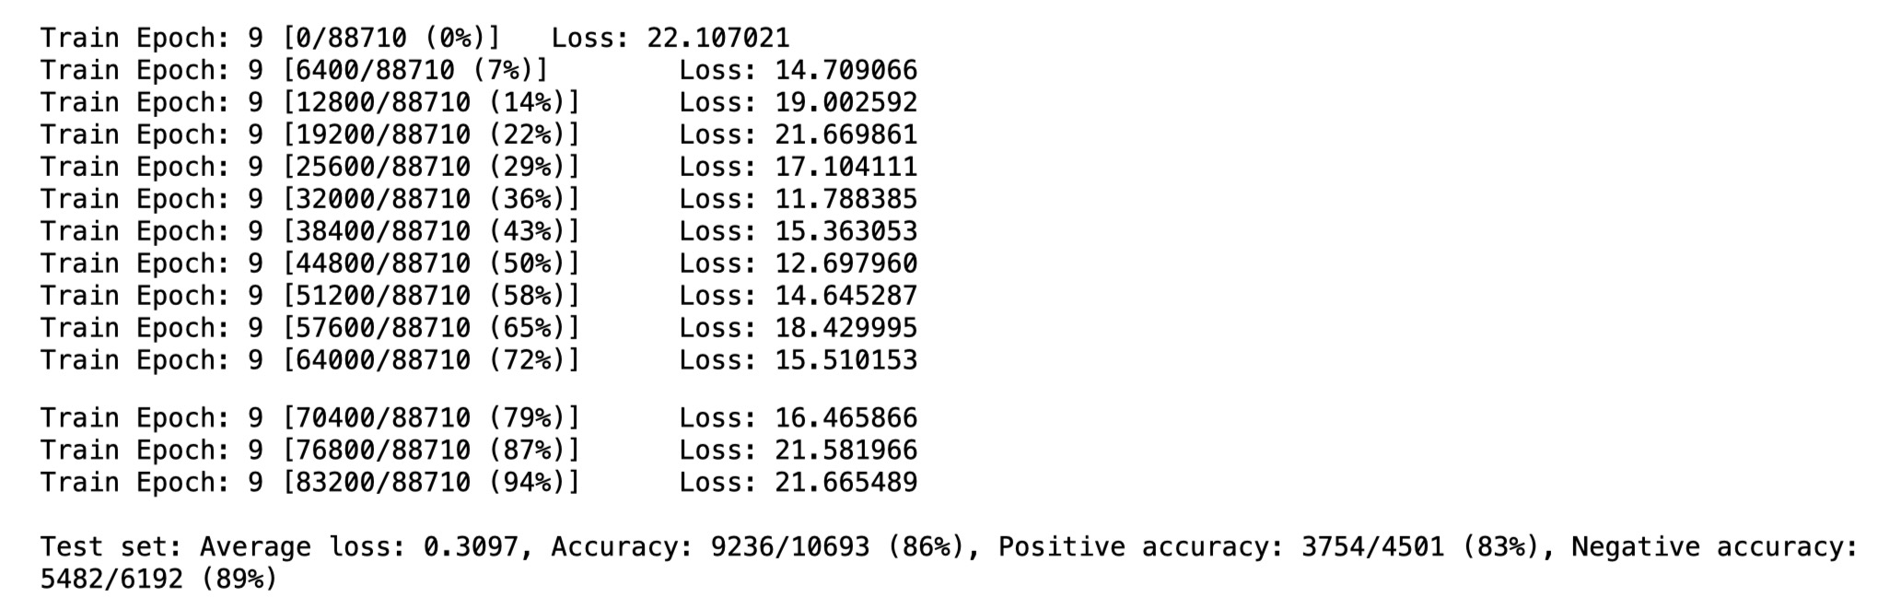

Slide 29
model =GaborConvPC(19, 1, 8, 10).to(device) batch size = 512
Epoch1:
Test set: Average loss: 0.3705, Accuracy: 8963/10693 (84%), Positive accuracy: 3117/4501 (69%), Negative accuracy: 5846/6192 (94%)
Epoch2:
Test set: Average loss: 0.3174, Accuracy: 9185/10693 (86%), Positive accuracy: 3757/4501 (83%), Negative accuracy: 5428/6192 (88%)
Epoch3
Test set: Average loss: 0.3065, Accuracy: 9223/10693 (86%), Positive accuracy: 3755/4501 (83%), Negative accuracy: 5468/6192 (88%)
Epoch4:
Test set: Average loss: 0.2968, Accuracy: 9275/10693 (87%), Positive accuracy: 3676/4501 (82%), Negative accuracy: 5599/6192 (90%)
Epoch5:
Test set: Average loss: 0.2970, Accuracy: 9242/10693 (86%), Positive accuracy: 3705/4501 (82%), Negative accuracy: 5537/6192 (89%)
Epoch6:
Test set: Average loss: 0.3034, Accuracy: 9241/10693 (86%), Positive accuracy: 3505/4501 (78%), Negative accuracy: 5736/6192 (93%)
Epoch7:
Test set: Average loss: 0.2934, Accuracy: 9262/10693 (87%), Positive accuracy: 3707/4501 (82%), Negative accuracy: 5555/6192 (90%)
Epoch8:
Test set: Average loss: 0.2959, Accuracy: 9253/10693 (87%), Positive accuracy: 3879/4501 (86%), Negative accuracy: 5374/6192 (87%)
Epoch9:
Test set: Average loss: 0.2848, Accuracy: 9288/10693 (87%), Positive accuracy: 3742/4501 (83%), Negative accuracy: 5546/6192 (90%)
Epoch10:
Test set: Average loss: 0.3103, Accuracy: 9092/10693 (85%), Positive accuracy: 3893/4501 (86%), Negative accuracy: 5199/6192 (84%)

Slide 30
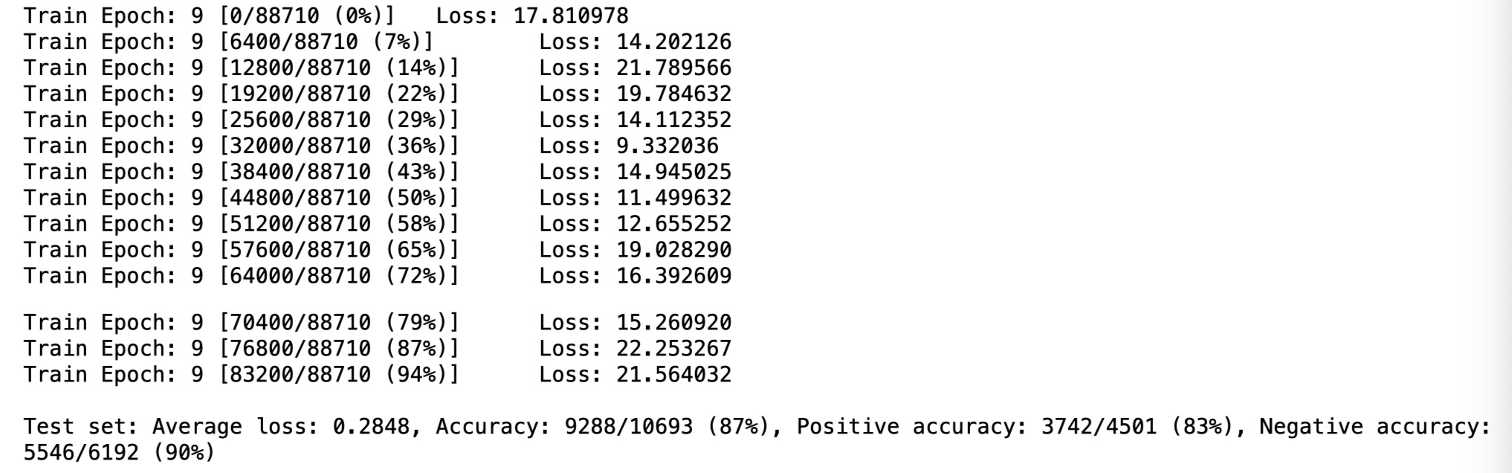

Slide 31
Result
Sep. 30th

Slide 32
CNN Model
batch-size：64
learning rate：0.01
2 layers of Convolution, channels are 32, 64, filter size is 3
2 layers of fully connected with 3136, 128

Slide 33
Before change weight
Epoch1:
Test set: Average loss: 0.4183, Accuracy: 8491/10693 (79%), Positive accuracy: 3128/4501 (69%), Negative accuracy: 5363/6192 (87%), f1 score: 0.7933
Epoch2:
Test set: Average loss: 0.3449, Accuracy: 9098/10693 (85%), Positive accuracy: 3800/4501 (84%), Negative accuracy: 5298/6192 (86%), f1 score: 0.8447
Epoch3
Test set: Average loss: 0.3173, Accuracy: 9218/10693 (86%), Positive accuracy: 3724/4501 (83%), Negative accuracy: 5494/6192 (89%), f1 score: 0.8588
Epoch4:
Test set: Average loss: 0.3141, Accuracy: 9238/10693 (86%), Positive accuracy: 3929/4501 (87%), Negative accuracy: 5309/6192 (86%), f1 score: 0.8575
Epoch5:
Test set: Average loss: 0.3059, Accuracy: 9242/10693 (86%), Positive accuracy: 3674/4501 (82%), Negative accuracy: 5568/6192 (90%), f1 score: 0.8627
Epoch6:
Test set: Average loss: 0.3027, Accuracy: 9268/10693 (87%), Positive accuracy: 3808/4501 (85%), Negative accuracy: 5460/6192 (88%), f1 score: 0.8624
Epoch7:
Test set: Average loss: 0.3030, Accuracy: 9236/10693 (86%), Positive accuracy: 3670/4501 (82%), Negative accuracy: 5566/6192 (90%), f1 score: 0.8621
Epoch8:
Test set: Average loss: 0.3002, Accuracy: 9276/10693 (87%), Positive accuracy: 3763/4501 (84%), Negative accuracy: 5513/6192 (89%), f1 score: 0.864
Epoch9:
Test set: Average loss: 0.3011, Accuracy: 9246/10693 (86%), Positive accuracy: 3706/4501 (82%), Negative accuracy: 5540/6192 (89%), f1 score: 0.8623
Epoch10:
Test set: Average loss: 0.2997, Accuracy: 9266/10693 (87%), Positive accuracy: 3753/4501 (83%), Negative accuracy: 5513/6192 (89%), f1 score: 0.8633

Slide 34
After change weight
Epoch1:
Test set: Average loss: 0.4101, Accuracy: 8590/10693 (80%), Positive accuracy: 3631/4501 (81%), Negative accuracy: 4959/6192 (80%), f1 score: 0.7952
Epoch2:
Test set: Average loss: 0.3611, Accuracy: 8975/10693 (84%), Positive accuracy: 4016/4501 (89%), Negative accuracy: 4959/6192 (80%), f1 score: 0.8317
Epoch3
Test set: Average loss: 0.3240, Accuracy: 9171/10693 (86%), Positive accuracy: 3952/4501 (88%), Negative accuracy: 5219/6192 (84%), f1 score: 0.8506
Epoch4:
Test set: Average loss: 0.3378, Accuracy: 9080/10693 (85%), Positive accuracy: 4113/4501 (91%), Negative accuracy: 4967/6192 (80%), f1 score: 0.8418
Epoch5:
Test set: Average loss: 0.3073, Accuracy: 9258/10693 (87%), Positive accuracy: 3916/4501 (87%), Negative accuracy: 5342/6192 (86%), f1 score: 0.8596
Epoch6:
Test set: Average loss: 0.3149, Accuracy: 9201/10693 (86%), Positive accuracy: 4022/4501 (89%), Negative accuracy: 5179/6192 (84%), f1 score: 0.8531
Epoch7:
Test set: Average loss: 0.3036, Accuracy: 9275/10693 (87%), Positive accuracy: 3914/4501 (87%), Negative accuracy: 5361/6192 (87%), f1 score: 0.8614
Epoch8:
Test set: Average loss: 0.3074, Accuracy: 9258/10693 (87%), Positive accuracy: 3984/4501 (89%), Negative accuracy: 5274/6192 (85%), f1 score: 0.8589
Epoch9:
Test set: Average loss: 0.3043, Accuracy: 9274/10693 (87%), Positive accuracy: 3952/4501 (88%), Negative accuracy: 5322/6192 (86%), f1 score: 0.8608
Epoch10:
Test set: Average loss: 0.3071, Accuracy: 9255/10693 (87%), Positive accuracy: 3984/4501 (89%), Negative accuracy: 5271/6192 (85%), f1 score: 0.8586

Slide 35
After change weight and add Dense layer
Epoch1:
Test set: Average loss: 0.3275, Accuracy: 9135/10693 (85%), Positive accuracy: 3762/4501 (84%), Negative accuracy: 5373/6192 (87%), f1 score: 0.8492
Epoch2:
Test set: Average loss: 0.3311, Accuracy: 9234/10693 (86%), Positive accuracy: 3579/4501 (80%), Negative accuracy: 5655/6192 (91%), f1 score: 0.8646
Epoch3
Test set: Average loss: 0.3250, Accuracy: 9226/10693 (86%), Positive accuracy: 3634/4501 (81%), Negative accuracy: 5592/6192 (90%), f1 score: 0.8620
Epoch4:
Test set: Average loss: 0.3075, Accuracy: 9249/10693 (86%), Positive accuracy: 3783/4501 (84%), Negative accuracy: 5466/6192 (88%), f1 score: 0.8609
Epoch5:
Test set: Average loss: 0.3276, Accuracy: 9252/10693 (87%), Positive accuracy: 3584/4501 (80%), Negative accuracy: 5668/6192 (92%), f1 score: 0.8666
Epoch6:
Test set: Average loss: 0.3239, Accuracy: 9208/10693 (86%), Positive accuracy: 4008/4501 (89%), Negative accuracy: 5200/6192 (84%), f1 score: 0.8539
Epoch7:
Test set: Average loss: 0.3242, Accuracy: 9253/10693 (87%), Positive accuracy: 3600/4501 (80%), Negative accuracy: 5653/6192 (91%), f1 score: 0.8661
Epoch8:
Epoch9:
Epoch10:
Test set: Average loss: 0.3130, Accuracy: 9256/10693 (87%), Positive accuracy: 3840/4501 (85%), Negative accuracy: 5416/6192 (87%), f1 score: 0.8605
Test set: Average loss: 0.3096, Accuracy: 9262/10693 (87%), Positive accuracy: 3735/4501 (83%), Negative accuracy: 5527/6192 (89%), f1 score: 0.8633
Test set: Average loss: 0.3145, Accuracy: 9251/10693 (87%), Positive accuracy: 3704/4501 (82%), Negative accuracy: 5547/6192 (90%), f1 score: 0.8629

Slide 36
Gabor Model
batch-size：512
learning rate：0.01
model =GaborConvPC(19, 1, 8, 10).to(device)

Slide 37
Before change weight
Epoch1:
Test set: Average loss: 0.3705, Accuracy: 8963/10693 (84%), Positive accuracy: 3117/4501 (69%), Negative accuracy: 5846/6192 (94%)
Epoch2:
Test set: Average loss: 0.3174, Accuracy: 9185/10693 (86%), Positive accuracy: 3757/4501 (83%), Negative accuracy: 5428/6192 (88%)
Epoch3
Test set: Average loss: 0.3065, Accuracy: 9223/10693 (86%), Positive accuracy: 3755/4501 (83%), Negative accuracy: 5468/6192 (88%)
Epoch4:
Test set: Average loss: 0.2968, Accuracy: 9275/10693 (87%), Positive accuracy: 3676/4501 (82%), Negative accuracy: 5599/6192 (90%)
Epoch5:
Test set: Average loss: 0.2970, Accuracy: 9242/10693 (86%), Positive accuracy: 3705/4501 (82%), Negative accuracy: 5537/6192 (89%)
Epoch6:
Test set: Average loss: 0.3034, Accuracy: 9241/10693 (86%), Positive accuracy: 3505/4501 (78%), Negative accuracy: 5736/6192 (93%)
Epoch7:
Test set: Average loss: 0.2934, Accuracy: 9262/10693 (87%), Positive accuracy: 3707/4501 (82%), Negative accuracy: 5555/6192 (90%)
Epoch8:
Test set: Average loss: 0.2959, Accuracy: 9253/10693 (87%), Positive accuracy: 3879/4501 (86%), Negative accuracy: 5374/6192 (87%)
Epoch9:
Test set: Average loss: 0.2848, Accuracy: 9288/10693 (87%), Positive accuracy: 3742/4501 (83%), Negative accuracy: 5546/6192 (90%)
Epoch10:
Test set: Average loss: 0.3103, Accuracy: 9092/10693 (85%), Positive accuracy: 3893/4501 (86%), Negative accuracy: 5199/6192 (84%)

Slide 38
After change weight
Epoch1:
Test set: Average loss: 0.4541, Accuracy: 9151/10693 (86%), Positive accuracy: 3555/4501 (79%), Negative accuracy: 5596/6192 (90%)
Epoch2:
Test set: Average loss: 0.4076, Accuracy: 9019/10693 (84%), Positive accuracy: 4011/4501 (89%), Negative accuracy: 5008/6192 (81%)
Epoch3
Test set: Average loss: 0.3927, Accuracy: 9104/10693 (85%), Positive accuracy: 3998/4501 (89%), Negative accuracy: 5106/6192 (82%)
Epoch4:
Test set: Average loss: 0.3794, Accuracy: 9195/10693 (86%), Positive accuracy: 3949/4501 (88%), Negative accuracy: 5246/6192 (85%)
Epoch5:
Test set: Average loss: 0.3815, Accuracy: 9189/10693 (86%), Positive accuracy: 3922/4501 (87%), Negative accuracy: 5267/6192 (85%)
Epoch6:
Test set: Average loss: 0.3806, Accuracy: 9262/10693 (87%), Positive accuracy: 3805/4501 (85%), Negative accuracy: 5457/6192 (88%)
Epoch7:
Test set: Average loss: 0.3776, Accuracy: 9177/10693 (86%), Positive accuracy: 3986/4501 (89%), Negative accuracy: 5191/6192 (84%)
Epoch8:
Test set: Average loss: 0.3809, Accuracy: 9108/10693 (85%), Positive accuracy: 4116/4501 (91%), Negative accuracy: 4992/6192 (81%)
Epoch9:
Test set: Average loss: 0.3659, Accuracy: 9251/10693 (87%), Positive accuracy: 3900/4501 (87%), Negative accuracy: 5351/6192 (86%)
Epoch10:
Test set: Average loss: 0.3947, Accuracy: 8975/10693 (84%), Positive accuracy: 4104/4501 (91%), Negative accuracy: 4871/6192 (79%)

Slide 39
Result
OCT. 7th

Slide 40
CNN Model
batch-size：64
learning rate：0.01
2 layers of Convolution, channels are 32, 64, filter size is 3
2 layers of fully connected with 3136, 1024

Slide 41
Without Buffer
Epoch1:
Test set: Average loss: 0.4101, Accuracy: 8590/10693 (80%), Positive accuracy: 3631/4501 (81%), Negative accuracy: 4959/6192 (80%), f1 score: 0.7952
Epoch2:
Test set: Average loss: 0.3611, Accuracy: 8975/10693 (84%), Positive accuracy: 4016/4501 (89%), Negative accuracy: 4959/6192 (80%), f1 score: 0.8317
Epoch3
Test set: Average loss: 0.3240, Accuracy: 9171/10693 (86%), Positive accuracy: 3952/4501 (88%), Negative accuracy: 5219/6192 (84%), f1 score: 0.8506
Epoch4:
Test set: Average loss: 0.3378, Accuracy: 9080/10693 (85%), Positive accuracy: 4113/4501 (91%), Negative accuracy: 4967/6192 (80%), f1 score: 0.8418
Epoch5:
Test set: Average loss: 0.3073, Accuracy: 9258/10693 (87%), Positive accuracy: 3916/4501 (87%), Negative accuracy: 5342/6192 (86%), f1 score: 0.8596
Epoch6:
Test set: Average loss: 0.3149, Accuracy: 9201/10693 (86%), Positive accuracy: 4022/4501 (89%), Negative accuracy: 5179/6192 (84%), f1 score: 0.8531
Epoch7:
Test set: Average loss: 0.3036, Accuracy: 9275/10693 (87%), Positive accuracy: 3914/4501 (87%), Negative accuracy: 5361/6192 (87%), f1 score: 0.8614
Epoch8:
Test set: Average loss: 0.3074, Accuracy: 9258/10693 (87%), Positive accuracy: 3984/4501 (89%), Negative accuracy: 5274/6192 (85%), f1 score: 0.8589
Epoch9:
Test set: Average loss: 0.3043, Accuracy: 9274/10693 (87%), Positive accuracy: 3952/4501 (88%), Negative accuracy: 5322/6192 (86%), f1 score: 0.8608
Epoch10:
Test set: Average loss: 0.3071, Accuracy: 9255/10693 (87%), Positive accuracy: 3984/4501 (89%), Negative accuracy: 5271/6192 (85%), f1 score: 0.8586

Slide 42
With Buffer
Epoch1:
Test set: Average loss: 0.3767, Accuracy: 7706/9374 (82%), Positive accuracy: 2831/3527 (80%), Negative accuracy: 4875/5847 (83%), f1 score: 0.8045
Epoch2:
Test set: Average loss: 0.3244, Accuracy: 8050/9374 (86%), Positive accuracy: 3267/3527 (93%), Negative accuracy: 4783/5847 (82%), f1 score: 0.8403
Epoch3
Test set: Average loss: 0.3577, Accuracy: 7941/9374 (85%), Positive accuracy: 3390/3527 (96%), Negative accuracy: 4551/5847 (78%), f1 score: 0.8290
Epoch4:
Test set: Average loss: 0.3628, Accuracy: 7933/9374 (85%), Positive accuracy: 3405/3527 (97%), Negative accuracy: 4528/5847 (77%), f1 score: 0.8284
Epoch5:
Test set: Average loss: 0.3829, Accuracy: 7892/9374 (84%), Positive accuracy: 3431/3527 (97%), Negative accuracy: 4461/5847 (76%), f1 score: 0.8246
Epoch6:
Test set: Average loss: 0.3854, Accuracy: 7894/9374 (84%), Positive accuracy: 3436/3527 (97%), Negative accuracy: 4458/5847 (76%), f1 score: 0.8249
Epoch7:
Test set: Average loss: 0.3826, Accuracy: 7911/9374 (84%), Positive accuracy: 3432/3527 (97%), Negative accuracy: 4479/5847 (77%), f1 score: 0.8265
Epoch8:
Test set: Average loss: 0.3980, Accuracy: 7872/9374 (84%), Positive accuracy: 3442/3527 (98%), Negative accuracy: 4430/5847 (76%), f1 score: 0.8228
Epoch9:
Test set: Average loss: 0.3968, Accuracy: 7877/9374 (84%), Positive accuracy: 3441/3527 (98%), Negative accuracy: 4436/5847 (76%), f1 score: 0.8232
Epoch10:
Test set: Average loss: 0.3924, Accuracy: 7886/9374 (84%), Positive accuracy: 3439/3527 (98%), Negative accuracy: 4447/5847 (76%), f1 score: 0.8241

Slide 43
Gabor Model
batch-size：512
learning rate：0.01
model =GaborConvPC(19, 1, 8, 10).to(device)

Slide 44
Without buffer
Epoch1:
Test set: Average loss: 0.4541, Accuracy: 9151/10693 (86%), Positive accuracy: 3555/4501 (79%), Negative accuracy: 5596/6192 (90%)
Epoch2:
Test set: Average loss: 0.4076, Accuracy: 9019/10693 (84%), Positive accuracy: 4011/4501 (89%), Negative accuracy: 5008/6192 (81%)
Epoch3
Test set: Average loss: 0.3927, Accuracy: 9104/10693 (85%), Positive accuracy: 3998/4501 (89%), Negative accuracy: 5106/6192 (82%)
Epoch4:
Test set: Average loss: 0.3794, Accuracy: 9195/10693 (86%), Positive accuracy: 3949/4501 (88%), Negative accuracy: 5246/6192 (85%)
Epoch5:
Test set: Average loss: 0.3815, Accuracy: 9189/10693 (86%), Positive accuracy: 3922/4501 (87%), Negative accuracy: 5267/6192 (85%)
Epoch6:
Test set: Average loss: 0.3806, Accuracy: 9262/10693 (87%), Positive accuracy: 3805/4501 (85%), Negative accuracy: 5457/6192 (88%)
Epoch7:
Test set: Average loss: 0.3776, Accuracy: 9177/10693 (86%), Positive accuracy: 3986/4501 (89%), Negative accuracy: 5191/6192 (84%)
Epoch8:
Test set: Average loss: 0.3809, Accuracy: 9108/10693 (85%), Positive accuracy: 4116/4501 (91%), Negative accuracy: 4992/6192 (81%)
Epoch9:
Test set: Average loss: 0.3659, Accuracy: 9251/10693 (87%), Positive accuracy: 3900/4501 (87%), Negative accuracy: 5351/6192 (86%)
Epoch10:
Test set: Average loss: 0.3947, Accuracy: 8975/10693 (84%), Positive accuracy: 4104/4501 (91%), Negative accuracy: 4871/6192 (79%)

Slide 45
With Buffer
Epoch1:
Test set: Average loss: 0.4657, Accuracy: 7517/9374 (80%), Positive accuracy: 3444/3527 (98%), Negative accuracy: 4073/5847 (70%)
Epoch2:
Test set: Average loss: 0.3296, Accuracy: 8090/9374 (86%), Positive accuracy: 3302/3527 (94%), Negative accuracy: 4788/5847 (82%)
Epoch3
Test set: Average loss: 0.3076, Accuracy: 8211/9374 (88%), Positive accuracy: 3258/3527 (92%), Negative accuracy: 4953/5847 (85%)
Epoch4:
Test set: Average loss: 0.3198, Accuracy: 8136/9374 (87%), Positive accuracy: 3322/3527 (94%), Negative accuracy: 4814/5847 (82%)
Epoch5:
Test set: Average loss: 0.3199, Accuracy: 8171/9374 (87%), Positive accuracy: 3347/3527 (95%), Negative accuracy: 4824/5847 (83%)
Epoch6:
Test set: Average loss: 0.6266, Accuracy: 7118/9374 (76%), Positive accuracy: 3495/3527 (99%), Negative accuracy: 3623/5847 (62%)
Epoch7:
Test set: Average loss: 0.4207, Accuracy: 7892/9374 (84%), Positive accuracy: 3444/3527 (98%), Negative accuracy: 4448/5847 (76%)
Epoch8:
Test set: Average loss: 0.5323, Accuracy: 7602/9374 (81%), Positive accuracy: 3490/3527 (99%), Negative accuracy: 4112/5847 (70%)
Epoch9:
Test set: Average loss: 0.3661, Accuracy: 8060/9374 (86%), Positive accuracy: 3399/3527 (96%), Negative accuracy: 4661/5847 (80%)
Epoch10:
Test set: Average loss: 0.3620, Accuracy: 8095/9374 (86%), Positive accuracy: 3395/3527 (96%), Negative accuracy: 4700/5847 (80%)

Slide 46
Result
OCT. 13th

Slide 47
CNN Model
batch-size：64
learning rate：0.01
2 layers of Convolution, channels are 32, 64, filter size is 3
2 layers of fully connected with 3136, 1024

Slide 48
With Buffer
Epoch1:
Test set: Average loss: 0.2378, Accuracy: 7417/8088 (92%), Positive accuracy: 3994/4089 (98%), Negative accuracy: 3423/3999 (86%), f1 score: 0.9208
Epoch2:
Test set: Average loss: 0.1517, Accuracy: 7602/8088 (94%), Positive accuracy: 3818/4089 (93%), Negative accuracy: 3784/3999 (95%), f1 score: 0.9399
Epoch3
Test set: Average loss: 0.1354, Accuracy: 7656/8088 (95%), Positive accuracy: 3811/4089 (93%), Negative accuracy: 3845/3999 (96%), f1 score: 0.9467
Epoch4:
Test set: Average loss: 0.1279, Accuracy: 7674/8088 (95%), Positive accuracy: 3860/4089 (94%), Negative accuracy: 3814/3999 (95%), f1 score: 0.9488
Epoch5:
Test set: Average loss: 0.1262, Accuracy: 7679/8088 (95%), Positive accuracy: 3842/4089 (94%), Negative accuracy: 3837/3999 (96%), f1 score: 0.9494
Epoch6:
Test set: Average loss: 0.1250, Accuracy: 7680/8088 (95%), Positive accuracy: 3844/4089 (94%), Negative accuracy: 3836/3999 (96%), f1 score: 0.9495
Epoch7:
Test set: Average loss: 0.1237, Accuracy: 7695/8088 (95%), Positive accuracy: 3856/4089 (94%), Negative accuracy: 3839/3999 (96%), f1 score: 0.9514
Epoch8:
Test set: Average loss: 0.1225, Accuracy: 7699/8088 (95%), Positive accuracy: 3855/4089 (94%), Negative accuracy: 3844/3999 (96%), f1 score: 0.9519
Epoch9:
Test set: Average loss: 0.1233, Accuracy: 7689/8088 (95%), Positive accuracy: 3836/4089 (94%), Negative accuracy: 3853/3999 (96%), f1 score: 0.9507
Epoch10:
Test set: Average loss: 0.1226, Accuracy: 7693/8088 (95%), Positive accuracy: 3844/4089 (94%), Negative accuracy: 3849/3999 (96%), f1 score: 0.9512
Notes:
Test set: Average loss: 0.1226, Accuracy: 7693/8088 (95%), Positive accuracy: 3844/4089 (94%), Negative accuracy: 3849/3999 (96%), f1 score: 0.9512

Slide 49
Gabor Model
batch-size：512
learning rate：0.01
model =GaborConvPC(19, 1, 8, 10).to(device)

Slide 50
With Buffer
Epoch1:
Test set: Average loss: 0.1819, Accuracy: 7547/8088 (93%), Positive accuracy: 3750/4089 (92%), Negative accuracy: 3797/3999 (95%)
Epoch2:
Test set: Average loss: 0.1541, Accuracy: 7618/8088 (94%), Positive accuracy: 3785/4089 (93%), Negative accuracy: 3833/3999 (96%)
Epoch3
Test set: Average loss: 0.1525, Accuracy: 7597/8088 (94%), Positive accuracy: 3856/4089 (94%), Negative accuracy: 3741/3999 (94%)
Epoch4:
Test set: Average loss: 0.1614, Accuracy: 7579/8088 (94%), Positive accuracy: 3701/4089 (91%), Negative accuracy: 3878/3999 (97%)
Epoch5:
Test set: Average loss: 0.1428, Accuracy: 7649/8088 (95%), Positive accuracy: 3782/4089 (92%), Negative accuracy: 3867/3999 (97%)
Epoch6:
Test set: Average loss: 0.1375, Accuracy: 7682/8088 (95%), Positive accuracy: 3899/4089 (95%), Negative accuracy: 3783/3999 (95%)
Epoch7:
Test set: Average loss: 0.1284, Accuracy: 7695/8088 (95%), Positive accuracy: 3854/4089 (94%), Negative accuracy: 3841/3999 (96%)
Epoch8:
Test set: Average loss: 0.1229, Accuracy: 7707/8088 (95%), Positive accuracy: 3848/4089 (94%), Negative accuracy: 3859/3999 (96%)
Epoch9:
Test set: Average loss: 0.1218, Accuracy: 7726/8088 (96%), Positive accuracy: 3890/4089 (95%), Negative accuracy: 3836/3999 (96%)
Epoch10:
Test set: Average loss: 0.1481, Accuracy: 7624/8088 (94%), Positive accuracy: 3730/4089 (91%), Negative accuracy: 3894/3999 (97%)
Notes:
Test set: Average loss: 0.1481, Accuracy: 7624/8088 (94%), Positive accuracy: 3730/4089 (91%), Negative accuracy: 3894/3999 (97%)

Slide 51
Result
Nov. 3RD

Slide 52
Comparing MATLAB and Python
Sigma: 0.6614
Theta: 0.2669
Lambda: 0.0617
Psi: 0.6213
Gamma: -0.4519
Wavelength: 0.0617
Angle: 0.2669
Psi: 0.6213
Kx: 10.719611021069692
Ky: -23.768538849378473

Slide 53
What we changed
1. (x, y) = np.meshgrid(np.arange(xmin, xmax + 1), np.arange(ymin, ymax + 1))
Switch X and y in Gabor function
2. theta[0]+i*np.pi/num_orientations
Change 2pi to pi in the loop for angle

Slide 54
Current Result
Epoch1:
Test set: Average loss: 0.2132, Accuracy: 7494/8141 (92%), Positive accuracy: 3708/4091 (91%), Negative accuracy: 3786/4050 (93%)
Epoch2:
Test set: Average loss: 0.1961, Accuracy: 7578/8141 (93%), Positive accuracy: 3758/4091 (92%), Negative accuracy: 3820/4050 (94%)
Epoch3
Test set: Average loss: 0.2138, Accuracy: 7468/8141 (92%), Positive accuracy: 3680/4091 (90%), Negative accuracy: 3788/4050 (94%)
Epoch4:
Test set: Average loss: 0.2127, Accuracy: 7464/8141 (92%), Positive accuracy: 3558/4091 (87%), Negative accuracy: 3906/4050 (96%)
Epoch5:
Test set: Average loss: 0.1930, Accuracy: 7529/8141 (92%), Positive accuracy: 3642/4091 (89%), Negative accuracy: 3887/4050 (96%)
Epoch6:
Test set: Average loss: 0.1898, Accuracy: 7552/8141 (93%), Positive accuracy: 3716/4091 (91%), Negative accuracy: 3836/4050 (95%)
Epoch7:
Test set: Average loss: 0.2311, Accuracy: 7361/8141 (90%), Positive accuracy: 3864/4091 (94%), Negative accuracy: 3497/4050 (86%)
Epoch8:
Test set: Average loss: 0.1972, Accuracy: 7506/8141 (92%), Positive accuracy: 3652/4091 (89%), Negative accuracy: 3854/4050 (95%)
Epoch9:
Test set: Average loss: 0.1661, Accuracy: 7637/8141 (94%), Positive accuracy: 3820/4091 (93%), Negative accuracy: 3817/4050 (94%)
Epoch10:
Test set: Average loss: 0.1481, Accuracy: 7624/8088 (94%), Positive accuracy: 3730/4089 (91%), Negative accuracy: 3894/3999 (97%)
Notes:
Test set: Average loss: 0.1661, Accuracy: 7637/8141 (94%), Positive accuracy: 3820/4091 (93%), Negative accuracy: 3817/4050 (94%)

Slide 55
Result
Nov. 10Th

Slide 56
model =GaborConvPC(19, 1, 8, 10).to(device)
Epoch1:
Test set: Average loss: 0.2094, Accuracy: 7520/8141 (92%), Positive accuracy: 3649/4091 (89%), Negative accuracy: 3871/4050 (96%)
Epoch2:
Test set: Average loss: 0.1931, Accuracy: 7592/8141 (93%), Positive accuracy: 3803/4091 (93%), Negative accuracy: 3789/4050 (94%)
Epoch3
Test set: Average loss: 0.1971, Accuracy: 7519/8141 (92%), Positive accuracy: 3709/4091 (91%), Negative accuracy: 3810/4050 (94%)
Epoch4:
Test set: Average loss: 0.2094, Accuracy: 7460/8141 (92%), Positive accuracy: 3545/4091 (87%), Negative accuracy: 3915/4050 (97%)
Epoch5:
Test set: Average loss: 0.1815, Accuracy: 7551/8141 (93%), Positive accuracy: 3677/4091 (90%), Negative accuracy: 3874/4050 (96%)
Epoch6:
Test set: Average loss: 0.1914, Accuracy: 7535/8141 (93%), Positive accuracy: 3699/4091 (90%), Negative accuracy: 3836/4050 (95%)
Epoch7:
Test set: Average loss: 0.2349, Accuracy: 7341/8141 (90%), Positive accuracy: 3852/4091 (94%), Negative accuracy: 3489/4050 (86%)
Epoch8:
Test set: Average loss: 0.2130, Accuracy: 7452/8141 (92%), Positive accuracy: 3600/4091 (88%), Negative accuracy: 3852/4050 (95%)
Epoch9:
Test set: Average loss: 0.1678, Accuracy: 7641/8141 (94%), Positive accuracy: 3829/4091 (94%), Negative accuracy: 3812/4050 (94%)
Epoch10:
Test set: Average loss: 0.2100, Accuracy: 7471/8141 (92%), Positive accuracy: 3642/4091 (89%), Negative accuracy: 3829/4050 (95%)
Notes:
Test set: Average loss: 0.2100, Accuracy: 7471/8141 (92%), Positive accuracy: 3642/4091 (89%), Negative accuracy: 3829/4050 (95%)

Slide 57
model =GaborConvPC(19, 1, 8, 6).to(device)
Epoch1:
Test set: Average loss: 0.2377, Accuracy: 7444/8141 (91%), Positive accuracy: 3462/4091 (85%), Negative accuracy: 3982/4050 (98%)
Epoch2:
Test set: Average loss: 0.1481, Accuracy: 7687/8141 (94%), Positive accuracy: 3798/4091 (93%), Negative accuracy: 3889/4050 (96%)
Epoch3
Test set: Average loss: 0.1792, Accuracy: 7583/8141 (93%), Positive accuracy: 3614/4091 (88%), Negative accuracy: 3969/4050 (98%)
Epoch4:
Test set: Average loss: 0.1493, Accuracy: 7668/8141 (94%), Positive accuracy: 3760/4091 (92%), Negative accuracy: 3908/4050 (96%)
Epoch5:
Test set: Average loss: 0.1384, Accuracy: 7709/8141 (95%), Positive accuracy: 3780/4091 (92%), Negative accuracy: 3929/4050 (97%)
Epoch6:
Test set: Average loss: 0.1377, Accuracy: 7753/8141 (95%), Positive accuracy: 3975/4091 (97%), Negative accuracy: 3778/4050 (93%)
Epoch7:
Test set: Average loss: 0.1273, Accuracy: 7761/8141 (95%), Positive accuracy: 3861/4091 (94%), Negative accuracy: 3900/4050 (96%)
Epoch8:
Test set: Average loss: 0.1439, Accuracy: 7678/8141 (94%), Positive accuracy: 3764/4091 (92%), Negative accuracy: 3914/4050 (97%)
Epoch9:
Test set: Average loss: 0.1194, Accuracy: 7773/8141 (95%), Positive accuracy: 3893/4091 (95%), Negative accuracy: 3880/4050 (96%)
Epoch10:
Test set: Average loss: 0.1470, Accuracy: 7692/8141 (94%), Positive accuracy: 3718/4091 (91%), Negative accuracy: 3974/4050 (98%)
Notes:
Test set: Average loss: 0.1470, Accuracy: 7692/8141 (94%), Positive accuracy: 3718/4091 (91%), Negative accuracy: 3974/4050 (98%)

Slide 58
Result
Nov. 13Th
Notes:
CNN+Gabor+CNN实验2,4/4,8 and gabor

Slide 59
CNN Model
batch-size：64
learning rate：0.01
2 layers of Convolution, channels are 32,64
filter size is 3
2 layers of fully connected with 3136, 1024

Slide 60
Epoch1:
Test set: Average loss: 0.2261, Accuracy: 7444/8141 (91%), Positive accuracy: 3865/4091 (94%), Negative accuracy: 3579/4050 (88%), f1 score: 0.9153
Epoch2:
Test set: Average loss: 0.1733, Accuracy: 7626/8141 (94%), Positive accuracy: 3896/4091 (95%), Negative accuracy: 3730/4050 (92%), f1 score: 0.9370
Epoch3
Test set: Average loss: 0.1474, Accuracy: 7703/8141 (95%), Positive accuracy: 3904/4091 (95%), Negative accuracy: 3799/4050 (94%), f1 score: 0.9463
Epoch4:
Test set: Average loss: 0.1351, Accuracy: 7707/8141 (95%), Positive accuracy: 3839/4091 (94%), Negative accuracy: 3868/4050 (96%), f1 score: 0.9467
Epoch5:
Test set: Average loss: 0.1333, Accuracy: 7705/8141 (95%), Positive accuracy: 3837/4091 (94%), Negative accuracy: 3868/4050 (96%), f1 score: 0.9465
Epoch6:
Test set: Average loss: 0.1310, Accuracy: 7714/8141 (95%), Positive accuracy: 3833/4091 (94%), Negative accuracy: 3881/4050 (96%), f1 score: 0.9476
Epoch7:
Test set: Average loss: 0.1272, Accuracy: 7736/8141 (95%), Positive accuracy: 3859/4091 (94%), Negative accuracy: 3877/4050 (96%), f1 score: 0.9503
Epoch8:
Test set: Average loss: 0.1277, Accuracy: 7721/8141 (95%), Positive accuracy: 3838/4091 (94%), Negative accuracy: 3883/4050 (96%), f1 score: 0.9485
Epoch9:
Test set: Average loss: 0.1276, Accuracy: 7720/8141 (95%), Positive accuracy: 3848/4091 (94%), Negative accuracy: 3872/4050 (96%), f1 score: 0.9483
Epoch10:
Test set: Average loss: 0.1274, Accuracy: 7721/8141 (95%), Positive accuracy: 3848/4091 (94%), Negative accuracy: 3873/4050 (96%), f1 score: 0.9484
Notes:
Test set: Average loss: 0.1274, Accuracy: 7721/8141 (95%), Positive accuracy: 3848/4091 (94%), Negative accuracy: 3873/4050 (96%), f1 score: 0.9484

Slide 61
CNN Model
batch-size：64
learning rate：0.01
2 layers of Convolution, channels are 40,80
filter size is 3
2 layers of fully connected with 3920, 1024

Slide 62
Epoch1:
Test set: Average loss: 0.2167, Accuracy: 7416/8141 (91%), Positive accuracy: 3694/4091 (90%), Negative accuracy: 3722/4050 (92%), f1 score: 0.9110
Epoch2:
Test set: Average loss: 0.1626, Accuracy: 7625/8141 (94%), Positive accuracy: 3809/4091 (93%), Negative accuracy: 3816/4050 (94%), f1 score: 0.9366
Epoch3
Test set: Average loss: 0.1398, Accuracy: 7688/8141 (94%), Positive accuracy: 3835/4091 (94%), Negative accuracy: 3853/4050 (95%), f1 score: 0.9444
Epoch4:
Test set: Average loss: 0.1343, Accuracy: 7700/8141 (95%), Positive accuracy: 3797/4091 (93%), Negative accuracy: 3903/4050 (96%), f1 score: 0.9461
Epoch5:
Test set: Average loss: 0.1320, Accuracy: 7714/8141 (95%), Positive accuracy: 3845/4091 (94%), Negative accuracy: 3869/4050 (96%), f1 score: 0.9476
Epoch6:
Test set: Average loss: 0.1294, Accuracy: 7708/8141 (95%), Positive accuracy: 3833/4091 (94%), Negative accuracy: 3875/4050 (96%), f1 score: 0.9469
Epoch7:
Test set: Average loss: 0.1270, Accuracy: 7722/8141 (95%), Positive accuracy: 3851/4091 (94%), Negative accuracy: 3871/4050 (96%), f1 score: 0.9486
Epoch8:
Test set: Average loss: 0.1267, Accuracy: 7726/8141 (95%), Positive accuracy: 3856/4091 (94%), Negative accuracy: 3870/4050 (96%), f1 score: 0.9490
Epoch9:
Test set: Average loss: 0.1265, Accuracy: 7721/8141 (95%), Positive accuracy: 3841/4091 (94%), Negative accuracy: 3880/4050 (96%), f1 score: 0.9485
Epoch10:
Test set: Average loss: 0.1263, Accuracy: 7722/8141 (95%), Positive accuracy: 3843/4091 (94%), Negative accuracy: 3879/4050 (96%), f1 score: 0.9486
Notes:
Test set: Average loss: 0.1263, Accuracy: 7722/8141 (95%), Positive accuracy: 3843/4091 (94%), Negative accuracy: 3879/4050 (96%), f1 score: 0.9486

Slide 63
CNN Model
batch-size：64
learning rate：0.01
2 layers of Convolution, channels are 64,128
filter size is 3
2 layers of fully connected with 6727, 1024

Slide 64
Epoch1:
Test set: Average loss: 0.2154, Accuracy: 7491/8141 (92%), Positive accuracy: 3928/4091 (96%), Negative accuracy: 3563/4050 (88%), f1 score: 0.9218
Epoch2:
Test set: Average loss: 0.1439, Accuracy: 7660/8141 (94%), Positive accuracy: 3819/4091 (93%), Negative accuracy: 3841/4050 (95%), f1 score: 0.9409
Epoch3
Test set: Average loss: 0.1260, Accuracy: 7737/8141 (95%), Positive accuracy: 3879/4091 (95%), Negative accuracy: 3858/4050 (95%), f1 score: 0.9504
Epoch4:
Test set: Average loss: 0.1251, Accuracy: 7722/8141 (95%), Positive accuracy: 3854/4091 (94%), Negative accuracy: 3868/4050 (96%), f1 score: 0.9485
Epoch5:
Test set: Average loss: 0.1222, Accuracy: 7744/8141 (95%), Positive accuracy: 3872/4091 (95%), Negative accuracy: 3872/4050 (96%), f1 score: 0.9512
Epoch6:
Test set: Average loss: 0.1205, Accuracy: 7743/8141 (95%), Positive accuracy: 3870/4091 (95%), Negative accuracy: 3873/4050 (96%), f1 score: 0.9511
Epoch7:
Test set: Average loss: 0.1219, Accuracy: 7731/8141 (95%), Positive accuracy: 3826/4091 (94%), Negative accuracy: 3905/4050 (96%), f1 score: 0.9498
Epoch8:
Test set: Average loss: 0.1195, Accuracy: 7748/8141 (95%), Positive accuracy: 3869/4091 (95%), Negative accuracy: 3879/4050 (96%), f1 score: 0.9517
Epoch9:
Test set: Average loss: 0.1189, Accuracy: 7744/8141 (95%), Positive accuracy: 3855/4091 (94%), Negative accuracy: 3889/4050 (96%), f1 score: 0.9513
Epoch10:
Test set: Average loss: 0.1196, Accuracy: 7746/8141 (95%), Positive accuracy: 3849/4091 (94%), Negative accuracy: 3897/4050 (96%), f1 score: 0.9515
Notes:
Test set: Average loss: 0.1196, Accuracy: 7746/8141 (95%), Positive accuracy: 3849/4091 (94%), Negative accuracy: 3897/4050 (96%), f1 score: 0.9515

Slide 65
comparison
CNN Model (2 layers of convolution with 32,64, filter size is 3, 2 layers of fully connected with 3136,1024)
Test set: Average loss: 0.1272, Accuracy: 7736/8141 (95%), Positive accuracy: 3859/4091 (94%), Negative accuracy: 3877/4050 (96%), f1 score: 0.9503
CNN Model (2 layers of convolution with 40,80, filter size is 3, 2 layers of fully connected with 3920,1024)
Test set: Average loss: 0.1267, Accuracy: 7726/8141 (95%), Positive accuracy: 3856/4091 (94%), Negative accuracy: 3870/4050 (96%), f1 score: 0.9490
CNN Model (2 layers of convolution with 64,128, filter size is 3, 2 layers of fully connected with 6727,1024)
Test set: Average loss: 0.1195, Accuracy: 7748/8141 (95%), Positive accuracy: 3869/4091 (95%), Negative accuracy: 3879/4050 (96%), f1 score: 0.9517

Slide 66
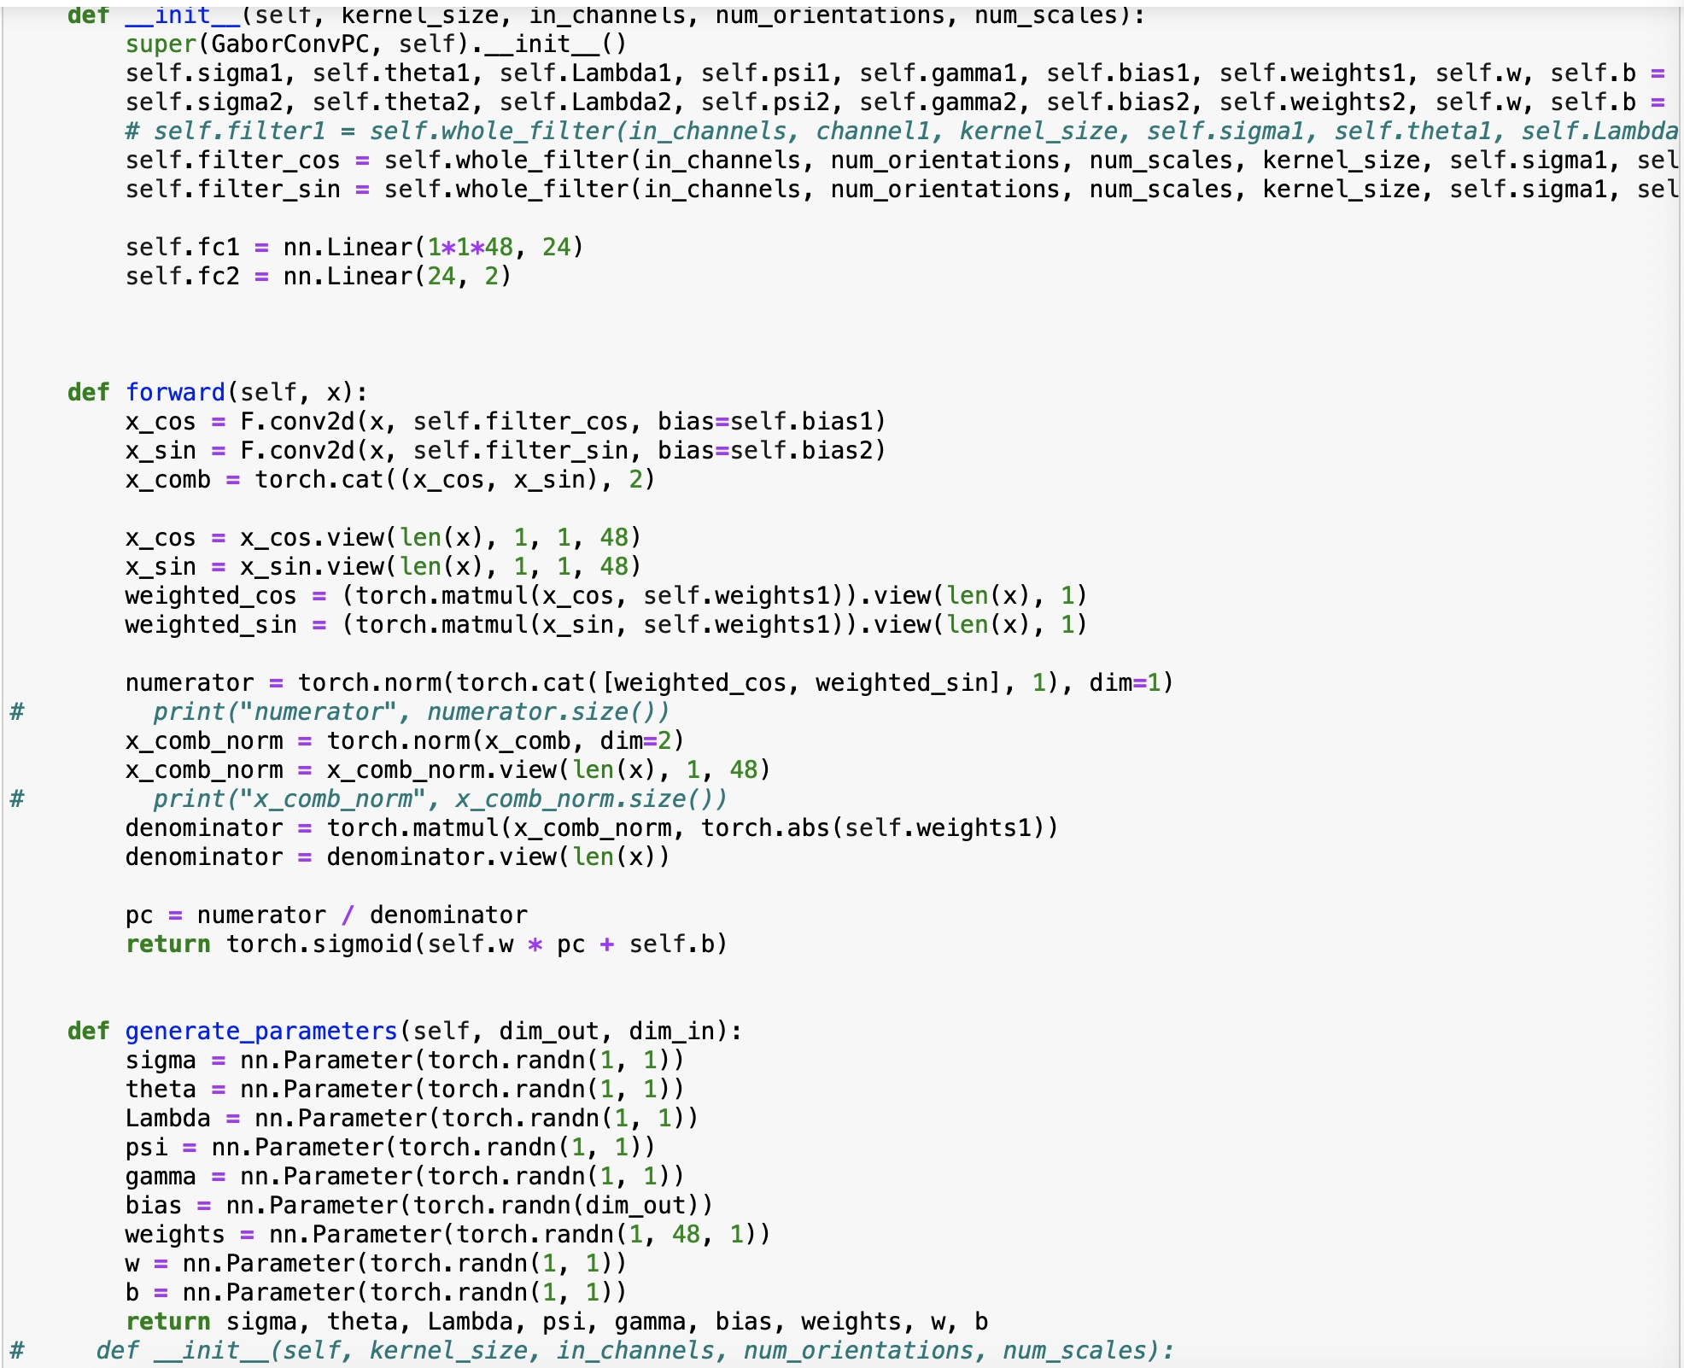
OLD Gabor
Notes:
CNN+Gabor+CNN实验2,4/4,8 and gabor

Slide 67
Old model =GaborConvPC(19, 1, 8, 6).to(device)
Epoch1:
Test set: Average loss: 0.2377, Accuracy: 7444/8141 (91%), Positive accuracy: 3462/4091 (85%), Negative accuracy: 3982/4050 (98%)
Epoch2:
Test set: Average loss: 0.1481, Accuracy: 7687/8141 (94%), Positive accuracy: 3798/4091 (93%), Negative accuracy: 3889/4050 (96%)
Epoch3
Test set: Average loss: 0.1792, Accuracy: 7583/8141 (93%), Positive accuracy: 3614/4091 (88%), Negative accuracy: 3969/4050 (98%)
Epoch4:
Test set: Average loss: 0.1493, Accuracy: 7668/8141 (94%), Positive accuracy: 3760/4091 (92%), Negative accuracy: 3908/4050 (96%)
Epoch5:
Test set: Average loss: 0.1384, Accuracy: 7709/8141 (95%), Positive accuracy: 3780/4091 (92%), Negative accuracy: 3929/4050 (97%)
Epoch6:
Test set: Average loss: 0.1377, Accuracy: 7753/8141 (95%), Positive accuracy: 3975/4091 (97%), Negative accuracy: 3778/4050 (93%)
Epoch7:
Test set: Average loss: 0.1273, Accuracy: 7761/8141 (95%), Positive accuracy: 3861/4091 (94%), Negative accuracy: 3900/4050 (96%)
Epoch8:
Test set: Average loss: 0.1439, Accuracy: 7678/8141 (94%), Positive accuracy: 3764/4091 (92%), Negative accuracy: 3914/4050 (97%)
Epoch9:
Test set: Average loss: 0.1194, Accuracy: 7773/8141 (95%), Positive accuracy: 3893/4091 (95%), Negative accuracy: 3880/4050 (96%)
Epoch10:
Test set: Average loss: 0.1470, Accuracy: 7692/8141 (94%), Positive accuracy: 3718/4091 (91%), Negative accuracy: 3974/4050 (98%)
Notes:
Test set: Average loss: 0.1470, Accuracy: 7692/8141 (94%), Positive accuracy: 3718/4091 (91%), Negative accuracy: 3974/4050 (98%)

Slide 68
Epoch11:
Test set: Average loss: 0.1237, Accuracy: 7774/8141 (95%), Positive accuracy: 3939/4091 (96%), Negative accuracy: 3835/4050 (95%)
Epoch12:
Test set: Average loss: 0.1908, Accuracy: 7412/8141 (91%), Positive accuracy: 4013/4091 (98%), Negative accuracy: 3399/4050 (84%)
Epoch13
Test set: Average loss: 0.1277, Accuracy: 7751/8141 (95%), Positive accuracy: 3800/4091 (93%), Negative accuracy: 3951/4050 (98%)
Epoch14:
Test set: Average loss: 0.1385, Accuracy: 7717/8141 (95%), Positive accuracy: 3768/4091 (92%), Negative accuracy: 3949/4050 (98%)
Epoch15:
Test set: Average loss: 0.1299, Accuracy: 7720/8141 (95%), Positive accuracy: 3857/4091 (94%), Negative accuracy: 3863/4050 (95%)
Epoch16:
Test set: Average loss: 0.1571, Accuracy: 7526/8141 (92%), Positive accuracy: 3961/4091 (97%), Negative accuracy: 3565/4050 (88%)
Epoch17:
Test set: Average loss: 0.1239, Accuracy: 7767/8141 (95%), Positive accuracy: 3944/4091 (96%), Negative accuracy: 3823/4050 (94%)
Epoch18:
Test set: Average loss: 0.1511, Accuracy: 7670/8141 (94%), Positive accuracy: 3704/4091 (91%), Negative accuracy: 3966/4050 (98%)
Epoch19:
Test set: Average loss: 0.1124, Accuracy: 7796/8141 (96%), Positive accuracy: 3891/4091 (95%), Negative accuracy: 3905/4050 (96%)
Epoch20:
Test set: Average loss: 0.1174, Accuracy: 7774/8141 (95%), Positive accuracy: 3887/4091 (95%), Negative accuracy: 3887/4050 (96%)
Notes:
Test set: Average loss: 0.1174, Accuracy: 7774/8141 (95%), Positive accuracy: 3887/4091 (95%), Negative accuracy: 3887/4050 (96%)

Slide 69
Model : old Gabor + CNN (2 layers of convolution with 32,64, filter size is 3, 2 layers of fully connected with 3136,129)
Epoch1:
Test set: Average loss: 0.1122, Accuracy: 7791/8141 (96%), Positive accuracy: 3907/4091 (96%), Negative accuracy: 3884/4050 (96%), f1 score: 0.9570
Epoch2:
Test set: Average loss: 0.1056, Accuracy: 7785/8141 (96%), Positive accuracy: 3851/4091 (94%), Negative accuracy: 3934/4050 (97%), f1 score: 0.9564
Epoch3
Test set: Average loss: 0.0959, Accuracy: 7840/8141 (96%), Positive accuracy: 3875/4091 (95%), Negative accuracy: 3965/4050 (98%), f1 score: 0.9632
Epoch4:
Test set: Average loss: 0.0868, Accuracy: 7859/8141 (97%), Positive accuracy: 3913/4091 (96%), Negative accuracy: 3946/4050 (97%), f1 score: 0.9654
Epoch5:
Test set: Average loss: 0.0911, Accuracy: 7852/8141 (96%), Positive accuracy: 3896/4091 (95%), Negative accuracy: 3956/4050 (98%), f1 score: 0.9646
Epoch6:
Test set: Average loss: 0.0813, Accuracy: 7877/8141 (97%), Positive accuracy: 3906/4091 (95%), Negative accuracy: 3971/4050 (98%), f1 score: 0.9677
Epoch7:
Test set: Average loss: 0.0728, Accuracy: 7914/8141 (97%), Positive accuracy: 3936/4091 (96%), Negative accuracy: 3978/4050 (98%), f1 score: 0.9722
Epoch8:
Test set: Average loss: 0.0728, Accuracy: 7914/8141 (97%), Positive accuracy: 3928/4091 (96%), Negative accuracy: 3986/4050 (98%), f1 score: 0.9722
Epoch9:
Test set: Average loss: 0.0691, Accuracy: 7923/8141 (97%), Positive accuracy: 3946/4091 (96%), Negative accuracy: 3977/4050 (98%), f1 score: 0.9733
Epoch10:
Test set: Average loss: 0.0701, Accuracy: 7921/8141 (97%), Positive accuracy: 3939/4091 (96%), Negative accuracy: 3982/4050 (98%), f1 score: 0.9730
Notes:
Test set: Average loss: 0.0701, Accuracy: 7921/8141 (97%), Positive accuracy: 3939/4091 (96%), Negative accuracy: 3982/4050 (98%), f1 score: 0.9730

Slide 70
Model : old Gabor + CNN (2 layers of convolution with 2,4, filter size is 3, 2 layers of fully connected with 196,129)
Epoch1:
Test set: Average loss: 0.1174, Accuracy: 7765/8141 (95%), Positive accuracy: 3903/4091 (95%), Negative accuracy: 3862/4050 (95%), f1 score: 0.9538
Epoch2:
Test set: Average loss: 0.1147, Accuracy: 7773/8141 (95%), Positive accuracy: 3898/4091 (95%), Negative accuracy: 3875/4050 (96%), f1 score: 0.9548
Epoch3
Test set: Average loss: 0.1173, Accuracy: 7778/8141 (96%), Positive accuracy: 3916/4091 (96%), Negative accuracy: 3862/4050 (95%), f1 score: 0.9554
Epoch4:
Test set: Average loss: 0.1169, Accuracy: 7783/8141 (96%), Positive accuracy: 3899/4091 (95%), Negative accuracy: 3884/4050 (96%), f1 score: 0.9560
Epoch5:
Test set: Average loss: 0.1144, Accuracy: 7782/8141 (96%), Positive accuracy: 3909/4091 (96%), Negative accuracy: 3873/4050 (96%), f1 score: 0.9559
Epoch6:
Test set: Average loss: 0.1162, Accuracy: 7777/8141 (96%), Positive accuracy: 3910/4091 (96%), Negative accuracy: 3867/4050 (95%), f1 score: 0.9553
Epoch7:
Test set: Average loss: 0.1152, Accuracy: 7784/8141 (96%), Positive accuracy: 3912/4091 (96%), Negative accuracy: 3872/4050 (96%), f1 score: 0.9561
Epoch8:
Test set: Average loss: 0.1159, Accuracy: 7781/8141 (96%), Positive accuracy: 3913/4091 (96%), Negative accuracy: 3868/4050 (96%), f1 score: 0.9558
Epoch9:
Test set: Average loss: 0.1156, Accuracy: 7783/8141 (96%), Positive accuracy: 3908/4091 (96%), Negative accuracy: 3875/4050 (96%), f1 score: 0.9560
Epoch10:
Test set: Average loss: 0.1153, Accuracy: 7785/8141 (96%), Positive accuracy: 3909/4091 (96%), Negative accuracy: 3876/4050 (96%), f1 score: 0.9563
Notes:
Test set: Average loss: 0.1153, Accuracy: 7785/8141 (96%), Positive accuracy: 3909/4091 (96%), Negative accuracy: 3876/4050 (96%), f1 score: 0.9563

Slide 71
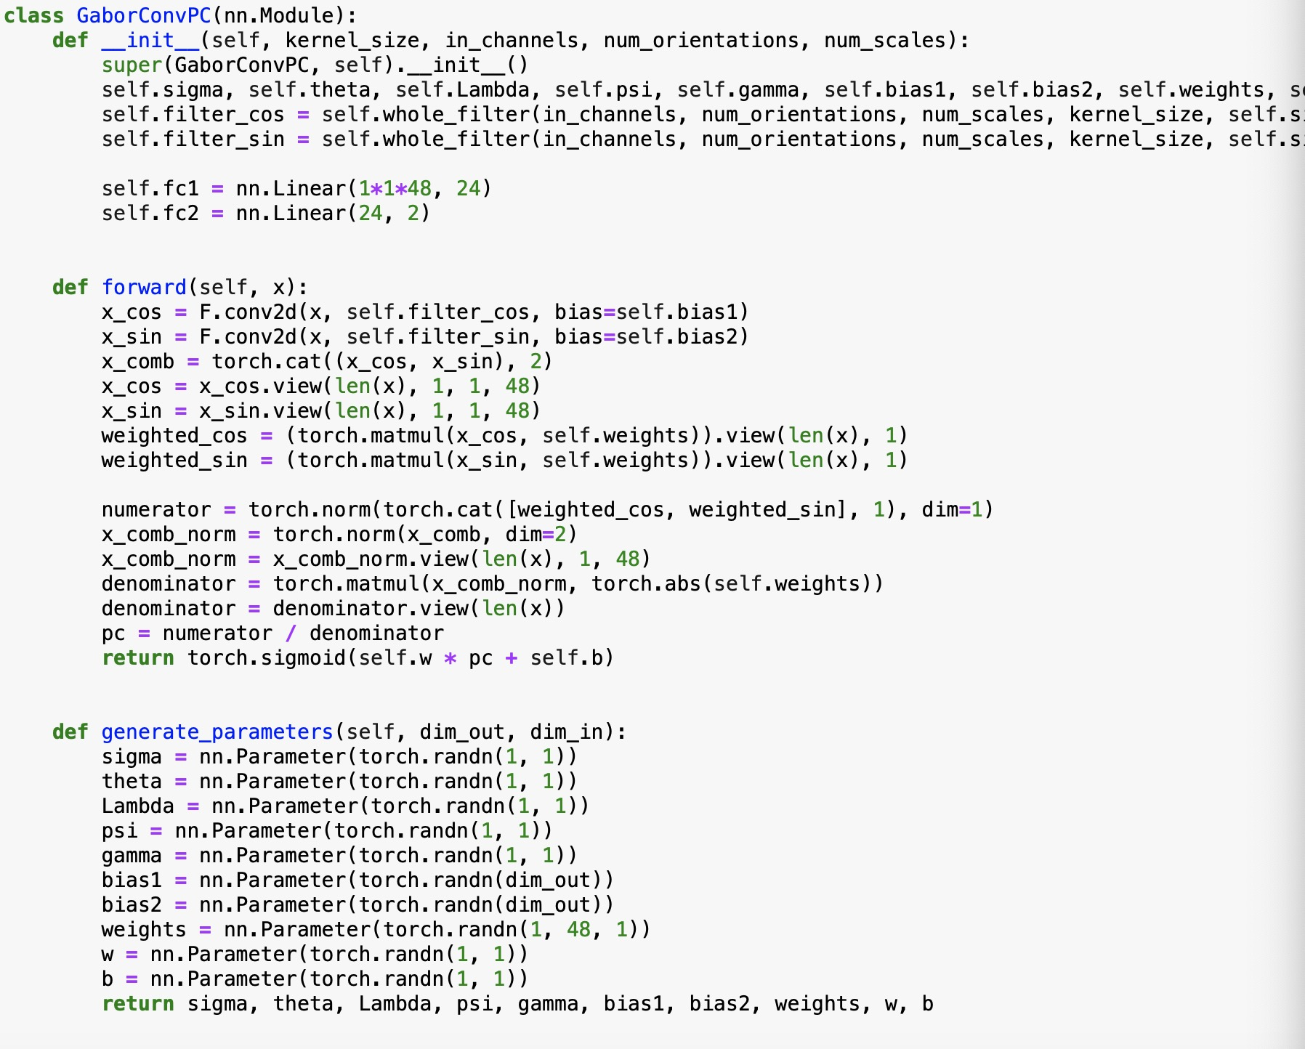
New Gabor
Notes:
CNN+Gabor+CNN实验2,4/4,8 and gabor

Slide 72
New : model =GaborConvPC(19, 1, 8, 6).to(device)
Epoch1:
Test set: Average loss: 0.2239, Accuracy: 7435/8141 (91%), Positive accuracy: 3558/4091 (87%), Negative accuracy: 3877/4050 (96%)
Epoch2:
Test set: Average loss: 0.2018, Accuracy: 7527/8141 (92%), Positive accuracy: 3703/4091 (91%), Negative accuracy: 3824/4050 (94%)
Epoch3
Test set: Average loss: 0.1916, Accuracy: 7538/8141 (93%), Positive accuracy: 3716/4091 (91%), Negative accuracy: 3822/4050 (94%)
Epoch4:
Test set: Average loss: 0.1946, Accuracy: 7568/8141 (93%), Positive accuracy: 3730/4091 (91%), Negative accuracy: 3838/4050 (95%)
Epoch5:
Test set: Average loss: 0.1780, Accuracy: 7587/8141 (93%), Positive accuracy: 3758/4091 (92%), Negative accuracy: 3829/4050 (95%)
Epoch6:
Test set: Average loss: 0.1751, Accuracy: 7611/8141 (93%), Positive accuracy: 3765/4091 (92%), Negative accuracy: 3846/4050 (95%)
Epoch7:
Test set: Average loss: 0.1761, Accuracy: 7627/8141 (94%), Positive accuracy: 3845/4091 (94%), Negative accuracy: 3782/4050 (93%)
Epoch8:
Test set: Average loss: 0.1734, Accuracy: 7570/8141 (93%), Positive accuracy: 3699/4091 (90%), Negative accuracy: 3871/4050 (96%)
Epoch9:
Test set: Average loss: 0.2045, Accuracy: 7470/8141 (92%), Positive accuracy: 3698/4091 (90%), Negative accuracy: 3772/4050 (93%)
Epoch10:
Test set: Average loss: 0.1667, Accuracy: 7618/8141 (94%), Positive accuracy: 3735/4091 (91%), Negative accuracy: 3883/4050 (96%)
Notes:
Test set: Average loss: 0.1667, Accuracy: 7618/8141 (94%), Positive accuracy: 3735/4091 (91%), Negative accuracy: 3883/4050 (96%)

Slide 73
New : model =GaborConvPC(19, 1, 8, 6).to(device)
Epoch11:
Test set: Average loss: 0.1899, Accuracy: 7508/8141 (92%), Positive accuracy: 3604/4091 (88%), Negative accuracy: 3904/4050 (96%)
Epoch12:
Test set: Average loss: 0.2355, Accuracy: 7374/8141 (91%), Positive accuracy: 3474/4091 (85%), Negative accuracy: 3900/4050 (96%)
Epoch13
Test set: Average loss: 0.1631, Accuracy: 7636/8141 (94%), Positive accuracy: 3786/4091 (93%), Negative accuracy: 3850/4050 (95%)
Epoch14:
Test set: Average loss: 0.2125, Accuracy: 7443/8141 (91%), Positive accuracy: 3524/4091 (86%), Negative accuracy: 3919/4050 (97%)
Epoch15:
Test set: Average loss: 0.1829, Accuracy: 7530/8141 (92%), Positive accuracy: 3635/4091 (89%), Negative accuracy: 3895/4050 (96%)
Epoch16:
Test set: Average loss: 0.1654, Accuracy: 7658/8141 (94%), Positive accuracy: 3885/4091 (95%), Negative accuracy: 3773/4050 (93%)
Epoch17:
Test set: Average loss: 0.1905, Accuracy: 7508/8141 (92%), Positive accuracy: 3599/4091 (88%), Negative accuracy: 3909/4050 (97%)
Epoch18:
Test set: Average loss: 0.1977, Accuracy: 7500/8141 (92%), Positive accuracy: 3567/4091 (87%), Negative accuracy: 3933/4050 (97%)
Epoch19:
Test set: Average loss: 0.1761, Accuracy: 7557/8141 (93%), Positive accuracy: 3684/4091 (90%), Negative accuracy: 3873/4050 (96%)
Epoch20:
Test set: Average loss: 0.1738, Accuracy: 7566/8141 (93%), Positive accuracy: 3684/4091 (90%), Negative accuracy: 3882/4050 (96%)
Notes:
Test set: Average loss: 0.1738, Accuracy: 7566/8141 (93%), Positive accuracy: 3684/4091 (90%), Negative accuracy: 3882/4050 (96%)

Slide 74
Model : Gabor + CNN (2 layers of convolution with 4,8, filter size is 3, 2 layers of fully connected with 392,129)
Epoch1:
Test set: Average loss: 0.1264, Accuracy: 7712/8141 (95%), Positive accuracy: 3830/4091 (94%), Negative accuracy: 3882/4050 (96%), f1 score: 0.9474
Epoch2:
Test set: Average loss: 0.1248, Accuracy: 7721/8141 (95%), Positive accuracy: 3813/4091 (93%), Negative accuracy: 3908/4050 (96%), f1 score: 0.9486
Epoch3
Test set: Average loss: 0.1206, Accuracy: 7714/8141 (95%), Positive accuracy: 3801/4091 (93%), Negative accuracy: 3913/4050 (97%), f1 score: 0.9478
Epoch4:
Test set: Average loss: 0.1183, Accuracy: 7733/8141 (95%), Positive accuracy: 3847/4091 (94%), Negative accuracy: 3886/4050 (96%), f1 score: 0.9499
Epoch5:
Test set: Average loss: 0.1212, Accuracy: 7717/8141 (95%), Positive accuracy: 3810/4091 (93%), Negative accuracy: 3907/4050 (96%), f1 score: 0.9481
Epoch6:
Test set: Average loss: 0.1208, Accuracy: 7738/8141 (95%), Positive accuracy: 3862/4091 (94%), Negative accuracy: 3876/4050 (96%), f1 score: 0.9505
Epoch7:
Test set: Average loss: 0.1171, Accuracy: 7736/8141 (95%), Positive accuracy: 3837/4091 (94%), Negative accuracy: 3899/4050 (96%), f1 score: 0.9503
Epoch8:
Test set: Average loss: 0.1167, Accuracy: 7738/8141 (95%), Positive accuracy: 3836/4091 (94%), Negative accuracy: 3902/4050 (96%), f1 score: 0.9506
Epoch9:
Test set: Average loss: 0.1172, Accuracy: 7743/8141 (95%), Positive accuracy: 3852/4091 (94%), Negative accuracy: 3891/4050 (96%), f1 score: 0.9512
Epoch10:
Test set: Average loss: 0.1170, Accuracy: 7734/8141 (95%), Positive accuracy: 3831/4091 (94%), Negative accuracy: 3903/4050 (96%), f1 score: 0.9501
Notes:
Test set: Average loss: 0.1170, Accuracy: 7734/8141 (95%), Positive accuracy: 3831/4091 (94%), Negative accuracy: 3903/4050 (96%), f1 score: 0.9501

Slide 75
Epoch11:
Test set: Average loss: 0.1173, Accuracy: 7740/8141 (95%), Positive accuracy: 3847/4091 (94%), Negative accuracy: 3893/4050 (96%), f1 score: 0.9508
Epoch12:
Test set: Average loss: 0.1165, Accuracy: 7737/8141 (95%), Positive accuracy: 3841/4091 (94%), Negative accuracy: 3896/4050 (96%), f1 score: 0.9505
Epoch13
Test set: Average loss: 0.1167, Accuracy: 7739/8141 (95%), Positive accuracy: 3843/4091 (94%), Negative accuracy: 3896/4050 (96%), f1 score: 0.9507
Epoch14:
Test set: Average loss: 0.1163, Accuracy: 7738/8141 (95%), Positive accuracy: 3841/4091 (94%), Negative accuracy: 3897/4050 (96%), f1 score: 0.9506
Epoch15:
Test set: Average loss: 0.1166, Accuracy: 7740/8141 (95%), Positive accuracy: 3843/4091 (94%), Negative accuracy: 3897/4050 (96%), f1 score: 0.9508
Epoch16:
Test set: Average loss: 0.1163, Accuracy: 7738/8141 (95%), Positive accuracy: 3838/4091 (94%), Negative accuracy: 3900/4050 (96%), f1 score: 0.9506
Epoch17:
Test set: Average loss: 0.1164, Accuracy: 7737/8141 (95%), Positive accuracy: 3839/4091 (94%), Negative accuracy: 3898/4050 (96%), f1 score: 0.9505
Epoch18:
Test set: Average loss: 0.1163, Accuracy: 7738/8141 (95%), Positive accuracy: 3839/4091 (94%), Negative accuracy: 3899/4050 (96%), f1 score: 0.9506
Epoch19:
Test set: Average loss: 0.1163, Accuracy: 7739/8141 (95%), Positive accuracy: 3839/4091 (94%), Negative accuracy: 3900/4050 (96%), f1 score: 0.9507
Epoch20:
Test set: Average loss: 0.1163, Accuracy: 7738/8141 (95%), Positive accuracy: 3838/4091 (94%), Negative accuracy: 3900/4050 (96%), f1 score: 0.9506
Notes:
Test set: Average loss: 0.1163, Accuracy: 7738/8141 (95%), Positive accuracy: 3838/4091 (94%), Negative accuracy: 3900/4050 (96%), f1 score: 0.9506

Slide 76
Model : Gabor + CNN (2 layers of convolution with 2,4, filter size is 3, 2 layers of fully connected with 196,129)
Epoch1:
Test set: Average loss: 0.1251, Accuracy: 7729/8141 (95%), Positive accuracy: 3863/4091 (94%), Negative accuracy: 3866/4050 (95%), f1 score: 0.9494
Epoch2:
Test set: Average loss: 0.1227, Accuracy: 7742/8141 (95%), Positive accuracy: 3874/4091 (95%), Negative accuracy: 3868/4050 (96%), f1 score: 0.9510
Epoch3
Test set: Average loss: 0.1234, Accuracy: 7744/8141 (95%), Positive accuracy: 3884/4091 (95%), Negative accuracy: 3860/4050 (95%), f1 score: 0.9512
Epoch4:
Test set: Average loss: 0.1215, Accuracy: 7731/8141 (95%), Positive accuracy: 3856/4091 (94%), Negative accuracy: 3875/4050 (96%), f1 score: 0.9497
Epoch5:
Test set: Average loss: 0.1205, Accuracy: 7731/8141 (95%), Positive accuracy: 3859/4091 (94%), Negative accuracy: 3872/4050 (96%), f1 score: 0.9496
Epoch6:
Test set: Average loss: 0.1246, Accuracy: 7722/8141 (95%), Positive accuracy: 3863/4091 (94%), Negative accuracy: 3859/4050 (95%), f1 score: 0.9485
Epoch7:
Test set: Average loss: 0.1270, Accuracy: 7729/8141 (95%), Positive accuracy: 3870/4091 (95%), Negative accuracy: 3859/4050 (95%), f1 score: 0.9494
Epoch8:
Test set: Average loss: 0.1249, Accuracy: 7736/8141 (95%), Positive accuracy: 3875/4091 (95%), Negative accuracy: 3861/4050 (95%), f1 score: 0.9502
Epoch9:
Test set: Average loss: 0.1251, Accuracy: 7734/8141 (95%), Positive accuracy: 3870/4091 (95%), Negative accuracy: 3864/4050 (95%), f1 score: 0.9500
Epoch10:
Test set: Average loss: 0.1228, Accuracy: 7734/8141 (95%), Positive accuracy: 3866/4091 (95%), Negative accuracy: 3868/4050 (96%), f1 score: 0.9500
Notes:
Test set: Average loss: 0.1228, Accuracy: 7734/8141 (95%), Positive accuracy: 3866/4091 (95%), Negative accuracy: 3868/4050 (96%), f1 score: 0.9500

Slide 77
Epoch11:
Test set: Average loss: 0.1227, Accuracy: 7737/8141 (95%), Positive accuracy: 3868/4091 (95%), Negative accuracy: 3869/4050 (96%), f1 score: 0.9504
Epoch12:
Test set: Average loss: 0.1213, Accuracy: 7740/8141 (95%), Positive accuracy: 3871/4091 (95%), Negative accuracy: 3869/4050 (96%), f1 score: 0.9507
Epoch13
Test set: Average loss: 0.1223, Accuracy: 7738/8141 (95%), Positive accuracy: 3868/4091 (95%), Negative accuracy: 3870/4050 (96%), f1 score: 0.9505
Epoch14:
Test set: Average loss: 0.1226, Accuracy: 7740/8141 (95%), Positive accuracy: 3875/4091 (95%), Negative accuracy: 3865/4050 (95%), f1 score: 0.9507
Epoch15:
Test set: Average loss: 0.1222, Accuracy: 7741/8141 (95%), Positive accuracy: 3874/4091 (95%), Negative accuracy: 3867/4050 (95%), f1 score: 0.9509
Epoch16:
Test set: Average loss: 0.1229, Accuracy: 7740/8141 (95%), Positive accuracy: 3877/4091 (95%), Negative accuracy: 3863/4050 (95%), f1 score: 0.9507
Epoch17:
Test set: Average loss: 0.1229, Accuracy: 7740/8141 (95%), Positive accuracy: 3875/4091 (95%), Negative accuracy: 3865/4050 (95%), f1 score: 0.9507
Epoch18:
Test set: Average loss: 0.1229, Accuracy: 7740/8141 (95%), Positive accuracy: 3876/4091 (95%), Negative accuracy: 3864/4050 (95%), f1 score: 0.9507
Epoch19:
Test set: Average loss: 0.1229, Accuracy: 7741/8141 (95%), Positive accuracy: 3876/4091 (95%), Negative accuracy: 3865/4050 (95%), f1 score: 0.9509
Epoch20:
Test set: Average loss: 0.1228, Accuracy: 7741/8141 (95%), Positive accuracy: 3875/4091 (95%), Negative accuracy: 3866/4050 (95%), f1 score: 0.9509
Notes:
Test set: Average loss: 0.1228, Accuracy: 7741/8141 (95%), Positive accuracy: 3875/4091 (95%), Negative accuracy: 3866/4050 (95%), f1 score: 0.9509

Slide 78
Model : Gabor + CNN (2 layers of convolution with 2,4, filter size is 3, 2 layers of fully connected with 196,129) + No Dropout
Epoch1:
Test set: Average loss: 0.1223, Accuracy: 7795/8141 (96%), Positive accuracy: 3893/4091 (95%), Negative accuracy: 3902/4050 (96%), f1 score: 0.9575
Epoch2:
Test set: Average loss: 0.1210, Accuracy: 7746/8141 (95%), Positive accuracy: 3831/4091 (94%), Negative accuracy: 3915/4050 (97%), f1 score: 0.9516
Epoch3
Test set: Average loss: 0.1173, Accuracy: 7750/8141 (95%), Positive accuracy: 3812/4091 (93%), Negative accuracy: 3938/4050 (97%), f1 score: 0.9523
Epoch4:
Test set: Average loss: 0.1067, Accuracy: 7797/8141 (96%), Positive accuracy: 3884/4091 (95%), Negative accuracy: 3913/4050 (97%), f1 score: 0.9578
Epoch5:
Test set: Average loss: 0.1052, Accuracy: 7816/8141 (96%), Positive accuracy: 3930/4091 (96%), Negative accuracy: 3886/4050 (96%), f1 score: 0.9601
Epoch6:
Test set: Average loss: 0.1023, Accuracy: 7812/8141 (96%), Positive accuracy: 3883/4091 (95%), Negative accuracy: 3929/4050 (97%), f1 score: 0.9596
Epoch7:
Test set: Average loss: 0.1024, Accuracy: 7804/8141 (96%), Positive accuracy: 3863/4091 (94%), Negative accuracy: 3941/4050 (97%), f1 score: 0.9587
Epoch8:
Test set: Average loss: 0.1011, Accuracy: 7824/8141 (96%), Positive accuracy: 3887/4091 (95%), Negative accuracy: 3937/4050 (97%), f1 score: 0.9611
Epoch9:
Test set: Average loss: 0.1019, Accuracy: 7813/8141 (96%), Positive accuracy: 3873/4091 (95%), Negative accuracy: 3940/4050 (97%), f1 score: 0.9598
Epoch10:
Test set: Average loss: 0.0978, Accuracy: 7841/8141 (96%), Positive accuracy: 3912/4091 (96%), Negative accuracy: 3929/4050 (97%), f1 score: 0.9632
Notes:
Test set: Average loss: 0.0978, Accuracy: 7841/8141 (96%), Positive accuracy: 3912/4091 (96%), Negative accuracy: 3929/4050 (97%), f1 score: 0.9632

Slide 79
Epoch11:
Test set: Average loss: 0.1009, Accuracy: 7819/8141 (96%), Positive accuracy: 3887/4091 (95%), Negative accuracy: 3932/4050 (97%), f1 score: 0.9605
Epoch12:
Test set: Average loss: 0.1011, Accuracy: 7814/8141 (96%), Positive accuracy: 3877/4091 (95%), Negative accuracy: 3937/4050 (97%), f1 score: 0.9599
Epoch13
Test set: Average loss: 0.1000, Accuracy: 7820/8141 (96%), Positive accuracy: 3883/4091 (95%), Negative accuracy: 3937/4050 (97%), f1 score: 0.9606
Epoch14:
Test set: Average loss: 0.1002, Accuracy: 7823/8141 (96%), Positive accuracy: 3886/4091 (95%), Negative accuracy: 3937/4050 (97%), f1 score: 0.9610
Epoch15:
Test set: Average loss: 0.0996, Accuracy: 7829/8141 (96%), Positive accuracy: 3893/4091 (95%), Negative accuracy: 3936/4050 (97%), f1 score: 0.9617
Epoch16:
Test set: Average loss: 0.1002, Accuracy: 7817/8141 (96%), Positive accuracy: 3880/4091 (95%), Negative accuracy: 3937/4050 (97%), f1 score: 0.9603
Epoch17:
Test set: Average loss: 0.1002, Accuracy: 7821/8141 (96%), Positive accuracy: 3883/4091 (95%), Negative accuracy: 3938/4050 (97%), f1 score: 0.9608
Epoch18:
Test set: Average loss: 0.0998, Accuracy: 7824/8141 (96%), Positive accuracy: 3887/4091 (95%), Negative accuracy: 3937/4050 (97%), f1 score: 0.9611
Epoch19:
Test set: Average loss: 0.0999, Accuracy: 7823/8141 (96%), Positive accuracy: 3886/4091 (95%), Negative accuracy: 3937/4050 (97%), f1 score: 0.9610
Epoch20:
Test set: Average loss: 0.0999, Accuracy: 7824/8141 (96%), Positive accuracy: 3887/4091 (95%), Negative accuracy: 3937/4050 (97%), f1 score: 0.9611
Notes:
Test set: Average loss: 0.0999, Accuracy: 7824/8141 (96%), Positive accuracy: 3887/4091 (95%), Negative accuracy: 3937/4050 (97%), f1 score: 0.9611

Slide 80
Model : Gabor + CNN (2 layers of convolution with 4,8, filter size is 3, 2 layers of fully connected with 392,129) + No Dropout
Epoch1:
Test set: Average loss: 0.1694, Accuracy: 7626/8141 (94%), Positive accuracy: 4035/4091 (99%), Negative accuracy: 3591/4050 (89%), f1 score: 0.9393
Epoch2:
Test set: Average loss: 0.1094, Accuracy: 7756/8141 (95%), Positive accuracy: 3860/4091 (94%), Negative accuracy: 3896/4050 (96%), f1 score: 0.9527
Epoch3
Test set: Average loss: 0.1171, Accuracy: 7779/8141 (96%), Positive accuracy: 3803/4091 (93%), Negative accuracy: 3976/4050 (98%), f1 score: 0.9561
Epoch4:
Test set: Average loss: 0.1223, Accuracy: 7725/8141 (95%), Positive accuracy: 3746/4091 (92%), Negative accuracy: 3979/4050 (98%), f1 score: 0.9498
Epoch5:
Test set: Average loss: 0.1009, Accuracy: 7812/8141 (96%), Positive accuracy: 3857/4091 (94%), Negative accuracy: 3955/4050 (98%), f1 score: 0.9598
Epoch6:
Test set: Average loss: 0.0928, Accuracy: 7815/8141 (96%), Positive accuracy: 3909/4091 (96%), Negative accuracy: 3906/4050 (96%), f1 score: 0.9600
Epoch7:
Test set: Average loss: 0.0922, Accuracy: 7838/8141 (96%), Positive accuracy: 3872/4091 (95%), Negative accuracy: 3966/4050 (98%), f1 score: 0.9630
Epoch8:
Test set: Average loss: 0.0887, Accuracy: 7857/8141 (97%), Positive accuracy: 3896/4091 (95%), Negative accuracy: 3961/4050 (98%), f1 score: 0.9652
Epoch9:
Test set: Average loss: 0.0978, Accuracy: 7827/8141 (96%), Positive accuracy: 3844/4091 (94%), Negative accuracy: 3983/4050 (98%), f1 score: 0.9618
Epoch10:
Test set: Average loss: 0.0920, Accuracy: 7846/8141 (96%), Positive accuracy: 3868/4091 (95%), Negative accuracy: 3978/4050 (98%), f1 score: 0.9640
Notes:
Test set: Average loss: 0.0920, Accuracy: 7846/8141 (96%), Positive accuracy: 3868/4091 (95%), Negative accuracy: 3978/4050 (98%), f1 score: 0.9640

Slide 81
Epoch11:
Test set: Average loss: 0.0903, Accuracy: 7847/8141 (96%), Positive accuracy: 3886/4091 (95%), Negative accuracy: 3961/4050 (98%), f1 score: 0.9640
Epoch12:
Test set: Average loss: 0.0898, Accuracy: 7842/8141 (96%), Positive accuracy: 3885/4091 (95%), Negative accuracy: 3957/4050 (98%), f1 score: 0.9634
Epoch13
Test set: Average loss: 0.0883, Accuracy: 7847/8141 (96%), Positive accuracy: 3894/4091 (95%), Negative accuracy: 3953/4050 (98%), f1 score: 0.9640
Epoch14:
Test set: Average loss: 0.0908, Accuracy: 7851/8141 (96%), Positive accuracy: 3882/4091 (95%), Negative accuracy: 3969/4050 (98%), f1 score: 0.9645
Epoch15:
Test set: Average loss: 0.0895, Accuracy: 7850/8141 (96%), Positive accuracy: 3890/4091 (95%), Negative accuracy: 3960/4050 (98%), f1 score: 0.9644
Epoch16:
Test set: Average loss: 0.0899, Accuracy: 7852/8141 (96%), Positive accuracy: 3885/4091 (95%), Negative accuracy: 3967/4050 (98%), f1 score: 0.9646
Epoch17:
Test set: Average loss: 0.0892, Accuracy: 7850/8141 (96%), Positive accuracy: 3888/4091 (95%), Negative accuracy: 3962/4050 (98%), f1 score: 0.9644
Epoch18:
Test set: Average loss: 0.0894, Accuracy: 7851/8141 (96%), Positive accuracy: 3888/4091 (95%), Negative accuracy: 3963/4050 (98%), f1 score: 0.9645
Epoch19:
Test set: Average loss: 0.0895, Accuracy: 7851/8141 (96%), Positive accuracy: 3888/4091 (95%), Negative accuracy: 3963/4050 (98%), f1 score: 0.9645
Epoch20:
Test set: Average loss: 0.0895, Accuracy: 7851/8141 (96%), Positive accuracy: 3888/4091 (95%), Negative accuracy: 3963/4050 (98%), f1 score: 0.9645
Notes:
Test set: Average loss: 0.0895, Accuracy: 7851/8141 (96%), Positive accuracy: 3888/4091 (95%), Negative accuracy: 3963/4050 (98%), f1 score: 0.9645

Slide 82
Model : Gabor + CNN (2 layers of convolution with 4,8, filter size is 3, 2 layers of fully connected with 392,64) + No Dropout
Epoch1:
Test set: Average loss: 0.1368, Accuracy: 7708/8141 (95%), Positive accuracy: 4024/4091 (98%), Negative accuracy: 3684/4050 (91%), f1 score: 0.9483
Epoch2:
Test set: Average loss: 0.1130, Accuracy: 7778/8141 (96%), Positive accuracy: 3841/4091 (94%), Negative accuracy: 3937/4050 (97%), f1 score: 0.9556
Epoch3
Test set: Average loss: 0.0980, Accuracy: 7813/8141 (96%), Positive accuracy: 3902/4091 (95%), Negative accuracy: 3911/4050 (97%), f1 score: 0.9597
Epoch4:
Test set: Average loss: 0.1013, Accuracy: 7812/8141 (96%), Positive accuracy: 3861/4091 (94%), Negative accuracy: 3951/4050 (98%), f1 score: 0.9598
Epoch5:
Test set: Average loss: 0.1032, Accuracy: 7801/8141 (96%), Positive accuracy: 3841/4091 (94%), Negative accuracy: 3960/4050 (98%), f1 score: 0.9585
Epoch6:
Test set: Average loss: 0.0953, Accuracy: 7833/8141 (96%), Positive accuracy: 3927/4091 (96%), Negative accuracy: 3906/4050 (96%), f1 score: 0.9622
Epoch7:
Test set: Average loss: 0.0976, Accuracy: 7824/8141 (96%), Positive accuracy: 3873/4091 (95%), Negative accuracy: 3951/4050 (98%), f1 score: 0.9612
Epoch8:
Test set: Average loss: 0.0986, Accuracy: 7810/8141 (96%), Positive accuracy: 3854/4091 (94%), Negative accuracy: 3956/4050 (98%), f1 score: 0.9596
Epoch9:
Test set: Average loss: 0.0940, Accuracy: 7843/8141 (96%), Positive accuracy: 3884/4091 (95%), Negative accuracy: 3959/4050 (98%), f1 score: 0.9635
Epoch10:
Test set: Average loss: 0.0939, Accuracy: 7826/8141 (96%), Positive accuracy: 3879/4091 (95%), Negative accuracy: 3947/4050 (97%), f1 score: 0.9614
Notes:
Test set: Average loss: 0.0939, Accuracy: 7826/8141 (96%), Positive accuracy: 3879/4091 (95%), Negative accuracy: 3947/4050 (97%), f1 score: 0.9614

Slide 83
Epoch11:
Test set: Average loss: 0.0917, Accuracy: 7838/8141 (96%), Positive accuracy: 3896/4091 (95%), Negative accuracy: 3942/4050 (97%), f1 score: 0.9628
Epoch12:
Test set: Average loss: 0.0943, Accuracy: 7831/8141 (96%), Positive accuracy: 3880/4091 (95%), Negative accuracy: 3951/4050 (98%), f1 score: 0.9620
Epoch13
Test set: Average loss: 0.0912, Accuracy: 7836/8141 (96%), Positive accuracy: 3897/4091 (95%), Negative accuracy: 3939/4050 (97%), f1 score: 0.9626
Epoch14:
Test set: Average loss: 0.0947, Accuracy: 7830/8141 (96%), Positive accuracy: 3878/4091 (95%), Negative accuracy: 3952/4050 (98%), f1 score: 0.9619
Epoch15:
Test set: Average loss: 0.0937, Accuracy: 7830/8141 (96%), Positive accuracy: 3882/4091 (95%), Negative accuracy: 3948/4050 (97%), f1 score: 0.9619
Epoch16:
Test set: Average loss: 0.0934, Accuracy: 7832/8141 (96%), Positive accuracy: 3882/4091 (95%), Negative accuracy: 3950/4050 (98%), f1 score: 0.9622
Epoch17:
Test set: Average loss: 0.0929, Accuracy: 7835/8141 (96%), Positive accuracy: 3886/4091 (95%), Negative accuracy: 3949/4050 (98%), f1 score: 0.9625
Epoch18:
Test set: Average loss: 0.0931, Accuracy: 7833/8141 (96%), Positive accuracy: 3884/4091 (95%), Negative accuracy: 3949/4050 (98%), f1 score: 0.9623
Epoch19:
Test set: Average loss: 0.0929, Accuracy: 7834/8141 (96%), Positive accuracy: 3885/4091 (95%), Negative accuracy: 3949/4050 (98%), f1 score: 0.9624
Epoch20:
Test set: Average loss: 0.0929, Accuracy: 7835/8141 (96%), Positive accuracy: 3886/4091 (95%), Negative accuracy: 3949/4050 (98%), f1 score: 0.9625
Notes:
Test set: Average loss: 0.0929, Accuracy: 7835/8141 (96%), Positive accuracy: 3886/4091 (95%), Negative accuracy: 3949/4050 (98%), f1 score: 0.9625

Slide 84
Model : Gabor + CNN (2 layers of convolution with 4,8, filter size is 5, 2 layers of fully connected with 200,36) + No Dropout
Epoch1:
Test set: Average loss: 0.1114, Accuracy: 7779/8141 (96%), Positive accuracy: 3851/4091 (94%), Negative accuracy: 3928/4050 (97%), f1 score: 0.9557
Epoch2:
Test set: Average loss: 0.1618, Accuracy: 7553/8141 (93%), Positive accuracy: 3953/4091 (97%), Negative accuracy: 3600/4050 (89%), f1 score: 0.9293
Epoch3
Test set: Average loss: 0.0988, Accuracy: 7824/8141 (96%), Positive accuracy: 3881/4091 (95%), Negative accuracy: 3943/4050 (97%), f1 score: 0.9612
Epoch4:
Test set: Average loss: 0.0946, Accuracy: 7854/8141 (96%), Positive accuracy: 3893/4091 (95%), Negative accuracy: 3961/4050 (98%), f1 score: 0.9649
Epoch5:
Test set: Average loss: 0.0995, Accuracy: 7822/8141 (96%), Positive accuracy: 3843/4091 (94%), Negative accuracy: 3979/4050 (98%), f1 score: 0.9612
Epoch6:
Test set: Average loss: 0.0875, Accuracy: 7854/8141 (96%), Positive accuracy: 3885/4091 (95%), Negative accuracy: 3969/4050 (98%), f1 score: 0.9649
Epoch7:
Test set: Average loss: 0.0974, Accuracy: 7836/8141 (96%), Positive accuracy: 3852/4091 (94%), Negative accuracy: 3984/4050 (98%), f1 score: 0.9629
Epoch8:
Test set: Average loss: 0.0876, Accuracy: 7863/8141 (97%), Positive accuracy: 3893/4091 (95%), Negative accuracy: 3970/4050 (98%), f1 score: 0.9660
Epoch9:
Test set: Average loss: 0.0898, Accuracy: 7853/8141 (96%), Positive accuracy: 3888/4091 (95%), Negative accuracy: 3965/4050 (98%), f1 score: 0.9648
Epoch10:
Test set: Average loss: 0.0895, Accuracy: 7863/8141 (97%), Positive accuracy: 3888/4091 (95%), Negative accuracy: 3975/4050 (98%), f1 score: 0.9660
Notes:
Test set: Average loss: 0.0895, Accuracy: 7863/8141 (97%), Positive accuracy: 3888/4091 (95%), Negative accuracy: 3975/4050 (98%), f1 score: 0.9660

Slide 85
Epoch11:
Test set: Average loss: 0.0875, Accuracy: 7868/8141 (97%), Positive accuracy: 3894/4091 (95%), Negative accuracy: 3974/4050 (98%), f1 score: 0.9666
Epoch12:
Test set: Average loss: 0.0874, Accuracy: 7866/8141 (97%), Positive accuracy: 3895/4091 (95%), Negative accuracy: 3971/4050 (98%), f1 score: 0.9664
Epoch13
Test set: Average loss: 0.0876, Accuracy: 7866/8141 (97%), Positive accuracy: 3893/4091 (95%), Negative accuracy: 3973/4050 (98%), f1 score: 0.9664
Epoch14:
Test set: Average loss: 0.0861, Accuracy: 7866/8141 (97%), Positive accuracy: 3897/4091 (95%), Negative accuracy: 3969/4050 (98%), f1 score: 0.9663
Epoch15:
Test set: Average loss: 0.0862, Accuracy: 7867/8141 (97%), Positive accuracy: 3898/4091 (95%), Negative accuracy: 3969/4050 (98%), f1 score: 0.9665
Epoch16:
Test set: Average loss: 0.0861, Accuracy: 7867/8141 (97%), Positive accuracy: 3898/4091 (95%), Negative accuracy: 3969/4050 (98%), f1 score: 0.9665
Epoch17:
Test set: Average loss: 0.0858, Accuracy: 7869/8141 (97%), Positive accuracy: 3901/4091 (95%), Negative accuracy: 3968/4050 (98%), f1 score: 0.9667
Epoch18:
Test set: Average loss: 0.0859, Accuracy: 7866/8141 (97%), Positive accuracy: 3898/4091 (95%), Negative accuracy: 3968/4050 (98%), f1 score: 0.9663
Epoch19:
Test set: Average loss: 0.0860, Accuracy: 7866/8141 (97%), Positive accuracy: 3897/4091 (95%), Negative accuracy: 3969/4050 (98%), f1 score: 0.9663
Epoch20:
Test set: Average loss: 0.0861, Accuracy: 7866/8141 (97%), Positive accuracy: 3897/4091 (95%), Negative accuracy: 3969/4050 (98%), f1 score: 0.9663
Notes:
Test set: Average loss: 0.0861, Accuracy: 7866/8141 (97%), Positive accuracy: 3897/4091 (95%), Negative accuracy: 3969/4050 (98%), f1 score: 0.9663

Slide 86
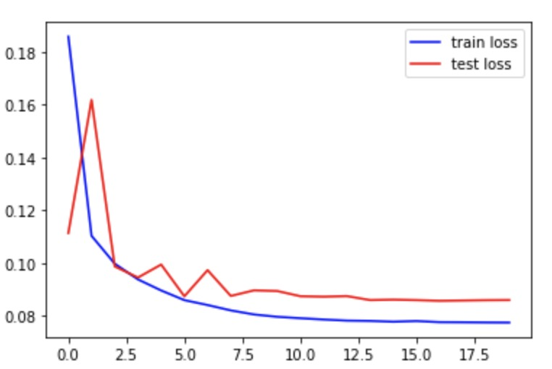
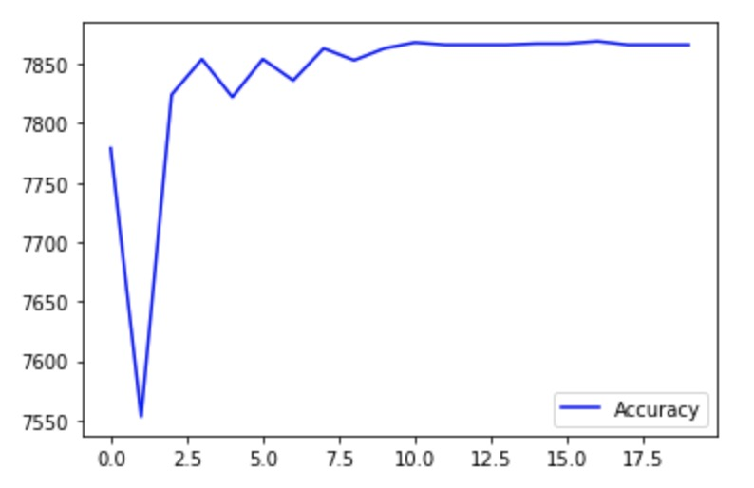

Slide 87
Model : Gabor + CNN (2 layers of convolution with 4,8, filter size is 7, 2 layers of fully connected with 72,16) + No Dropout
Epoch1:
Test set: Average loss: 0.1284, Accuracy: 7735/8141 (95%), Positive accuracy: 3786/4091 (93%), Negative accuracy: 3949/4050 (98%), f1 score: 0.9506
Epoch2:
Test set: Average loss: 0.1169, Accuracy: 7752/8141 (95%), Positive accuracy: 3807/4091 (93%), Negative accuracy: 3945/4050 (97%), f1 score: 0.9526
Epoch3
Test set: Average loss: 0.1038, Accuracy: 7793/8141 (96%), Positive accuracy: 3882/4091 (95%), Negative accuracy: 3911/4050 (97%), f1 score: 0.9573
Epoch4:
Test set: Average loss: 0.1053, Accuracy: 7774/8141 (95%), Positive accuracy: 3860/4091 (94%), Negative accuracy: 3914/4050 (97%), f1 score: 0.9550
Epoch5:
Test set: Average loss: 0.1027, Accuracy: 7791/8141 (96%), Positive accuracy: 3885/4091 (95%), Negative accuracy: 3906/4050 (96%), f1 score: 0.9570
Epoch6:
Test set: Average loss: 0.1150, Accuracy: 7765/8141 (95%), Positive accuracy: 3806/4091 (93%), Negative accuracy: 3959/4050 (98%), f1 score: 0.9542
Epoch7:
Test set: Average loss: 0.1040, Accuracy: 7790/8141 (96%), Positive accuracy: 3849/4091 (94%), Negative accuracy: 3941/4050 (97%), f1 score: 0.9571
Epoch8:
Test set: Average loss: 0.1028, Accuracy: 7796/8141 (96%), Positive accuracy: 3850/4091 (94%), Negative accuracy: 3946/4050 (97%), f1 score: 0.9578
Epoch9:
Test set: Average loss: 0.0999, Accuracy: 7807/8141 (96%), Positive accuracy: 3882/4091 (95%), Negative accuracy: 3925/4050 (97%), f1 score: 0.9590
Epoch10:
Test set: Average loss: 0.1025, Accuracy: 7792/8141 (96%), Positive accuracy: 3859/4091 (94%), Negative accuracy: 3933/4050 (97%), f1 score: 0.9573
Notes:
Test set: Average loss: 0.1025, Accuracy: 7792/8141 (96%), Positive accuracy: 3859/4091 (94%), Negative accuracy: 3933/4050 (97%), f1 score: 0.9573

Slide 88
Epoch11:
Test set: Average loss: 0.0986, Accuracy: 7809/8141 (96%), Positive accuracy: 3884/4091 (95%), Negative accuracy: 3925/4050 (97%), f1 score: 0.9593
Epoch12:
Test set: Average loss: 0.0995, Accuracy: 7804/8141 (96%), Positive accuracy: 3875/4091 (95%), Negative accuracy: 3929/4050 (97%), f1 score: 0.9587
Epoch13
Test set: Average loss: 0.1000, Accuracy: 7805/8141 (96%), Positive accuracy: 3870/4091 (95%), Negative accuracy: 3935/4050 (97%), f1 score: 0.9588
Epoch14:
Test set: Average loss: 0.1003, Accuracy: 7802/8141 (96%), Positive accuracy: 3870/4091 (95%), Negative accuracy: 3932/4050 (97%), f1 score: 0.9585
Epoch15:
Test set: Average loss: 0.1007, Accuracy: 7800/8141 (96%), Positive accuracy: 3866/4091 (95%), Negative accuracy: 3934/4050 (97%), f1 score: 0.9582
Epoch16:
Test set: Average loss: 0.1005, Accuracy: 7801/8141 (96%), Positive accuracy: 3869/4091 (95%), Negative accuracy: 3932/4050 (97%), f1 score: 0.9583
Epoch17:
Epoch18:
Test set: Average loss: 0.1004, Accuracy: 7806/8141 (96%), Positive accuracy: 3868/4091 (95%), Negative accuracy: 3938/4050 (97%), f1 score: 0.9590
Epoch19:
Test set: Average loss: 0.1004, Accuracy: 7805/8141 (96%), Positive accuracy: 3867/4091 (95%), Negative accuracy: 3938/4050 (97%), f1 score: 0.9588
Epoch20:
Test set: Average loss: 0.1002, Accuracy: 7803/8141 (96%), Positive accuracy: 3867/4091 (95%), Negative accuracy: 3936/4050 (97%), f1 score: 0.9586
Test set: Average loss: 0.1001, Accuracy: 7807/8141 (96%), Positive accuracy: 3869/4091 (95%), Negative accuracy: 3938/4050 (97%), f1 score: 0.9591
Notes:
Test set: Average loss: 0.1002, Accuracy: 7803/8141 (96%), Positive accuracy: 3867/4091 (95%), Negative accuracy: 3936/4050 (97%), f1 score: 0.9586

Slide 89
Model : Gabor + CNN (3 layers of convolution with 2,4,8, filter size is 3, 2 layers of fully connected with 288,36) + No Dropout
Epoch1:
Test set: Average loss: 0.2588, Accuracy: 7458/8141 (92%), Positive accuracy: 3425/4091 (84%), Negative accuracy: 4033/4050 (100%), f1 score: 0.9216
Epoch2:
Test set: Average loss: 0.1198, Accuracy: 7749/8141 (95%), Positive accuracy: 3828/4091 (94%), Negative accuracy: 3921/4050 (97%), f1 score: 0.9520
Epoch3
Test set: Average loss: 0.1174, Accuracy: 7758/8141 (95%), Positive accuracy: 3820/4091 (93%), Negative accuracy: 3938/4050 (97%), f1 score: 0.9532
Epoch4:
Test set: Average loss: 0.1331, Accuracy: 7732/8141 (95%), Positive accuracy: 3750/4091 (92%), Negative accuracy: 3982/4050 (98%), f1 score: 0.9507
Epoch5:
Test set: Average loss: 0.0981, Accuracy: 7808/8141 (96%), Positive accuracy: 3892/4091 (95%), Negative accuracy: 3916/4050 (97%), f1 score: 0.9591
Epoch6:
Test set: Average loss: 0.0995, Accuracy: 7800/8141 (96%), Positive accuracy: 3896/4091 (95%), Negative accuracy: 3904/4050 (96%), f1 score: 0.9581
Epoch7:
Test set: Average loss: 0.0952, Accuracy: 7807/8141 (96%), Positive accuracy: 3927/4091 (96%), Negative accuracy: 3880/4050 (96%), f1 score: 0.9590
Epoch8:
Test set: Average loss: 0.1001, Accuracy: 7798/8141 (96%), Positive accuracy: 3849/4091 (94%), Negative accuracy: 3949/4050 (98%), f1 score: 0.9581
Epoch9:
Test set: Average loss: 0.1025, Accuracy: 7803/8141 (96%), Positive accuracy: 3845/4091 (94%), Negative accuracy: 3958/4050 (98%), f1 score: 0.9587
Epoch10:
Test set: Average loss: 0.0951, Accuracy: 7821/8141 (96%), Positive accuracy: 3890/4091 (95%), Negative accuracy: 3931/4050 (97%), f1 score: 0.9607
Notes:
Test set: Average loss: 0.0951, Accuracy: 7821/8141 (96%), Positive accuracy: 3890/4091 (95%), Negative accuracy: 3931/4050 (97%), f1 score: 0.9607

Slide 90
Epoch11:
Test set: Average loss: 0.0985, Accuracy: 7800/8141 (96%), Positive accuracy: 3861/4091 (94%), Negative accuracy: 3939/4050 (97%), f1 score: 0.9582
Epoch12:
Test set: Average loss: 0.0960, Accuracy: 7826/8141 (96%), Positive accuracy: 3882/4091 (95%), Negative accuracy: 3944/4050 (97%), f1 score: 0.9614
Epoch13
Test set: Average loss: 0.0976, Accuracy: 7809/8141 (96%), Positive accuracy: 3875/4091 (95%), Negative accuracy: 3934/4050 (97%), f1 score: 0.9593
Epoch14:
Test set: Average loss: 0.0990, Accuracy: 7809/8141 (96%), Positive accuracy: 3859/4091 (94%), Negative accuracy: 3950/4050 (98%), f1 score: 0.9594
Epoch15:
Test set: Average loss: 0.0969, Accuracy: 7806/8141 (96%), Positive accuracy: 3869/4091 (95%), Negative accuracy: 3937/4050 (97%), f1 score: 0.9590
Epoch16:
Test set: Average loss: 0.0976, Accuracy: 7811/8141 (96%), Positive accuracy: 3866/4091 (95%), Negative accuracy: 3945/4050 (97%), f1 score: 0.9596
Epoch17:
Test set: Average loss: 0.0976, Accuracy: 7813/8141 (96%), Positive accuracy: 3866/4091 (95%), Negative accuracy: 3947/4050 (97%), f1 score: 0.9599
Epoch18:
Test set: Average loss: 0.0977, Accuracy: 7806/8141 (96%), Positive accuracy: 3863/4091 (94%), Negative accuracy: 3943/4050 (97%), f1 score: 0.9590
Epoch19:
Test set: Average loss: 0.0977, Accuracy: 7806/8141 (96%), Positive accuracy: 3863/4091 (94%), Negative accuracy: 3943/4050 (97%), f1 score: 0.9590
Epoch20:
Test set: Average loss: 0.0978, Accuracy: 7809/8141 (96%), Positive accuracy: 3863/4091 (94%), Negative accuracy: 3946/4050 (97%), f1 score: 0.9594
Notes:
Test set: Average loss: 0.0978, Accuracy: 7809/8141 (96%), Positive accuracy: 3863/4091 (94%), Negative accuracy: 3946/4050 (97%), f1 score: 0.9594

Slide 91
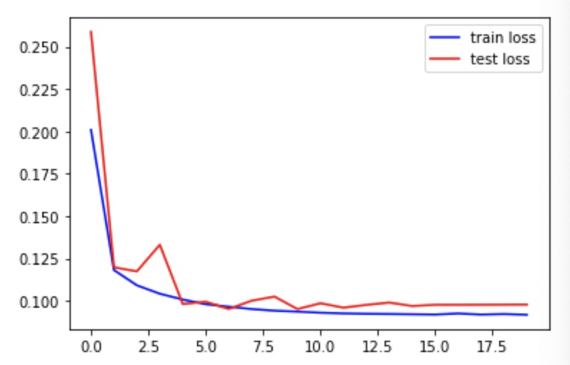
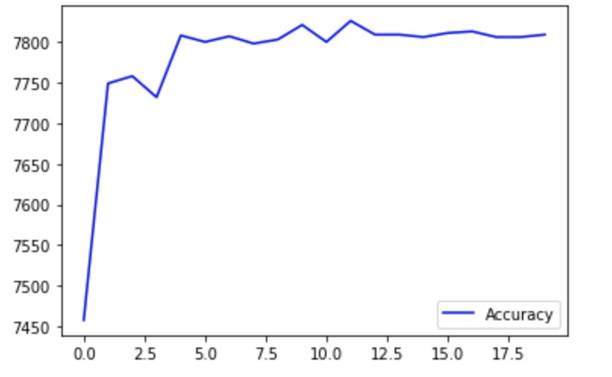

Slide 92
Model : Gabor + CNN (3 layers of convolution with 4,8,16 filter size is 3, 2 layers of fully connected with 576,36) + No Dropout
Epoch1:
Test set: Average loss: 0.1451, Accuracy: 7661/8141 (94%), Positive accuracy: 3705/4091 (91%), Negative accuracy: 3956/4050 (98%), f1 score: 0.9421
Epoch2:
Test set: Average loss: 0.1111, Accuracy: 7746/8141 (95%), Positive accuracy: 3848/4091 (94%), Negative accuracy: 3898/4050 (96%), f1 score: 0.9515
Epoch3
Test set: Average loss: 0.1212, Accuracy: 7751/8141 (95%), Positive accuracy: 3799/4091 (93%), Negative accuracy: 3952/4050 (98%), f1 score: 0.9525
Epoch4:
Test set: Average loss: 0.1018, Accuracy: 7773/8141 (95%), Positive accuracy: 3900/4091 (95%), Negative accuracy: 3873/4050 (96%), f1 score: 0.9548
Epoch5:
Test set: Average loss: 0.1094, Accuracy: 7770/8141 (95%), Positive accuracy: 3793/4091 (93%), Negative accuracy: 3977/4050 (98%), f1 score: 0.9550
Epoch6:
Test set: Average loss: 0.0953, Accuracy: 7814/8141 (96%), Positive accuracy: 3883/4091 (95%), Negative accuracy: 3931/4050 (97%), f1 score: 0.9599
Epoch7:
Test set: Average loss: 0.0965, Accuracy: 7804/8141 (96%), Positive accuracy: 3873/4091 (95%), Negative accuracy: 3931/4050 (97%), f1 score: 0.9587
Epoch8:
Test set: Average loss: 0.0966, Accuracy: 7821/8141 (96%), Positive accuracy: 3865/4091 (94%), Negative accuracy: 3956/4050 (98%), f1 score: 0.9609
Epoch9:
Test set: Average loss: 0.0951, Accuracy: 7818/8141 (96%), Positive accuracy: 3876/4091 (95%), Negative accuracy: 3942/4050 (97%), f1 score: 0.9604
Epoch10:
Test set: Average loss: 0.0932, Accuracy: 7822/8141 (96%), Positive accuracy: 3886/4091 (95%), Negative accuracy: 3936/4050 (97%), f1 score: 0.9609
Notes:
Test set: Average loss: 0.0932, Accuracy: 7822/8141 (96%), Positive accuracy: 3886/4091 (95%), Negative accuracy: 3936/4050 (97%), f1 score: 0.9609

Slide 93
Epoch11:
Test set: Average loss: 0.0942, Accuracy: 7824/8141 (96%), Positive accuracy: 3881/4091 (95%), Negative accuracy: 3943/4050 (97%), f1 score: 0.9612
Epoch12:
Test set: Average loss: 0.0943, Accuracy: 7823/8141 (96%), Positive accuracy: 3877/4091 (95%), Negative accuracy: 3946/4050 (97%), f1 score: 0.9611
Epoch13
Test set: Average loss: 0.0948, Accuracy: 7824/8141 (96%), Positive accuracy: 3875/4091 (95%), Negative accuracy: 3949/4050 (98%), f1 score: 0.9612
Epoch14:
Test set: Average loss: 0.0941, Accuracy: 7825/8141 (96%), Positive accuracy: 3876/4091 (95%), Negative accuracy: 3949/4050 (98%), f1 score: 0.9613
Epoch15:
Test set: Average loss: 0.0941, Accuracy: 7825/8141 (96%), Positive accuracy: 3877/4091 (95%), Negative accuracy: 3948/4050 (97%), f1 score: 0.9613
Epoch16:
Test set: Average loss: 0.0935, Accuracy: 7825/8141 (96%), Positive accuracy: 3881/4091 (95%), Negative accuracy: 3944/4050 (97%), f1 score: 0.9613
Epoch17:
Test set: Average loss: 0.0943, Accuracy: 7827/8141 (96%), Positive accuracy: 3875/4091 (95%), Negative accuracy: 3952/4050 (98%), f1 score: 0.9616
Epoch18:
Test set: Average loss: 0.0942, Accuracy: 7827/8141 (96%), Positive accuracy: 3875/4091 (95%), Negative accuracy: 3952/4050 (98%), f1 score: 0.9616
Epoch19:
Test set: Average loss: 0.0939, Accuracy: 7824/8141 (96%), Positive accuracy: 3876/4091 (95%), Negative accuracy: 3948/4050 (97%), f1 score: 0.9612
Epoch20:
Test set: Average loss: 0.0943, Accuracy: 7825/8141 (96%), Positive accuracy: 3873/4091 (95%), Negative accuracy: 3952/4050 (98%), f1 score: 0.9613
Notes:
Test set: Average loss: 0.0943, Accuracy: 7825/8141 (96%), Positive accuracy: 3873/4091 (95%), Negative accuracy: 3952/4050 (98%), f1 score: 0.9613

Slide 94
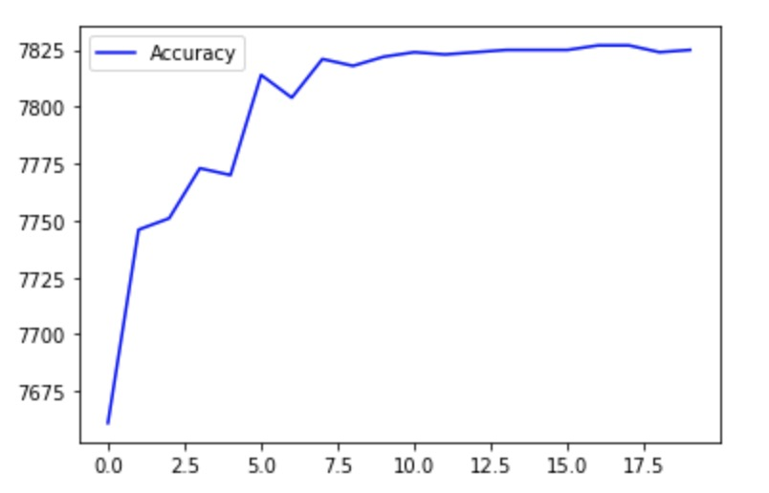
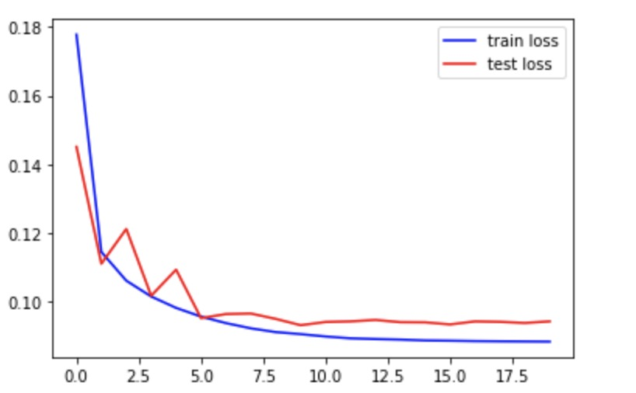

Slide 95
comparison
CNN Model (2 layers of convolution with 64,128, filter size is 3, 2 layers of fully connected with 6727,1024)
Test set: Average loss: 0.1195, Accuracy: 7748/8141 (95%), Positive accuracy: 3869/4091 (95%), Negative accuracy: 3879/4050 (96%), f1 score: 0.9517
Gabor model =GaborConvPC(19, 1, 8, 6).to(device)
Test set: Average loss: 0.1631, Accuracy: 7636/8141 (94%), Positive accuracy: 3786/4091 (93%), Negative accuracy: 3850/4050 (95%)
Model: Gabor + CNN (2 layers of convolution with 4,8, filter size is 5, 2 layers of fully connected with 200,36) + No Dropout
Test set: Average loss: 0.0858, Accuracy: 7869/8141 (97%), Positive accuracy: 3901/4091 (95%), Negative accuracy: 3968/4050 (98%), f1 score: 0.9667

Slide 96
Result
Nov. 25Th
Notes:
CNN+Gabor+CNN实验2,4/4,8 and gabor

Slide 97
Model : Gabor + CNN (2 layers of convolution with 4,8, filter size is 5, 2 layers of fully connected with 200,36) + F.sigmoid
Epoch1:
Test set: Average loss: 0.1350, Accuracy: 7712/8141 (95%), Positive accuracy: 3782/4091 (92%), Negative accuracy: 3930/4050 (97%), f1 score: 0.9477
Epoch2:
Test set: Average loss: 0.1161, Accuracy: 7797/8141 (96%), Positive accuracy: 3979/4091 (97%), Negative accuracy: 3818/4050 (94%), f1 score: 0.9580
Epoch3
Test set: Average loss: 0.1037, Accuracy: 7798/8141 (96%), Positive accuracy: 3900/4091 (95%), Negative accuracy: 3898/4050 (96%), f1 score: 0.9579
Epoch4:
Test set: Average loss: 0.0946, Accuracy: 7854/8141 (96%), Positive accuracy: 3893/4091 (95%), Negative accuracy: 3961/4050 (98%), f1 score: 0.9649
Epoch5:
Test set: Average loss: 0.1143, Accuracy: 7768/8141 (95%), Positive accuracy: 3819/4091 (93%), Negative accuracy: 3949/4050 (98%), f1 score: 0.9545
Epoch6:
Test set: Average loss: 0.0979, Accuracy: 7810/8141 (96%), Positive accuracy: 3871/4091 (95%), Negative accuracy: 3939/4050 (97%), f1 score: 0.9595
Epoch7:
Test set: Average loss: 0.1144, Accuracy: 7766/8141 (95%), Positive accuracy: 3795/4091 (93%), Negative accuracy: 3971/4050 (98%), f1 score: 0.9545
Epoch8:
Test set: Average loss: 0.0971, Accuracy: 7808/8141 (96%), Positive accuracy: 3872/4091 (95%), Negative accuracy: 3936/4050 (97%), f1 score: 0.9592
Epoch9:
Test set: Average loss: 0.1029, Accuracy: 7792/8141 (96%), Positive accuracy: 3846/4091 (94%), Negative accuracy: 3946/4050 (97%), f1 score: 0.9573
Epoch10:
Test set: Average loss: 0.1021, Accuracy: 7802/8141 (96%), Positive accuracy: 3842/4091 (94%), Negative accuracy: 3960/4050 (98%), f1 score: 0.9586
Notes:
Test set: Average loss: 0.1021, Accuracy: 7802/8141 (96%), Positive accuracy: 3842/4091 (94%), Negative accuracy: 3960/4050 (98%), f1 score: 0.9586

Slide 98
Epoch11:
Test set: Average loss: 0.1004, Accuracy: 7813/8141 (96%), Positive accuracy: 3856/4091 (94%), Negative accuracy: 3957/4050 (98%), f1 score: 0.9599
Epoch12:
Test set: Average loss: 0.1016, Accuracy: 7800/8141 (96%), Positive accuracy: 3845/4091 (94%), Negative accuracy: 3955/4050 (98%), f1 score: 0.9584
Epoch13
Test set: Average loss: 0.1001, Accuracy: 7807/8141 (96%), Positive accuracy: 3852/4091 (94%), Negative accuracy: 3955/4050 (98%), f1 score: 0.9592
Epoch14:
Test set: Average loss: 0.0994, Accuracy: 7804/8141 (96%), Positive accuracy: 3852/4091 (94%), Negative accuracy: 3952/4050 (98%), f1 score: 0.9588
Epoch15:
Test set: Average loss: 0.1001, Accuracy: 7800/8141 (96%), Positive accuracy: 3849/4091 (94%), Negative accuracy: 3951/4050 (98%), f1 score: 0.9583
Epoch16:
Test set: Average loss: 0.0994, Accuracy: 7801/8141 (96%), Positive accuracy: 3851/4091 (94%), Negative accuracy: 3950/4050 (98%), f1 score: 0.9584
Epoch17:
Test set: Average loss: 0.0994, Accuracy: 7803/8141 (96%), Positive accuracy: 3854/4091 (94%), Negative accuracy: 3949/4050 (98%), f1 score: 0.9587
Epoch18:
Test set: Average loss: 0.1001, Accuracy: 7802/8141 (96%), Positive accuracy: 3851/4091 (94%), Negative accuracy: 3951/4050 (98%), f1 score: 0.9586
Epoch19:
Test set: Average loss: 0.0998, Accuracy: 7802/8141 (96%), Positive accuracy: 3852/4091 (94%), Negative accuracy: 3950/4050 (98%), f1 score: 0.9586
Epoch20:
Test set: Average loss: 0.0999, Accuracy: 7800/8141 (96%), Positive accuracy: 3852/4091 (94%), Negative accuracy: 3948/4050 (97%), f1 score: 0.9583
Notes:
Test set: Average loss: 0.0999, Accuracy: 7800/8141 (96%), Positive accuracy: 3852/4091 (94%), Negative accuracy: 3948/4050 (97%), f1 score: 0.9583

Slide 99
CNN Model
batch-size：64
learning rate：0.01

Slide 100
Epoch1:
Test set: Average loss: 0.2261, Accuracy: 7444/8141 (91%), Positive accuracy: 3865/4091 (94%), Negative accuracy: 3579/4050 (88%), f1 score: 0.9153, Train loss: 0.3954
Epoch2:
Test set: Average loss: 0.1733, Accuracy: 7626/8141 (94%), Positive accuracy: 3896/4091 (95%), Negative accuracy: 3730/4050 (92%), f1 score: 0.9370, Train loss: 0.2225
Epoch3
Test set: Average loss: 0.1474, Accuracy: 7703/8141 (95%), Positive accuracy: 3904/4091 (95%), Negative accuracy: 3799/4050 (94%), f1 score: 0.9463, Train loss: 0.1790
Epoch4:
Test set: Average loss: 0.1351, Accuracy: 7707/8141 (95%), Positive accuracy: 3839/4091 (94%), Negative accuracy: 3868/4050 (96%), f1 score: 0.9467, Train loss: 0.1633
Epoch5:
Test set: Average loss: 0.1333, Accuracy: 7705/8141 (95%), Positive accuracy: 3837/4091 (94%), Negative accuracy: 3868/4050 (96%), f1 score: 0.9465, Train loss: 0.1582
Epoch6:
Test set: Average loss: 0.1310, Accuracy: 7714/8141 (95%), Positive accuracy: 3833/4091 (94%), Negative accuracy: 3881/4050 (96%), f1 score: 0.9476, Train loss: 0.1558
Epoch7:
Test set: Average loss: 0.1272, Accuracy: 7736/8141 (95%), Positive accuracy: 3859/4091 (94%), Negative accuracy: 3877/4050 (96%), f1 score: 0.9503, Train loss: 0.1548
Epoch8:
Test set: Average loss: 0.1277, Accuracy: 7721/8141 (95%), Positive accuracy: 3838/4091 (94%), Negative accuracy: 3883/4050 (96%), f1 score: 0.9485, Train loss: 0.1518
Epoch9:
Test set: Average loss: 0.1276, Accuracy: 7720/8141 (95%), Positive accuracy: 3848/4091 (94%), Negative accuracy: 3872/4050 (96%), f1 score: 0.9483, Train loss: 0.1520
Epoch10:
Test set: Average loss: 0.1274, Accuracy: 7721/8141 (95%), Positive accuracy: 3848/4091 (94%), Negative accuracy: 3873/4050 (96%), f1 score: 0.9484, Train loss: 0.1506
2 layers of Convolution,
channels are 32, 64, filter size is 3
2 layers of fully connected with 3136, 1024
Notes:
Test set: Average loss: 0.1274, Accuracy: 7721/8141 (95%), Positive accuracy: 3848/4091 (94%), Negative accuracy: 3873/4050 (96%), f1 score: 0.9484, Train loss: 0.1506

Slide 101
Epoch11:
Test set: Average loss: 0.1268, Accuracy: 7720/8141 (95%), Positive accuracy: 3841/4091 (94%), Negative accuracy: 3879/4050 (96%), f1 score: 0.9483, Train loss: 0.1519
Epoch12:
Test set: Average loss: 0.1267, Accuracy: 7722/8141 (95%), Positive accuracy: 3840/4091 (94%), Negative accuracy: 3882/4050 (96%), f1 score: 0.9486, Train loss: 0.1526
Epoch13
Test set: Average loss: 0.1265, Accuracy: 7721/8141 (95%), Positive accuracy: 3844/4091 (94%), Negative accuracy: 3877/4050 (96%), f1 score: 0.9484, Train loss: 0.1507
Epoch14:
Test set: Average loss: 0.1264, Accuracy: 7720/8141 (95%), Positive accuracy: 3848/4091 (94%), Negative accuracy: 3872/4050 (96%), f1 score: 0.9483, Train loss: 0.1520
Epoch15:
Test set: Average loss: 0.1264, Accuracy: 7723/8141 (95%), Positive accuracy: 3851/4091 (94%), Negative accuracy: 3872/4050 (96%), f1 score: 0.9487, Train loss: 0.1499
Epoch16:
Test set: Average loss: 0.1264, Accuracy: 7721/8141 (95%), Positive accuracy: 3845/4091 (94%), Negative accuracy: 3876/4050 (96%), f1 score: 0.9484, Train loss: 0.1513
Epoch17:
Test set: Average loss: 0.1263, Accuracy: 7721/8141 (95%), Positive accuracy: 3847/4091 (94%), Negative accuracy: 3874/4050 (96%), f1 score: 0.9484, Train loss: 0.1508
Epoch18:
Test set: Average loss: 0.1263, Accuracy: 7721/8141 (95%), Positive accuracy: 3849/4091 (94%), Negative accuracy: 3872/4050 (96%), f1 score: 0.9484, Train loss: 0.1523
Epoch19:
Test set: Average loss: 0.1263, Accuracy: 7721/8141 (95%), Positive accuracy: 3846/4091 (94%), Negative accuracy: 3875/4050 (96%), f1 score: 0.9484, Train loss: 0.1523
Epoch20:
Test set: Average loss: 0.1263, Accuracy: 7720/8141 (95%), Positive accuracy: 3845/4091 (94%), Negative accuracy: 3875/4050 (96%), f1 score: 0.9483, Train loss: 0.1508
2 layers of Convolution,
channels are 32, 64, filter size is 3
2 layers of fully connected with 3136, 1024
Notes:
Test set: Average loss: 0.1263, Accuracy: 7720/8141 (95%), Positive accuracy: 3845/4091 (94%), Negative accuracy: 3875/4050 (96%), f1 score: 0.9483, Train loss: 0.1508

Slide 102
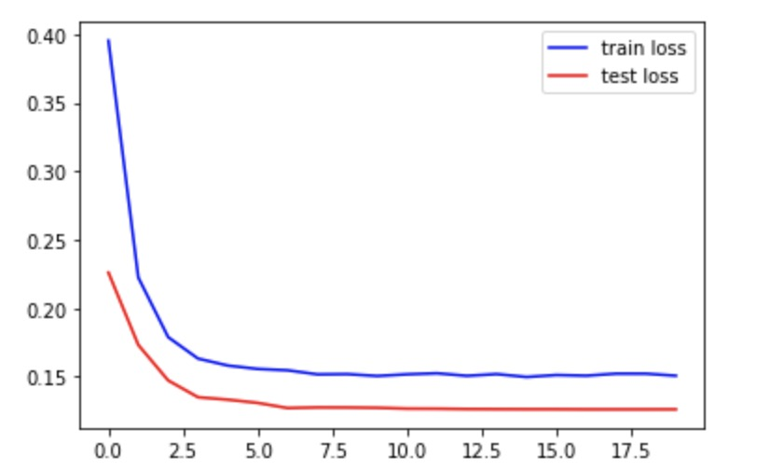
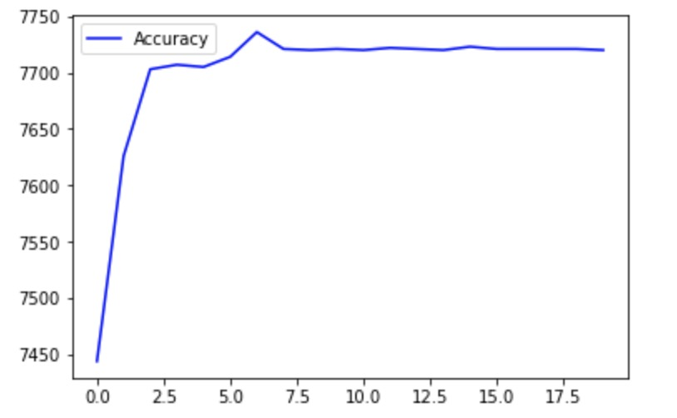
accuracy
loss
Epoch
Epoch

Slide 103
Epoch1:
Test set: Average loss: 0.2708, Accuracy: 7211/8141 (89%), Positive accuracy: 3730/4091 (91%), Negative accuracy: 3481/4050 (86%), f1 score: 0.8864, Train loss: 0.4360
Epoch2:
Test set: Average loss: 0.2041, Accuracy: 7468/8141 (92%), Positive accuracy: 3788/4091 (93%), Negative accuracy: 3680/4050 (91%), f1 score: 0.9174, Train loss: 0.2778
Epoch3
Test set: Average loss: 0.1686, Accuracy: 7587/8141 (93%), Positive accuracy: 3838/4091 (94%), Negative accuracy: 3749/4050 (93%), f1 score: 0.9320, Train loss: 0.2225
Epoch4:
Test set: Average loss: 0.1543, Accuracy: 7640/8141 (94%), Positive accuracy: 3861/4091 (94%), Negative accuracy: 3779/4050 (93%), f1 score: 0.9385, Train loss: 0.1927
Epoch5:
Test set: Average loss: 0.1459, Accuracy: 7661/8141 (94%), Positive accuracy: 3850/4091 (94%), Negative accuracy: 3811/4050 (94%), f1 score: 0.9410, Train loss: 0.1794
Epoch6:
Test set: Average loss: 0.1413, Accuracy: 7678/8141 (94%), Positive accuracy: 3847/4091 (94%), Negative accuracy: 3831/4050 (95%), f1 score: 0.9431, Train loss: 0.1725
Epoch7:
Test set: Average loss: 0.1377, Accuracy: 7687/8141 (94%), Positive accuracy: 3856/4091 (94%), Negative accuracy: 3831/4050 (95%), f1 score: 0.9442, Train loss: 0.1681
Epoch8:
Test set: Average loss: 0.1367, Accuracy: 7693/8141 (94%), Positive accuracy: 3864/4091 (94%), Negative accuracy: 3829/4050 (95%), f1 score: 0.9450, Train loss: 0.1657
Epoch9:
Test set: Average loss: 0.1349, Accuracy: 7700/8141 (95%), Positive accuracy: 3861/4091 (94%), Negative accuracy: 3839/4050 (95%), f1 score: 0.9458, Train loss: 0.1629
Epoch10:
Test set: Average loss: 0.1347, Accuracy: 7689/8141 (94%), Positive accuracy: 3846/4091 (94%), Negative accuracy: 3843/4050 (95%), f1 score: 0.9445, Train loss: 0.1630
2 layers of Convolution,
channels are 32, 64, filter size is 5
2 layers of fully connected with 1600, 512
Notes:
Test set: Average loss: 0.1347, Accuracy: 7689/8141 (94%), Positive accuracy: 3846/4091 (94%), Negative accuracy: 3843/4050 (95%), f1 score: 0.9445, Train loss: 0.1630

Slide 104
Epoch11:
Test set: Average loss: 0.1349, Accuracy: 7692/8141 (94%), Positive accuracy: 3842/4091 (94%), Negative accuracy: 3850/4050 (95%), f1 score: 0.9449, Train loss: 0.1627
Epoch12:
Test set: Average loss: 0.1338, Accuracy: 7697/8141 (95%), Positive accuracy: 3852/4091 (94%), Negative accuracy: 3845/4050 (95%), f1 score: 0.9455, Train loss: 0.1620
Epoch13
Test set: Average loss: 0.1336, Accuracy: 7697/8141 (95%), Positive accuracy: 3852/4091 (94%), Negative accuracy: 3845/4050 (95%), f1 score: 0.9455, Train loss: 0.1601
Epoch14:
Test set: Average loss: 0.1334, Accuracy: 7695/8141 (95%), Positive accuracy: 3853/4091 (94%), Negative accuracy: 3842/4050 (95%), f1 score: 0.9452, Train loss: 0.1611
Epoch15:
Test set: Average loss: 0.1332, Accuracy: 7697/8141 (95%), Positive accuracy: 3855/4091 (94%), Negative accuracy: 3842/4050 (95%), f1 score: 0.9455, Train loss: 0.1618
Epoch16:
Test set: Average loss: 0.1332, Accuracy: 7697/8141 (95%), Positive accuracy: 3852/4091 (94%), Negative accuracy: 3845/4050 (95%), f1 score: 0.9455, Train loss: 0.1622
Epoch17:
Test set: Average loss: 0.1331, Accuracy: 7699/8141 (95%), Positive accuracy: 3854/4091 (94%), Negative accuracy: 3845/4050 (95%), f1 score: 0.9457, Train loss: 0.1604
Epoch18:
Test set: Average loss: 0.1330, Accuracy: 7699/8141 (95%), Positive accuracy: 3854/4091 (94%), Negative accuracy: 3845/4050 (95%), f1 score: 0.9457, Train loss: 0.1613
Epoch19:
Test set: Average loss: 0.1330, Accuracy: 7699/8141 (95%), Positive accuracy: 3854/4091 (94%), Negative accuracy: 3845/4050 (95%), f1 score: 0.9457, Train loss: 0.1596
Epoch20:
Test set: Average loss: 0.1329, Accuracy: 7700/8141 (95%), Positive accuracy: 3855/4091 (94%), Negative accuracy: 3845/4050 (95%), f1 score: 0.9458, Train loss: 0.1610
2 layers of Convolution,
channels are 32, 64, filter size is 5
2 layers of fully connected with 1600, 512
Notes:
Test set: Average loss: 0.1329, Accuracy: 7700/8141 (95%), Positive accuracy: 3855/4091 (94%), Negative accuracy: 3845/4050 (95%), f1 score: 0.9458, Train loss: 0.1610

Slide 105
Epoch1:
Test set: Average loss: 0.2793, Accuracy: 7199/8141 (88%), Positive accuracy: 3767/4091 (92%), Negative accuracy: 3432/4050 (85%), f1 score: 0.8856, Train loss: 0.4553
Epoch2:
Test set: Average loss: 0.2142, Accuracy: 7460/8141 (92%), Positive accuracy: 3792/4091 (93%), Negative accuracy: 3668/4050 (91%), f1 score: 0.9165, Train loss: 0.2900
Epoch3
Test set: Average loss: 0.1738, Accuracy: 7605/8141 (93%), Positive accuracy: 3882/4091 (95%), Negative accuracy: 3723/4050 (92%), f1 score: 0.9344, Train loss: 0.2339
Epoch4:
Test set: Average loss: 0.1583, Accuracy: 7648/8141 (94%), Positive accuracy: 3893/4091 (95%), Negative accuracy: 3755/4050 (93%), f1 score: 0.9396, Train loss: 0.2060
Epoch5:
Test set: Average loss: 0.1546, Accuracy: 7649/8141 (94%), Positive accuracy: 3845/4091 (94%), Negative accuracy: 3804/4050 (94%), f1 score: 0.9396, Train loss: 0.1953
Epoch6:
Test set: Average loss: 0.1527, Accuracy: 7667/8141 (94%), Positive accuracy: 3823/4091 (93%), Negative accuracy: 3844/4050 (95%), f1 score: 0.9418, Train loss: 0.1878
Epoch7:
Test set: Average loss: 0.1487, Accuracy: 7671/8141 (94%), Positive accuracy: 3832/4091 (94%), Negative accuracy: 3839/4050 (95%), f1 score: 0.9423, Train loss: 0.1836
Epoch8:
Test set: Average loss: 0.1481, Accuracy: 7671/8141 (94%), Positive accuracy: 3827/4091 (94%), Negative accuracy: 3844/4050 (95%), f1 score: 0.9423, Train loss: 0.1818
Epoch9:
Test set: Average loss: 0.1483, Accuracy: 7672/8141 (94%), Positive accuracy: 3812/4091 (93%), Negative accuracy: 3860/4050 (95%), f1 score: 0.9425, Train loss: 0.1797
Epoch10:
Test set: Average loss: 0.1470, Accuracy: 7673/8141 (94%), Positive accuracy: 3815/4091 (93%), Negative accuracy: 3858/4050 (95%), f1 score: 0.9426, Train loss: 0.1799
2 layers of Convolution,
channels are 32, 64, filter size is 7
2 layers of fully connected with 576, 128
Notes:
Test set: Average loss: 0.1470, Accuracy: 7673/8141 (94%), Positive accuracy: 3815/4091 (93%), Negative accuracy: 3858/4050 (95%), f1 score: 0.9426, Train loss: 0.1799

Slide 106
Epoch11:
Test set: Average loss: 0.1470, Accuracy: 7674/8141 (94%), Positive accuracy: 3820/4091 (93%), Negative accuracy: 3854/4050 (95%), f1 score: 0.9427, Train loss: 0.1790
Epoch12:
Test set: Average loss: 0.1464, Accuracy: 7673/8141 (94%), Positive accuracy: 3819/4091 (93%), Negative accuracy: 3854/4050 (95%), f1 score: 0.9426, Train loss: 0.1784
Epoch13
Test set: Average loss: 0.1462, Accuracy: 7673/8141 (94%), Positive accuracy: 3819/4091 (93%), Negative accuracy: 3854/4050 (95%), f1 score: 0.9426, Train loss: 0.1777
Epoch14:
Test set: Average loss: 0.1464, Accuracy: 7672/8141 (94%), Positive accuracy: 3817/4091 (93%), Negative accuracy: 3855/4050 (95%), f1 score: 0.9424, Train loss: 0.1779
Epoch15:
Test set: Average loss: 0.1458, Accuracy: 7678/8141 (94%), Positive accuracy: 3824/4091 (93%), Negative accuracy: 3854/4050 (95%), f1 score: 0.9432, Train loss: 0.1783
Epoch16:
Test set: Average loss: 0.1457, Accuracy: 7678/8141 (94%), Positive accuracy: 3824/4091 (93%), Negative accuracy: 3854/4050 (95%), f1 score: 0.9432, Train loss: 0.1786
Epoch17:
Test set: Average loss: 0.1458, Accuracy: 7676/8141 (94%), Positive accuracy: 3822/4091 (93%), Negative accuracy: 3854/4050 (95%), f1 score: 0.9429, Train loss: 0.1774
Epoch18:
Test set: Average loss: 0.1459, Accuracy: 7675/8141 (94%), Positive accuracy: 3821/4091 (93%), Negative accuracy: 3854/4050 (95%), f1 score: 0.9428, Train loss: 0.1771
Epoch19:
Test set: Average loss: 0.1458, Accuracy: 7676/8141 (94%), Positive accuracy: 3822/4091 (93%), Negative accuracy: 3854/4050 (95%), f1 score: 0.9429, Train loss: 0.1773
Epoch20:
Test set: Average loss: 0.1329, Accuracy: 7700/8141 (95%), Positive accuracy: 3855/4091 (94%), Negative accuracy: 3845/4050 (95%), f1 score: 0.9458, Train loss: 0.1610
2 layers of Convolution,
channels are 32, 64, filter size is 7
2 layers of fully connected with 576, 128
Notes:
Test set: Average loss: 0.1458, Accuracy: 7676/8141 (94%), Positive accuracy: 3822/4091 (93%), Negative accuracy: 3854/4050 (95%), f1 score: 0.9429, Train loss: 0.1773

Slide 107
Epoch1:
Test set: Average loss: 0.2800, Accuracy: 7184/8141 (88%), Positive accuracy: 3726/4091 (91%), Negative accuracy: 3458/4050 (85%), f1 score: 0.8832, Train loss: 0.4445
Epoch2:
Test set: Average loss: 0.2297, Accuracy: 7401/8141 (91%), Positive accuracy: 3801/4091 (93%), Negative accuracy: 3600/4050 (89%), f1 score: 0.9095, Train loss: 0.2926
Epoch3
Test set: Average loss: 0.1860, Accuracy: 7541/8141 (93%), Positive accuracy: 3821/4091 (93%), Negative accuracy: 3720/4050 (92%), f1 score: 0.9264, Train loss: 0.2379
Epoch4:
Test set: Average loss: 0.1628, Accuracy: 7610/8141 (93%), Positive accuracy: 3829/4091 (94%), Negative accuracy: 3781/4050 (93%), f1 score: 0.9348, Train loss: 0.2040
Epoch5:
Test set: Average loss: 0.1544, Accuracy: 7625/8141 (94%), Positive accuracy: 3809/4091 (93%), Negative accuracy: 3816/4050 (94%), f1 score: 0.9366, Train loss: 0.1885
Epoch6:
Test set: Average loss: 0.1495, Accuracy: 7643/8141 (94%), Positive accuracy: 3808/4091 (93%), Negative accuracy: 3835/4050 (95%), f1 score: 0.9389, Train loss: 0.1797
Epoch7:
Test set: Average loss: 0.1454, Accuracy: 7650/8141 (94%), Positive accuracy: 3817/4091 (93%), Negative accuracy: 3833/4050 (95%), f1 score: 0.9397, Train loss: 0.1774
Epoch8:
Test set: Average loss: 0.1432, Accuracy: 7658/8141 (94%), Positive accuracy: 3818/4091 (93%), Negative accuracy: 3840/4050 (95%), f1 score: 0.9407, Train loss: 0.1743
Epoch9:
Test set: Average loss: 0.1430, Accuracy: 7650/8141 (94%), Positive accuracy: 3803/4091 (93%), Negative accuracy: 3847/4050 (95%), f1 score: 0.9397, Train loss: 0.1709
Epoch10:
Test set: Average loss: 0.1411, Accuracy: 7664/8141 (94%), Positive accuracy: 3821/4091 (93%), Negative accuracy: 3843/4050 (95%), f1 score: 0.9414, Train loss: 0.1702
3 layers of Convolution,
channels are 32, 64, 128, filter size is 3
2 layers of fully connected with 4608, 128
Notes:
Test set: Average loss: 0.1411, Accuracy: 7664/8141 (94%), Positive accuracy: 3821/4091 (93%), Negative accuracy: 3843/4050 (95%), f1 score: 0.9414, Train loss: 0.1702

Slide 108
Epoch11:
Test set: Average loss: 0.1420, Accuracy: 7660/8141 (94%), Positive accuracy: 3801/4091 (93%), Negative accuracy: 3859/4050 (95%), f1 score: 0.9410, Train loss: 0.1691
Epoch12:
Test set: Average loss: 0.1415, Accuracy: 7662/8141 (94%), Positive accuracy: 3801/4091 (93%), Negative accuracy: 3861/4050 (95%), f1 score: 0.9413, Train loss: 0.1682
Epoch13
Test set: Average loss: 0.1407, Accuracy: 7668/8141 (94%), Positive accuracy: 3811/4091 (93%), Negative accuracy: 3857/4050 (95%), f1 score: 0.9420, Train loss: 0.1693
Epoch14:
Test set: Average loss: 0.1402, Accuracy: 7667/8141 (94%), Positive accuracy: 3813/4091 (93%), Negative accuracy: 3854/4050 (95%), f1 score: 0.9418, Train loss: 0.1676
Epoch15:
Test set: Average loss: 0.1410, Accuracy: 7665/8141 (94%), Positive accuracy: 3803/4091 (93%), Negative accuracy: 3862/4050 (95%), f1 score: 0.9416, Train loss: 0.1699
Epoch16:
Test set: Average loss: 0.1411, Accuracy: 7662/8141 (94%), Positive accuracy: 3800/4091 (93%), Negative accuracy: 3862/4050 (95%), f1 score: 0.9413, Train loss: 0.1668
Epoch17:
Test set: Average loss: 0.1410, Accuracy: 7664/8141 (94%), Positive accuracy: 3802/4091 (93%), Negative accuracy: 3862/4050 (95%), f1 score: 0.9415, Train loss: 0.1700
Epoch18:
Test set: Average loss: 0.1407, Accuracy: 7667/8141 (94%), Positive accuracy: 3805/4091 (93%), Negative accuracy: 3862/4050 (95%), f1 score: 0.9419, Train loss: 0.1682
Epoch19:
Test set: Average loss: 0.1407, Accuracy: 7667/8141 (94%), Positive accuracy: 3805/4091 (93%), Negative accuracy: 3862/4050 (95%), f1 score: 0.9419, Train loss: 0.1689
Epoch20:
Test set: Average loss: 0.1406, Accuracy: 7667/8141 (94%), Positive accuracy: 3806/4091 (93%), Negative accuracy: 3861/4050 (95%), f1 score: 0.9419, Train loss: 0.1677
3 layers of Convolution,
channels are 32, 64, 128, filter size is 3
2 layers of fully connected with 4608, 128
Notes:
Test set: Average loss: 0.1406, Accuracy: 7667/8141 (94%), Positive accuracy: 3806/4091 (93%), Negative accuracy: 3861/4050 (95%), f1 score: 0.9419, Train loss: 0.1677

Slide 109
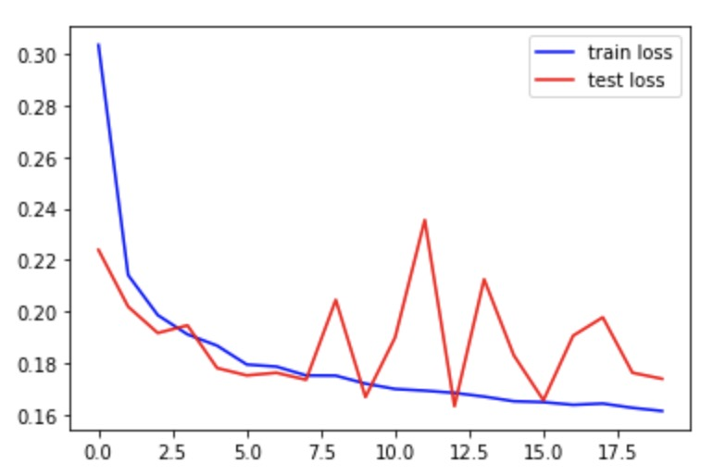
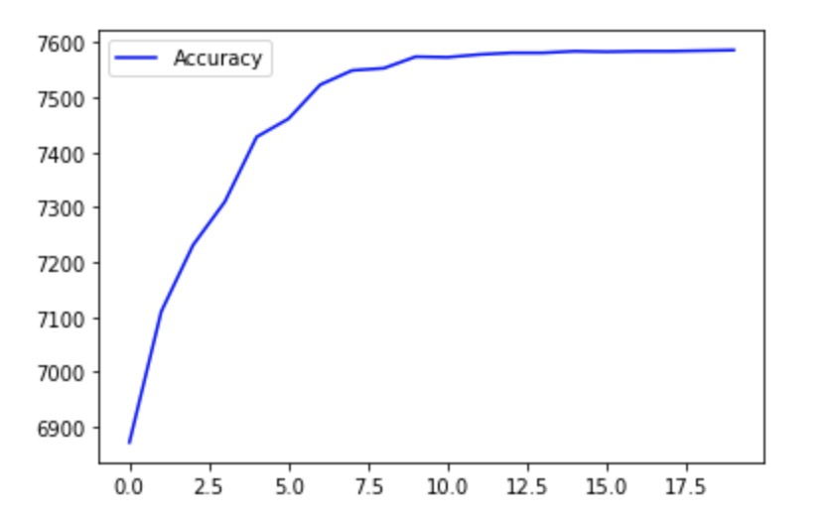
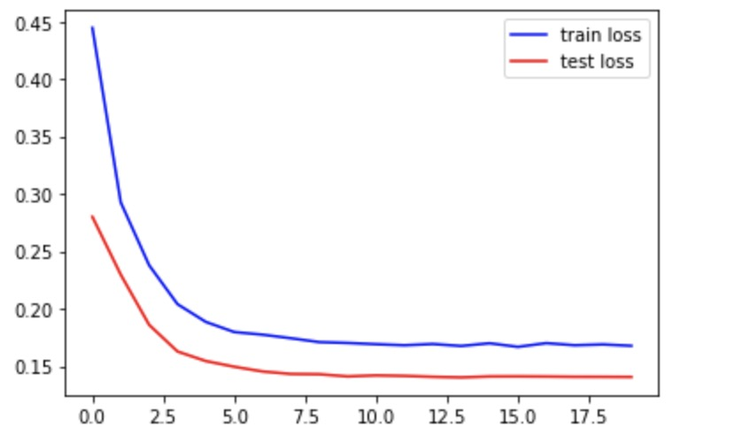
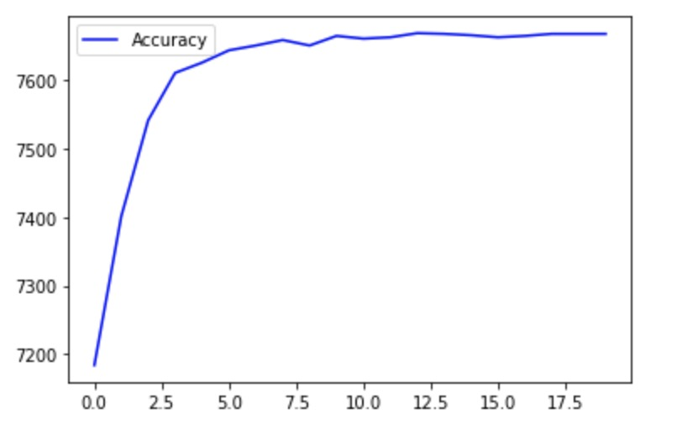
Accuracy
loss
Epoch
Epoch

Slide 110
Epoch1:
Test set: Average loss: 0.2868, Accuracy: 7170/8141 (88%), Positive accuracy: 3956/4091 (97%), Negative accuracy: 3214/4050 (79%), f1 score: 0.8876, Train loss: 0.4414
Epoch2:
Test set: Average loss: 0.1605, Accuracy: 7627/8141 (94%), Positive accuracy: 3838/4091 (94%), Negative accuracy: 3789/4050 (94%), f1 score: 0.9369, Train loss: 0.2489
Epoch3
Test set: Average loss: 0.1695, Accuracy: 7597/8141 (93%), Positive accuracy: 3672/4091 (90%), Negative accuracy: 3925/4050 (97%), f1 score: 0.9342, Train loss: 0.1806
Epoch4:
Test set: Average loss: 0.1330, Accuracy: 7718/8141 (95%), Positive accuracy: 3879/4091 (95%), Negative accuracy: 3839/4050 (95%), f1 score: 0.9480, Train loss: 0.1641
Epoch5:
Test set: Average loss: 0.1452, Accuracy: 7664/8141 (94%), Positive accuracy: 3737/4091 (91%), Negative accuracy: 3927/4050 (97%), f1 score: 0.9420, Train loss: 0.1555
Epoch6:
Test set: Average loss: 0.1311, Accuracy: 7710/8141 (95%), Positive accuracy: 3828/4091 (94%), Negative accuracy: 3882/4050 (96%), f1 score: 0.9471, Train loss: 0.1508
Epoch7:
Test set: Average loss: 0.1313, Accuracy: 7710/8141 (95%), Positive accuracy: 3807/4091 (93%), Negative accuracy: 3903/4050 (96%), f1 score: 0.9472, Train loss: 0.1492
Epoch8:
Test set: Average loss: 0.1326, Accuracy: 7701/8141 (95%), Positive accuracy: 3794/4091 (93%), Negative accuracy: 3907/4050 (96%), f1 score: 0.9462, Train loss: 0.1455
Epoch9:
Test set: Average loss: 0.1334, Accuracy: 7703/8141 (95%), Positive accuracy: 3785/4091 (93%), Negative accuracy: 3918/4050 (97%), f1 score: 0.9465, Train loss: 0.1457
Epoch10:
Test set: Average loss: 0.1339, Accuracy: 7701/8141 (95%), Positive accuracy: 3784/4091 (92%), Negative accuracy: 3917/4050 (97%), f1 score: 0.9463, Train loss: 0.1450
3 layers of Convolution,
channels are 32, 64,128 filter size is 5
2 layers of fully connected with 1152, 128
Notes:
Test set: Average loss: 0.1339, Accuracy: 7701/8141 (95%), Positive accuracy: 3784/4091 (92%), Negative accuracy: 3917/4050 (97%), f1 score: 0.9463, Train loss: 0.1450

Slide 111
Epoch11:
Test set: Average loss: 0.1324, Accuracy: 7708/8141 (95%), Positive accuracy: 3791/4091 (93%), Negative accuracy: 3917/4050 (97%), f1 score: 0.9471, Train loss: 0.1436
Epoch12:
Test set: Average loss: 0.1314, Accuracy: 7709/8141 (95%), Positive accuracy: 3799/4091 (93%), Negative accuracy: 3910/4050 (97%), f1 score: 0.9472, Train loss: 0.1449
Epoch13
Test set: Average loss: 0.1301, Accuracy: 7713/8141 (95%), Positive accuracy: 3811/4091 (93%), Negative accuracy: 3902/4050 (96%), f1 score: 0.9476, Train loss: 0.1431
Epoch14:
Test set: Average loss: 0.1300, Accuracy: 7714/8141 (95%), Positive accuracy: 3812/4091 (93%), Negative accuracy: 3902/4050 (96%), f1 score: 0.9477, Train loss: 0.1433
Epoch15:
Test set: Average loss: 0.1290, Accuracy: 7721/8141 (95%), Positive accuracy: 3821/4091 (93%), Negative accuracy: 3900/4050 (96%), f1 score: 0.9485, Train loss: 0.1439
Epoch16:
Test set: Average loss: 0.1300, Accuracy: 7712/8141 (95%), Positive accuracy: 3810/4091 (93%), Negative accuracy: 3902/4050 (96%), f1 score: 0.9475, Train loss: 0.1430
Epoch17:
Test set: Average loss: 0.1307, Accuracy: 7710/8141 (95%), Positive accuracy: 3802/4091 (93%), Negative accuracy: 3908/4050 (96%), f1 score: 0.9473, Train loss: 0.1430
Epoch18:
Test set: Average loss: 0.1302, Accuracy: 7712/8141 (95%), Positive accuracy: 3808/4091 (93%), Negative accuracy: 3904/4050 (96%), f1 score: 0.9475, Train loss: 0.1440
Epoch19:
Test set: Average loss: 0.1292, Accuracy: 7717/8141 (95%), Positive accuracy: 3816/4091 (93%), Negative accuracy: 3901/4050 (96%), f1 score: 0.9481, Train loss: 0.1425
Epoch20:
Test set: Average loss: 0.1299, Accuracy: 7713/8141 (95%), Positive accuracy: 3811/4091 (93%), Negative accuracy: 3902/4050 (96%), f1 score: 0.9476, Train loss: 0.1426
3 layers of Convolution,
channels are 32, 64,128 filter size is 5
2 layers of fully connected with 1152, 128
Notes:
Test set: Average loss: 0.1299, Accuracy: 7713/8141 (95%), Positive accuracy: 3811/4091 (93%), Negative accuracy: 3902/4050 (96%), f1 score: 0.9476, Train loss: 0.1426

Slide 112
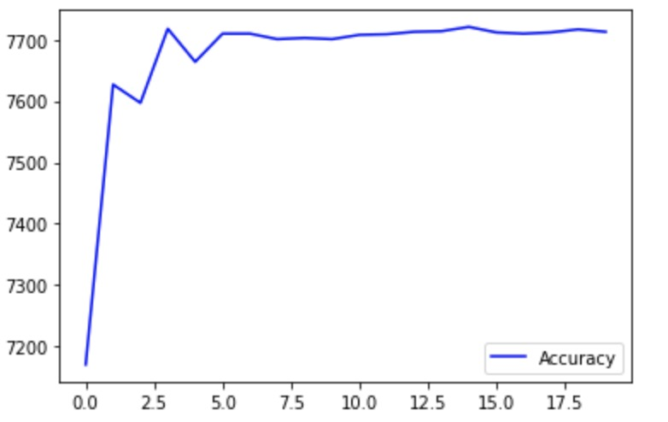
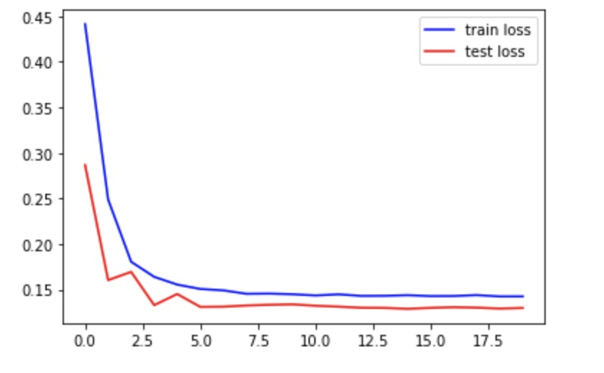

Slide 113
Epoch1:
Test set: Average loss: 0.3196, Accuracy: 7066/8141 (87%), Positive accuracy: 3752/4091 (92%), Negative accuracy: 3314/4050 (82%), f1 score: 0.8701, Train loss: 0.5157
Epoch2:
Test set: Average loss: 0.1984, Accuracy: 7494/8141 (92%), Positive accuracy: 3957/4091 (97%), Negative accuracy: 3537/4050 (87%), f1 score: 0.9227, Train loss: 0.3116
Epoch3
Test set: Average loss: 0.1528, Accuracy: 7649/8141 (94%), Positive accuracy: 3867/4091 (95%), Negative accuracy: 3782/4050 (93%), f1 score: 0.9396, Train loss: 0.2131
Epoch4:
Test set: Average loss: 0.1402, Accuracy: 7706/8141 (95%), Positive accuracy: 3879/4091 (95%), Negative accuracy: 3827/4050 (94%), f1 score: 0.9466, Train loss: 0.1801
Epoch5:
Test set: Average loss: 0.1471, Accuracy: 7664/8141 (94%), Positive accuracy: 3763/4091 (92%), Negative accuracy: 3901/4050 (96%), f1 score: 0.9418, Train loss: 0.1679
Epoch6:
Test set: Average loss: 0.1467, Accuracy: 7672/8141 (94%), Positive accuracy: 3749/4091 (92%), Negative accuracy: 3923/4050 (97%), f1 score: 0.9429, Train loss: 0.1646
Epoch7:
Test set: Average loss: 0.1384, Accuracy: 7690/8141 (94%), Positive accuracy: 3793/4091 (93%), Negative accuracy: 3897/4050 (96%), f1 score: 0.9448, Train loss: 0.1588
Epoch8:
Test set: Average loss: 0.1377, Accuracy: 7699/8141 (95%), Positive accuracy: 3792/4091 (93%), Negative accuracy: 3907/4050 (96%), f1 score: 0.9460, Train loss: 0.1569
Epoch9:
Test set: Average loss: 0.1343, Accuracy: 7704/8141 (95%), Positive accuracy: 3805/4091 (93%), Negative accuracy: 3899/4050 (96%), f1 score: 0.9465, Train loss: 0.1557
Epoch10:
Test set: Average loss: 0.1373, Accuracy: 7702/8141 (95%), Positive accuracy: 3789/4091 (93%), Negative accuracy: 3913/4050 (97%), f1 score: 0.9464, Train loss: 0.1538
3 layers of Convolution,
channels are 32, 64,128 filter size is 5
3 layers of fully connected with 1152, 400,128
Notes:
Test set: Average loss: 0.1373, Accuracy: 7702/8141 (95%), Positive accuracy: 3789/4091 (93%), Negative accuracy: 3913/4050 (97%), f1 score: 0.9464, Train loss: 0.1538

Slide 114
Epoch11:
Test set: Average loss: 0.1335, Accuracy: 7710/8141 (95%), Positive accuracy: 3809/4091 (93%), Negative accuracy: 3901/4050 (96%), f1 score: 0.9472, Train loss: 0.1535
Epoch12:
Test set: Average loss: 0.1359, Accuracy: 7704/8141 (95%), Positive accuracy: 3795/4091 (93%), Negative accuracy: 3909/4050 (97%), f1 score: 0.9466, Train loss: 0.1531
Epoch13
Test set: Average loss: 0.1360, Accuracy: 7704/8141 (95%), Positive accuracy: 3794/4091 (93%), Negative accuracy: 3910/4050 (97%), f1 score: 0.9466, Train loss: 0.1525
Epoch14:
Test set: Average loss: 0.1368, Accuracy: 7706/8141 (95%), Positive accuracy: 3790/4091 (93%), Negative accuracy: 3916/4050 (97%), f1 score: 0.9469, Train loss: 0.1526
Epoch15:
Test set: Average loss: 0.1354, Accuracy: 7702/8141 (95%), Positive accuracy: 3795/4091 (93%), Negative accuracy: 3907/4050 (96%), f1 score: 0.9463, Train loss: 0.1523
Epoch16:
Test set: Average loss: 0.1348, Accuracy: 7703/8141 (95%), Positive accuracy: 3797/4091 (93%), Negative accuracy: 3906/4050 (96%), f1 score: 0.9464, Train loss: 0.1521
Epoch17:
Test set: Average loss: 0.1347, Accuracy: 7703/8141 (95%), Positive accuracy: 3797/4091 (93%), Negative accuracy: 3906/4050 (96%), f1 score: 0.9464, Train loss: 0.1528
Epoch18:
Test set: Average loss: 0.1350, Accuracy: 7703/8141 (95%), Positive accuracy: 3797/4091 (93%), Negative accuracy: 3906/4050 (96%), f1 score: 0.9464, Train loss: 0.1526
Epoch19:
Test set: Average loss: 0.1350, Accuracy: 7703/8141 (95%), Positive accuracy: 3797/4091 (93%), Negative accuracy: 3906/4050 (96%), f1 score: 0.9464, Train loss: 0.1525
Epoch20:
Test set: Average loss: 0.1348, Accuracy: 7703/8141 (95%), Positive accuracy: 3797/4091 (93%), Negative accuracy: 3906/4050 (96%), f1 score: 0.9464, Train loss: 0.1519
3 layers of Convolution,
channels are 32, 64,128 filter size is 5
3 layers of fully connected with 1152, 400,128
Notes:
Test set: Average loss: 0.1348, Accuracy: 7703/8141 (95%), Positive accuracy: 3797/4091 (93%), Negative accuracy: 3906/4050 (96%), f1 score: 0.9464, Train loss: 0.1519

Slide 115
Epoch1:
Test set: Average loss: 0.3477, Accuracy: 6876/8141 (84%), Positive accuracy: 3539/4091 (87%), Negative accuracy: 3337/4050 (82%), f1 score: 0.8450, Train loss: 0.5066
Epoch2:
Test set: Average loss: 0.2926, Accuracy: 7128/8141 (88%), Positive accuracy: 3743/4091 (91%), Negative accuracy: 3385/4050 (84%), f1 score: 0.8770, Train loss: 0.3706
Epoch3
Test set: Average loss: 0.2464, Accuracy: 7321/8141 (90%), Positive accuracy: 3889/4091 (95%), Negative accuracy: 3432/4050 (85%), f1 score: 0.9018, Train loss: 0.3168
Epoch4:
Test set: Average loss: 0.2155, Accuracy: 7478/8141 (92%), Positive accuracy: 3847/4091 (94%), Negative accuracy: 3631/4050 (90%), f1 score: 0.9191, Train loss: 0.2699
Epoch5:
Test set: Average loss: 0.1937, Accuracy: 7533/8141 (93%), Positive accuracy: 3873/4091 (95%), Negative accuracy: 3660/4050 (90%), f1 score: 0.9258, Train loss: 0.2407
Epoch6:
Test set: Average loss: 0.1840, Accuracy: 7562/8141 (93%), Positive accuracy: 3838/4091 (94%), Negative accuracy: 3724/4050 (92%), f1 score: 0.9290, Train loss: 0.2233
Epoch7:
Test set: Average loss: 0.1754, Accuracy: 7584/8141 (93%), Positive accuracy: 3843/4091 (94%), Negative accuracy: 3741/4050 (92%), f1 score: 0.9317, Train loss: 0.2114
Epoch8:
Test set: Average loss: 0.1707, Accuracy: 7591/8141 (93%), Positive accuracy: 3844/4091 (94%), Negative accuracy: 3747/4050 (93%), f1 score: 0.9325, Train loss: 0.2066
Epoch9:
Test set: Average loss: 0.1672, Accuracy: 7603/8141 (93%), Positive accuracy: 3845/4091 (94%), Negative accuracy: 3758/4050 (93%), f1 score: 0.9340, Train loss: 0.2014
Epoch10:
Test set: Average loss: 0.1656, Accuracy: 7605/8141 (93%), Positive accuracy: 3836/4091 (94%), Negative accuracy: 3769/4050 (93%), f1 score: 0.9342, Train loss: 0.1984
3 layers of Convolution,
channels are 16,32, 64, filter size is 3
2 layers of fully connected with 2304, 128
Notes:
Test set: Average loss: 0.1656, Accuracy: 7605/8141 (93%), Positive accuracy: 3836/4091 (94%), Negative accuracy: 3769/4050 (93%), f1 score: 0.9342, Train loss: 0.1984

Slide 116
Epoch11:
Test set: Average loss: 0.1643, Accuracy: 7604/8141 (93%), Positive accuracy: 3832/4091 (94%), Negative accuracy: 3772/4050 (93%), f1 score: 0.9341, Train loss: 0.1957
Epoch12:
Test set: Average loss: 0.1635, Accuracy: 7611/8141 (93%), Positive accuracy: 3836/4091 (94%), Negative accuracy: 3775/4050 (93%), f1 score: 0.9349, Train loss: 0.1963
Epoch13
Test set: Average loss: 0.1627, Accuracy: 7609/8141 (93%), Positive accuracy: 3835/4091 (94%), Negative accuracy: 3774/4050 (93%), f1 score: 0.9347, Train loss: 0.1958
Epoch14:
Test set: Average loss: 0.1622, Accuracy: 7611/8141 (93%), Positive accuracy: 3836/4091 (94%), Negative accuracy: 3775/4050 (93%), f1 score: 0.9349, Train loss: 0.1939
Epoch15:
Test set: Average loss: 0.1621, Accuracy: 7615/8141 (94%), Positive accuracy: 3834/4091 (94%), Negative accuracy: 3781/4050 (93%), f1 score: 0.9354, Train loss: 0.1942
Epoch16:
Test set: Average loss: 0.1619, Accuracy: 7616/8141 (94%), Positive accuracy: 3835/4091 (94%), Negative accuracy: 3781/4050 (93%), f1 score: 0.9355, Train loss: 0.1937
Epoch17:
Test set: Average loss: 0.1618, Accuracy: 7615/8141 (94%), Positive accuracy: 3834/4091 (94%), Negative accuracy: 3781/4050 (93%), f1 score: 0.9354, Train loss: 0.1943
Epoch18:
Test set: Average loss: 0.1616, Accuracy: 7615/8141 (94%), Positive accuracy: 3834/4091 (94%), Negative accuracy: 3781/4050 (93%), f1 score: 0.9354, Train loss: 0.1925
Epoch19:
Test set: Average loss: 0.1616, Accuracy: 7615/8141 (94%), Positive accuracy: 3834/4091 (94%), Negative accuracy: 3781/4050 (93%), f1 score: 0.9354, Train loss: 0.1933
Epoch20:
Test set: Average loss: 0.1615, Accuracy: 7615/8141 (94%), Positive accuracy: 3834/4091 (94%), Negative accuracy: 3781/4050 (93%), f1 score: 0.9354, Train loss: 0.1925
3 layers of Convolution,
channels are 16,32, 64, filter size is 3
2 layers of fully connected with 2304, 128
Notes:
Test set: Average loss: 0.1615, Accuracy: 7615/8141 (94%), Positive accuracy: 3834/4091 (94%), Negative accuracy: 3781/4050 (93%), f1 score: 0.9354, Train loss: 0.1925

Slide 117
Epoch1:
Test set: Average loss: 0.3334, Accuracy: 6928/8141 (85%), Positive accuracy: 3745/4091 (92%), Negative accuracy: 3183/4050 (79%), f1 score: 0.8546, Train loss: 0.4907
Epoch2:
Test set: Average loss: 0.2491, Accuracy: 7270/8141 (89%), Positive accuracy: 3789/4091 (93%), Negative accuracy: 3481/4050 (86%), f1 score: 0.8941, Train loss: 0.3356
Epoch3
Test set: Average loss: 0.1779, Accuracy: 7569/8141 (93%), Positive accuracy: 3988/4091 (97%), Negative accuracy: 3581/4050 (88%), f1 score: 0.9318, Train loss: 0.2432
Epoch4:
Test set: Average loss: 0.1357, Accuracy: 7710/8141 (95%), Positive accuracy: 3912/4091 (96%), Negative accuracy: 3798/4050 (94%), f1 score: 0.9472, Train loss: 0.1806
Epoch5:
Test set: Average loss: 0.1305, Accuracy: 7705/8141 (95%), Positive accuracy: 3886/4091 (95%), Negative accuracy: 3819/4050 (94%), f1 score: 0.9465, Train loss: 0.1614
Epoch6:
Test set: Average loss: 0.1276, Accuracy: 7720/8141 (95%), Positive accuracy: 3881/4091 (95%), Negative accuracy: 3839/4050 (95%), f1 score: 0.9483, Train loss: 0.1569
Epoch7:
Test set: Average loss: 0.1249, Accuracy: 7730/8141 (95%), Positive accuracy: 3899/4091 (95%), Negative accuracy: 3831/4050 (95%), f1 score: 0.9495, Train loss: 0.1511
Epoch8:
Test set: Average loss: 0.1235, Accuracy: 7734/8141 (95%), Positive accuracy: 3862/4091 (94%), Negative accuracy: 3872/4050 (96%), f1 score: 0.9500, Train loss: 0.1514
Epoch9:
Test set: Average loss: 0.1229, Accuracy: 7736/8141 (95%), Positive accuracy: 3877/4091 (95%), Negative accuracy: 3859/4050 (95%), f1 score: 0.9502, Train loss: 0.1509
Epoch10:
Test set: Average loss: 0.1226, Accuracy: 7731/8141 (95%), Positive accuracy: 3883/4091 (95%), Negative accuracy: 3848/4050 (95%), f1 score: 0.9496, Train loss: 0.1495
4 layers of Convolution,
channels are 16,32, 64, 128, filter size is 3
2 layers of fully connected with 3200, 1024
Notes:
Test set: Average loss: 0.1226, Accuracy: 7731/8141 (95%), Positive accuracy: 3883/4091 (95%), Negative accuracy: 3848/4050 (95%), f1 score: 0.9496, Train loss: 0.1495

Slide 118
Epoch11:
Test set: Average loss: 0.1228, Accuracy: 7732/8141 (95%), Positive accuracy: 3867/4091 (95%), Negative accuracy: 3865/4050 (95%), f1 score: 0.9498, Train loss: 0.1486
Epoch12:
Test set: Average loss: 0.1225, Accuracy: 7730/8141 (95%), Positive accuracy: 3873/4091 (95%), Negative accuracy: 3857/4050 (95%), f1 score: 0.9495, Train loss: 0.1487
Epoch13
Test set: Average loss: 0.1229, Accuracy: 7730/8141 (95%), Positive accuracy: 3864/4091 (94%), Negative accuracy: 3866/4050 (95%), f1 score: 0.9495, Train loss: 0.1483
Epoch14:
Test set: Average loss: 0.1225, Accuracy: 7734/8141 (95%), Positive accuracy: 3870/4091 (95%), Negative accuracy: 3864/4050 (95%), f1 score: 0.9500, Train loss: 0.1480
Epoch15:
Test set: Average loss: 0.1224, Accuracy: 7734/8141 (95%), Positive accuracy: 3872/4091 (95%), Negative accuracy: 3862/4050 (95%), f1 score: 0.9500, Train loss: 0.1486
Epoch16:
Test set: Average loss: 0.1225, Accuracy: 7734/8141 (95%), Positive accuracy: 3870/4091 (95%), Negative accuracy: 3864/4050 (95%), f1 score: 0.9500, Train loss: 0.1480
Epoch17:
Test set: Average loss: 0.1225, Accuracy: 7734/8141 (95%), Positive accuracy: 3870/4091 (95%), Negative accuracy: 3864/4050 (95%), f1 score: 0.9500, Train loss: 0.1478
Epoch18:
Test set: Average loss: 0.1224, Accuracy: 7735/8141 (95%), Positive accuracy: 3871/4091 (95%), Negative accuracy: 3864/4050 (95%), f1 score: 0.9501, Train loss: 0.1474
Epoch19:
Test set: Average loss: 0.1223, Accuracy: 7734/8141 (95%), Positive accuracy: 3870/4091 (95%), Negative accuracy: 3864/4050 (95%), f1 score: 0.9500, Train loss: 0.1485
Epoch20:
Test set: Average loss: 0.1224, Accuracy: 7734/8141 (95%), Positive accuracy: 3870/4091 (95%), Negative accuracy: 3864/4050 (95%), f1 score: 0.9500, Train loss: 0.1473
4 layers of Convolution,
channels are 16,32, 64, 128, filter size is 3
2 layers of fully connected with 3200, 1024
Notes:
Test set: Average loss: 0.1224, Accuracy: 7734/8141 (95%), Positive accuracy: 3870/4091 (95%), Negative accuracy: 3864/4050 (95%), f1 score: 0.9500, Train loss: 0.1473

Slide 119
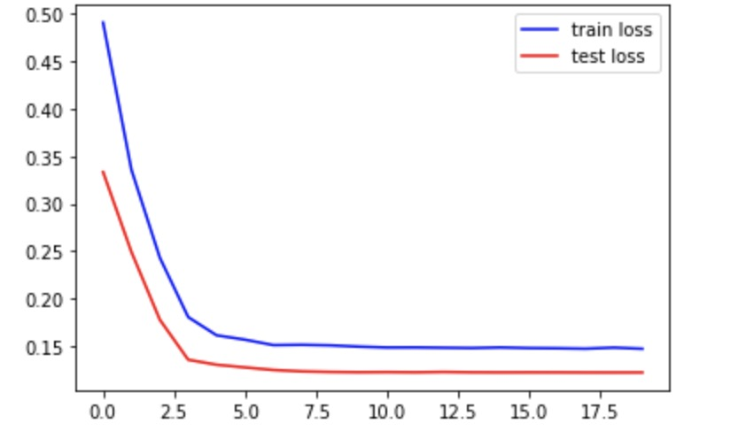
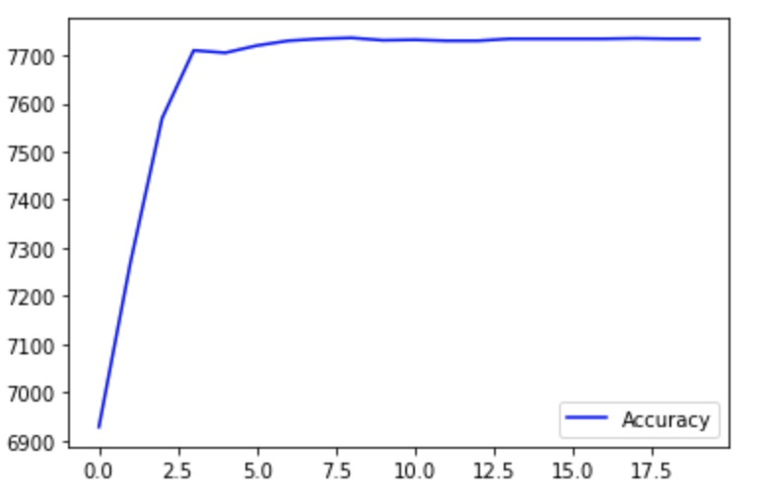
Notes:
竖轴：Loss

Slide 120
Epoch1:
Test set: Average loss: 0.3336, Accuracy: 6975/8141 (86%), Positive accuracy: 3514/4091 (86%), Negative accuracy: 3461/4050 (85%), f1 score: 0.8568, Train loss: 0.5551
Epoch2:
Test set: Average loss: 0.2174, Accuracy: 7443/8141 (91%), Positive accuracy: 3850/4091 (94%), Negative accuracy: 3593/4050 (89%), f1 score: 0.9150, Train loss: 0.3438
Epoch3
Test set: Average loss: 0.1414, Accuracy: 7681/8141 (94%), Positive accuracy: 3962/4091 (97%), Negative accuracy: 3719/4050 (92%), f1 score: 0.9442, Train loss: 0.2273
Epoch4:
Test set: Average loss: 0.1230, Accuracy: 7734/8141 (95%), Positive accuracy: 3904/4091 (95%), Negative accuracy: 3830/4050 (95%), f1 score: 0.9500, Train loss: 0.1776
Epoch5:
Test set: Average loss: 0.1225, Accuracy: 7739/8141 (95%), Positive accuracy: 3894/4091 (95%), Negative accuracy: 3845/4050 (95%), f1 score: 0.9506, Train loss: 0.1645
Epoch6:
Test set: Average loss: 0.1238, Accuracy: 7737/8141 (95%), Positive accuracy: 3841/4091 (94%), Negative accuracy: 3896/4050 (96%), f1 score: 0.9505, Train loss: 0.1613
Epoch7:
Test set: Average loss: 0.1199, Accuracy: 7742/8141 (95%), Positive accuracy: 3867/4091 (95%), Negative accuracy: 3875/4050 (96%), f1 score: 0.9510, Train loss: 0.1553
Epoch8:
Test set: Average loss: 0.1217, Accuracy: 7735/8141 (95%), Positive accuracy: 3859/4091 (94%), Negative accuracy: 3876/4050 (96%), f1 score: 0.9501, Train loss: 0.1565
Epoch9:
Test set: Average loss: 0.1210, Accuracy: 7738/8141 (95%), Positive accuracy: 3855/4091 (94%), Negative accuracy: 3883/4050 (96%), f1 score: 0.9505, Train loss: 0.1545
Epoch10:
Test set: Average loss: 0.1237, Accuracy: 7729/8141 (95%), Positive accuracy: 3822/4091 (93%), Negative accuracy: 3907/4050 (96%), f1 score: 0.9495, Train loss: 0.1539
4 layers of Convolution,
channels are 32, 64, 128, 256, filter size is 3
3 layers of fully connected with 6400, 1024,36
Notes:
Test set: Average loss: 0.1237, Accuracy: 7729/8141 (95%), Positive accuracy: 3822/4091 (93%), Negative accuracy: 3907/4050 (96%), f1 score: 0.9495, Train loss: 0.1539

Slide 121
Epoch1:
Test set: Average loss: 0.2699, Accuracy: 7186/8141 (88%), Positive accuracy: 3743/4091 (91%), Negative accuracy: 3443/4050 (85%), f1 score: 0.8837, Train loss: 0.4389
Epoch2:
Test set: Average loss: 0.1470, Accuracy: 7662/8141 (94%), Positive accuracy: 3926/4091 (96%), Negative accuracy: 3736/4050 (92%), f1 score: 0.9416, Train loss: 0.2447
Epoch3
Test set: Average loss: 0.1286, Accuracy: 7716/8141 (95%), Positive accuracy: 3872/4091 (95%), Negative accuracy: 3844/4050 (95%), f1 score: 0.9478, Train loss: 0.1606
Epoch4:
Test set: Average loss: 0.1277, Accuracy: 7727/8141 (95%), Positive accuracy: 3811/4091 (93%), Negative accuracy: 3916/4050 (97%), f1 score: 0.9494, Train loss: 0.1484
Epoch5:
Test set: Average loss: 0.1201, Accuracy: 7748/8141 (95%), Positive accuracy: 3903/4091 (95%), Negative accuracy: 3845/4050 (95%), f1 score: 0.9517, Train loss: 0.1417
Epoch6:
Test set: Average loss: 0.1186, Accuracy: 7751/8141 (95%), Positive accuracy: 3883/4091 (95%), Negative accuracy: 3868/4050 (96%), f1 score: 0.9521, Train loss: 0.1410
Epoch7:
Test set: Average loss: 0.1179, Accuracy: 7758/8141 (95%), Positive accuracy: 3890/4091 (95%), Negative accuracy: 3868/4050 (96%), f1 score: 0.9529, Train loss: 0.1386
Epoch8:
Test set: Average loss: 0.1196, Accuracy: 7748/8141 (95%), Positive accuracy: 3864/4091 (94%), Negative accuracy: 3884/4050 (96%), f1 score: 0.9517, Train loss: 0.1369
Epoch9:
Test set: Average loss: 0.1180, Accuracy: 7759/8141 (95%), Positive accuracy: 3892/4091 (95%), Negative accuracy: 3867/4050 (95%), f1 score: 0.9531, Train loss: 0.1381
Epoch10:
Test set: Average loss: 0.1175, Accuracy: 7759/8141 (95%), Positive accuracy: 3892/4091 (95%), Negative accuracy: 3867/4050 (95%), f1 score: 0.9531, Train loss: 0.1356
4 layers of Convolution,
channels are 32, 64, 128, 256, filter size is 3
2 layers of fully connected with 6400, 1024
Notes:
Test set: Average loss: 0.1175, Accuracy: 7759/8141 (95%), Positive accuracy: 3892/4091 (95%), Negative accuracy: 3867/4050 (95%), f1 score: 0.9531, Train loss: 0.1356

Slide 122
Epoch11:
Test set: Average loss: 0.1182, Accuracy: 7753/8141 (95%), Positive accuracy: 3876/4091 (95%), Negative accuracy: 3877/4050 (96%), f1 score: 0.9523, Train loss: 0.1366
Epoch12:
Test set: Average loss: 0.1192, Accuracy: 7746/8141 (95%), Positive accuracy: 3861/4091 (94%), Negative accuracy: 3885/4050 (96%), f1 score: 0.9515, Train loss: 0.1364
Epoch13
Test set: Average loss: 0.1179, Accuracy: 7761/8141 (95%), Positive accuracy: 3888/4091 (95%), Negative accuracy: 3873/4050 (96%), f1 score: 0.9533, Train loss: 0.1359
Epoch14:
Test set: Average loss: 0.1181, Accuracy: 7753/8141 (95%), Positive accuracy: 3876/4091 (95%), Negative accuracy: 3877/4050 (96%), f1 score: 0.9523, Train loss: 0.1356
Epoch15:
Test set: Average loss: 0.1175, Accuracy: 7760/8141 (95%), Positive accuracy: 3890/4091 (95%), Negative accuracy: 3870/4050 (96%), f1 score: 0.9532, Train loss: 0.1368
Epoch16:
Test set: Average loss: 0.1178, Accuracy: 7758/8141 (95%), Positive accuracy: 3884/4091 (95%), Negative accuracy: 3874/4050 (96%), f1 score: 0.9529, Train loss: 0.1356
Epoch17:
Test set: Average loss: 0.1184, Accuracy: 7748/8141 (95%), Positive accuracy: 3868/4091 (95%), Negative accuracy: 3880/4050 (96%), f1 score: 0.9517, Train loss: 0.1359
Epoch18:
Test set: Average loss: 0.1181, Accuracy: 7755/8141 (95%), Positive accuracy: 3876/4091 (95%), Negative accuracy: 3879/4050 (96%), f1 score: 0.9526, Train loss: 0.1347
Epoch19:
Test set: Average loss: 0.1180, Accuracy: 7754/8141 (95%), Positive accuracy: 3876/4091 (95%), Negative accuracy: 3878/4050 (96%), f1 score: 0.9525, Train loss: 0.1357
Epoch20:
Test set: Average loss: 0.1179, Accuracy: 7756/8141 (95%), Positive accuracy: 3879/4091 (95%), Negative accuracy: 3877/4050 (96%), f1 score: 0.9527, Train loss: 0.1351
4 layers of Convolution,
channels are 32, 64, 128, 256, filter size is 3
2 layers of fully connected with 6400, 1024
Notes:
Test set: Average loss: 0.1179, Accuracy: 7756/8141 (95%), Positive accuracy: 3879/4091 (95%), Negative accuracy: 3877/4050 (96%), f1 score: 0.9527, Train loss: 0.1351

Slide 123
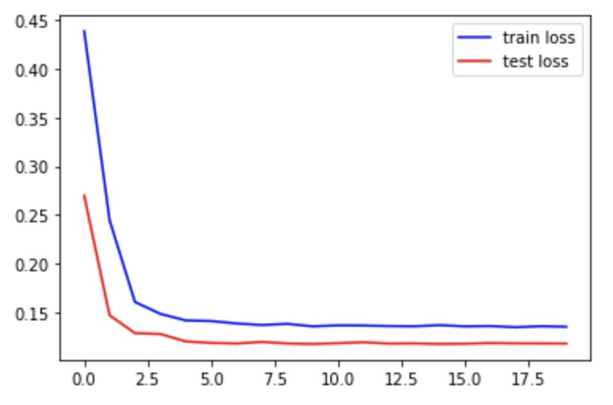
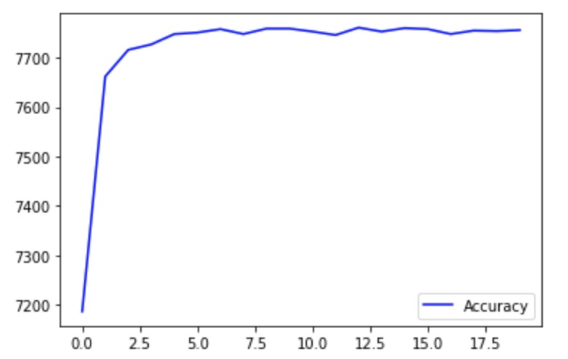

Slide 124
Epoch1:
Test set: Average loss: 0.3454, Accuracy: 6872/8141 (84%), Positive accuracy: 3726/4091 (91%), Negative accuracy: 3146/4050 (78%), f1 score: 0.8479, Train loss: 0.5527
Epoch2:
Test set: Average loss: 0.2978, Accuracy: 7110/8141 (87%), Positive accuracy: 3703/4091 (91%), Negative accuracy: 3407/4050 (84%), f1 score: 0.8743, Train loss: 0.3540
Epoch3
Test set: Average loss: 0.2653, Accuracy: 7231/8141 (89%), Positive accuracy: 3797/4091 (93%), Negative accuracy: 3434/4050 (85%), f1 score: 0.8897, Train loss: 0.3159
Epoch4:
Test set: Average loss: 0.2356, Accuracy: 7310/8141 (90%), Positive accuracy: 3883/4091 (95%), Negative accuracy: 3427/4050 (85%), f1 score: 0.9004, Train loss: 0.2823
Epoch5:
Test set: Average loss: 0.2124, Accuracy: 7428/8141 (91%), Positive accuracy: 3907/4091 (96%), Negative accuracy: 3521/4050 (87%), f1 score: 0.9142, Train loss: 0.2516
Epoch6:
Test set: Average loss: 0.1983, Accuracy: 7461/8141 (92%), Positive accuracy: 3949/4091 (97%), Negative accuracy: 3512/4050 (87%), f1 score: 0.9188, Train loss: 0.2288
Epoch7:
Test set: Average loss: 0.1871, Accuracy: 7523/8141 (92%), Positive accuracy: 3897/4091 (95%), Negative accuracy: 3626/4050 (90%), f1 score: 0.9249, Train loss: 0.2137
Epoch8:
Test set: Average loss: 0.1826, Accuracy: 7549/8141 (93%), Positive accuracy: 3880/4091 (95%), Negative accuracy: 3669/4050 (91%), f1 score: 0.9278, Train loss: 0.2041
Epoch9:
Test set: Average loss: 0.1761, Accuracy: 7553/8141 (93%), Positive accuracy: 3929/4091 (96%), Negative accuracy: 3624/4050 (89%), f1 score: 0.9289, Train loss: 0.1983
Epoch10:
Test set: Average loss: 0.1729, Accuracy: 7574/8141 (93%), Positive accuracy: 3911/4091 (96%), Negative accuracy: 3663/4050 (90%), f1 score: 0.9311, Train loss: 0.1947
5 layers of Convolution,
channels are 16, 32, 64, 128, 256, filter size is 3
2 layers of fully connected with 4096, 1024
Notes:
Test set: Average loss: 0.1729, Accuracy: 7574/8141 (93%), Positive accuracy: 3911/4091 (96%), Negative accuracy: 3663/4050 (90%), f1 score: 0.9311, Train loss: 0.1947

Slide 125
Epoch11:
Test set: Average loss: 0.1711, Accuracy: 7573/8141 (93%), Positive accuracy: 3914/4091 (96%), Negative accuracy: 3659/4050 (90%), f1 score: 0.9310, Train loss: 0.1923
Epoch12:
Test set: Average loss: 0.1700, Accuracy: 7578/8141 (93%), Positive accuracy: 3911/4091 (96%), Negative accuracy: 3667/4050 (91%), f1 score: 0.9315, Train loss: 0.1919
Epoch13
Test set: Average loss: 0.1688, Accuracy: 7581/8141 (93%), Positive accuracy: 3916/4091 (96%), Negative accuracy: 3665/4050 (90%), f1 score: 0.9319, Train loss: 0.1894
Epoch14:
Test set: Average loss: 0.1681, Accuracy: 7581/8141 (93%), Positive accuracy: 3917/4091 (96%), Negative accuracy: 3664/4050 (90%), f1 score: 0.9320, Train loss: 0.1882
Epoch15:
Test set: Average loss: 0.1676, Accuracy: 7584/8141 (93%), Positive accuracy: 3921/4091 (96%), Negative accuracy: 3663/4050 (90%), f1 score: 0.9324, Train loss: 0.1890
Epoch16:
Test set: Average loss: 0.1673, Accuracy: 7583/8141 (93%), Positive accuracy: 3920/4091 (96%), Negative accuracy: 3663/4050 (90%), f1 score: 0.9322, Train loss: 0.1886
Epoch17:
Test set: Average loss: 0.1671, Accuracy: 7584/8141 (93%), Positive accuracy: 3920/4091 (96%), Negative accuracy: 3664/4050 (90%), f1 score: 0.9323, Train loss: 0.1876
Epoch18:
Test set: Average loss: 0.1673, Accuracy: 7584/8141 (93%), Positive accuracy: 3912/4091 (96%), Negative accuracy: 3672/4050 (91%), f1 score: 0.9322, Train loss: 0.1871
Epoch19:
Test set: Average loss: 0.1670, Accuracy: 7585/8141 (93%), Positive accuracy: 3917/4091 (96%), Negative accuracy: 3668/4050 (91%), f1 score: 0.9324, Train loss: 0.1872
Epoch20:
Test set: Average loss: 0.1669, Accuracy: 7586/8141 (93%), Positive accuracy: 3916/4091 (96%), Negative accuracy: 3670/4050 (91%), f1 score: 0.9325, Train loss: 0.1871
5 layers of Convolution,
channels are 16, 32, 64, 128, 256, filter size is 3
2 layers of fully connected with 4096, 1024
Notes:
Test set: Average loss: 0.1669, Accuracy: 7586/8141 (93%), Positive accuracy: 3916/4091 (96%), Negative accuracy: 3670/4050 (91%), f1 score: 0.9325, Train loss: 0.1871

Slide 126
summary

Slide 127
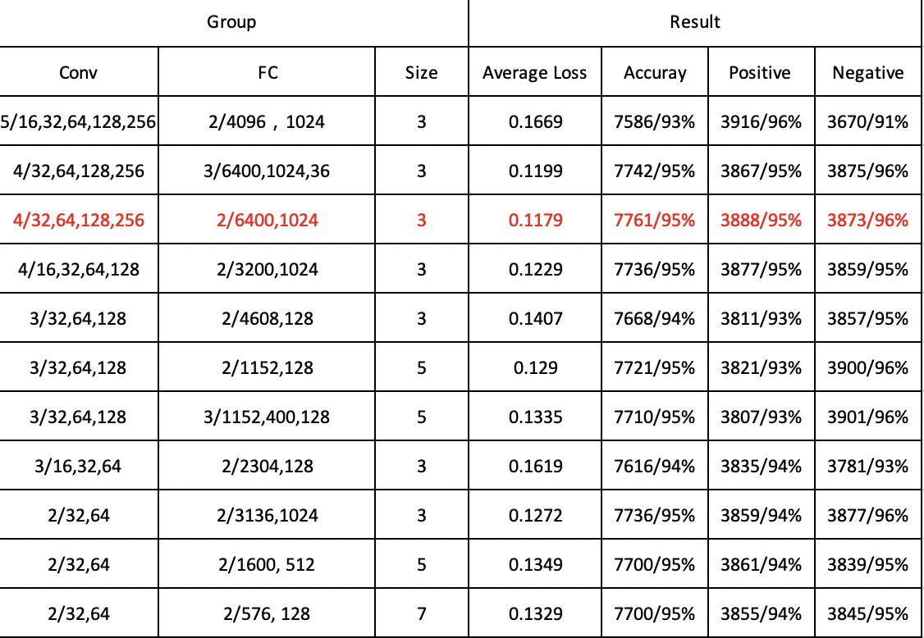
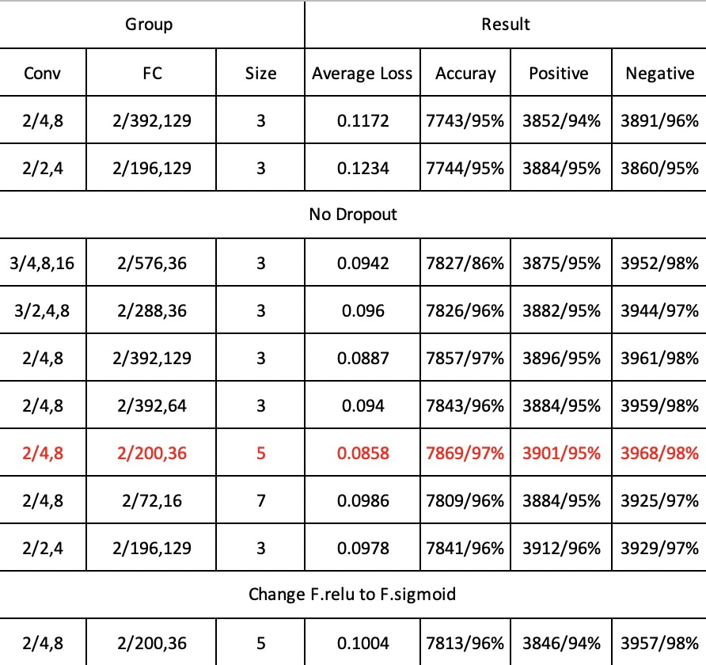
CNN
hybrid

Slide 128
CNN: 4/32,64,128,256; 2/6400,1024; 3
Accuracy
loss
Epoch
Epoch

Slide 129
CNN: 3/32,64,128; 2/1152,128; 5
Accuracy
loss
Epoch
Epoch

Slide 130
CNN: 2/32,64; 2/3136,1024; 3
Accuracy
loss
Epoch
Epoch

Slide 131
Gabor: model =GaborConvPC(19, 1, 8, 6).to(device)
Accuracy
loss
Epoch
Epoch

Slide 132
Model : Gabor + CNN (2 layers of convolution with 4,8, filter size is 5, 2 layers of fully connected with 200,36)
Accuracy
loss
Epoch
Epoch

Slide 133
Model : Gabor + CNN (3 layers of convolution with 4,8,16 filter size is 3, 2 layers of fully connected with 576,36)
Accuracy
loss
Epoch
Epoch

Slide 134
Result
DEC. 1st
Notes:
CNN+Gabor+CNN实验2,4/4,8 and gabor

Slide 135
Model : Gabor + CNN (2 layers of convolution with 4,8, filter size is 5, 3 layers of fully connected with 200,36,8)
Epoch1:
Test set: Average loss: 0.1357, Accuracy: 7727/8141 (95%), Positive accuracy: 3783/4091 (92%), Negative accuracy: 3944/4050 (97%), f1 score: 0.9496
Epoch2:
Test set: Average loss: 0.1099, Accuracy: 7785/8141 (96%), Positive accuracy: 3816/4091 (93%), Negative accuracy: 3969/4050 (98%), f1 score: 0.9567
Epoch3
Test set: Average loss: 0.1122, Accuracy: 7781/8141 (96%), Positive accuracy: 3827/4091 (94%), Negative accuracy: 3954/4050 (98%), f1 score: 0.9561
Epoch4:
Test set: Average loss: 0.0979, Accuracy: 7810/8141 (96%), Positive accuracy: 3847/4091 (94%), Negative accuracy: 3963/4050 (98%), f1 score: 0.9596
Epoch5:
Test set: Average loss: 0.0913, Accuracy: 7835/8141 (96%), Positive accuracy: 3872/4091 (95%), Negative accuracy: 3963/4050 (98%), f1 score: 0.9626
Epoch6:
Test set: Average loss: 0.0971, Accuracy: 7841/8141 (96%), Positive accuracy: 3863/4091 (94%), Negative accuracy: 3978/4050 (98%), f1 score: 0.9634
Epoch7:
Test set: Average loss: 0.0918, Accuracy: 7842/8141 (96%), Positive accuracy: 3867/4091 (95%), Negative accuracy: 3975/4050 (98%), f1 score: 0.9635
Epoch8:
Test set: Average loss: 0.0919, Accuracy: 7852/8141 (96%), Positive accuracy: 3878/4091 (95%), Negative accuracy: 3974/4050 (98%), f1 score: 0.9647
Epoch9:
Test set: Average loss: 0.0840, Accuracy: 7869/8141 (97%), Positive accuracy: 3911/4091 (96%), Negative accuracy: 3958/4050 (98%), f1 score: 0.9667
Epoch10:
Test set: Average loss: 0.0843, Accuracy: 7867/8141 (97%), Positive accuracy: 3898/4091 (95%), Negative accuracy: 3969/4050 (98%), f1 score: 0.9665
Notes:
Test set: Average loss: 0.0843, Accuracy: 7867/8141 (97%), Positive accuracy: 3898/4091 (95%), Negative accuracy: 3969/4050 (98%), f1 score: 0.9665

Slide 136
Epoch11:
Test set: Average loss: 0.0829, Accuracy: 7871/8141 (97%), Positive accuracy: 3903/4091 (95%), Negative accuracy: 3968/4050 (98%), f1 score: 0.9669
Epoch12:
Test set: Average loss: 0.0847, Accuracy: 7868/8141 (97%), Positive accuracy: 3899/4091 (95%), Negative accuracy: 3969/4050 (98%), f1 score: 0.9666
Epoch13
Test set: Average loss: 0.0847, Accuracy: 7864/8141 (97%), Positive accuracy: 3896/4091 (95%), Negative accuracy: 3968/4050 (98%), f1 score: 0.9661
Epoch14:
Test set: Average loss: 0.0841, Accuracy: 7869/8141 (97%), Positive accuracy: 3898/4091 (95%), Negative accuracy: 3971/4050 (98%), f1 score: 0.9667
Epoch15:
Test set: Average loss: 0.0839, Accuracy: 7867/8141 (97%), Positive accuracy: 3897/4091 (95%), Negative accuracy: 3970/4050 (98%), f1 score: 0.9665
Epoch16:
Test set: Average loss: 0.0834, Accuracy: 7868/8141 (97%), Positive accuracy: 3900/4091 (95%), Negative accuracy: 3968/4050 (98%), f1 score: 0.9666
Epoch17:
Test set: Average loss: 0.0839, Accuracy: 7867/8141 (97%), Positive accuracy: 3897/4091 (95%), Negative accuracy: 3970/4050 (98%), f1 score: 0.9665
Epoch18:
Test set: Average loss: 0.0835, Accuracy: 7868/8141 (97%), Positive accuracy: 3900/4091 (95%), Negative accuracy: 3968/4050 (98%), f1 score: 0.9666
Epoch19:
Test set: Average loss: 0.0835, Accuracy: 7867/8141 (97%), Positive accuracy: 3899/4091 (95%), Negative accuracy: 3968/4050 (98%), f1 score: 0.9665
Epoch20:
Test set: Average loss: 0.0835, Accuracy: 7867/8141 (97%), Positive accuracy: 3899/4091 (95%), Negative accuracy: 3968/4050 (98%), f1 score: 0.9665
Notes:
Test set: Average loss: 0.0835, Accuracy: 7867/8141 (97%), Positive accuracy: 3899/4091 (95%), Negative accuracy: 3968/4050 (98%), f1 score: 0.9665

Slide 137
Model : Gabor + CNN (2 layers of convolution with 4,8, filter size is 5, 3 layers of fully connected with 200,36,8) + Gabor on layer 2
Epoch1:
Test set: Average loss: 0.1261, Accuracy: 7722/8141 (95%), Positive accuracy: 3923/4091 (96%), Negative accuracy: 3799/4050 (94%), f1 score: 0.9487
Epoch2:
Test set: Average loss: 0.1252, Accuracy: 7720/8141 (95%), Positive accuracy: 3752/4091 (92%), Negative accuracy: 3968/4050 (98%), f1 score: 0.9491
Epoch3
Test set: Average loss: 0.1033, Accuracy: 7781/8141 (96%), Positive accuracy: 3842/4091 (94%), Negative accuracy: 3939/4050 (97%), f1 score: 0.9560
Epoch4:
Test set: Average loss: 0.0987, Accuracy: 7808/8141 (96%), Positive accuracy: 3857/4091 (94%), Negative accuracy: 3951/4050 (98%), f1 score: 0.9593
Epoch5:
Test set: Average loss: 0.1290, Accuracy: 7714/8141 (95%), Positive accuracy: 3718/4091 (91%), Negative accuracy: 3996/4050 (99%), f1 score: 0.9488
Epoch6:
Test set: Average loss: 0.0999, Accuracy: 7801/8141 (96%), Positive accuracy: 3841/4091 (94%), Negative accuracy: 3960/4050 (98%), f1 score: 0.9585
Epoch7:
Test set: Average loss: 0.0924, Accuracy: 7821/8141 (96%), Positive accuracy: 3842/4091 (94%), Negative accuracy: 3979/4050 (98%), f1 score: 0.9610
Epoch8:
Test set: Average loss: 0.0926, Accuracy: 7836/8141 (96%), Positive accuracy: 3861/4091 (94%), Negative accuracy: 3975/4050 (98%), f1 score: 0.9628
Epoch9:
Test set: Average loss: 0.0847, Accuracy: 7862/8141 (97%), Positive accuracy: 3914/4091 (96%), Negative accuracy: 3948/4050 (97%), f1 score: 0.9658
Epoch10:
Test set: Average loss: 0.0869, Accuracy: 7851/8141 (96%), Positive accuracy: 3896/4091 (95%), Negative accuracy: 3955/4050 (98%), f1 score: 0.9645
Notes:
Test set: Average loss: 0.0869, Accuracy: 7851/8141 (96%), Positive accuracy: 3896/4091 (95%), Negative accuracy: 3955/4050 (98%), f1 score: 0.9645

Slide 138
Epoch11:
Test set: Average loss: 0.0883, Accuracy: 7847/8141 (96%), Positive accuracy: 3879/4091 (95%), Negative accuracy: 3968/4050 (98%), f1 score: 0.9641
Epoch12:
Test set: Average loss: 0.0868, Accuracy: 7849/8141 (96%), Positive accuracy: 3886/4091 (95%), Negative accuracy: 3963/4050 (98%), f1 score: 0.9643
Epoch13
Test set: Average loss: 0.0860, Accuracy: 7853/8141 (96%), Positive accuracy: 3893/4091 (95%), Negative accuracy: 3960/4050 (98%), f1 score: 0.9647
Epoch14:
Test set: Average loss: 0.0864, Accuracy: 7852/8141 (96%), Positive accuracy: 3890/4091 (95%), Negative accuracy: 3962/4050 (98%), f1 score: 0.9646
Epoch15:
Test set: Average loss: 0.0863, Accuracy: 7853/8141 (96%), Positive accuracy: 3885/4091 (95%), Negative accuracy: 3968/4050 (98%), f1 score: 0.9648
Epoch16:
Test set: Average loss: 0.0858, Accuracy: 7853/8141 (96%), Positive accuracy: 3887/4091 (95%), Negative accuracy: 3966/4050 (98%), f1 score: 0.9648
Epoch17:
Test set: Average loss: 0.0863, Accuracy: 7853/8141 (96%), Positive accuracy: 3887/4091 (95%), Negative accuracy: 3966/4050 (98%), f1 score: 0.9648
Epoch18:
Test set: Average loss: 0.0859, Accuracy: 7854/8141 (96%), Positive accuracy: 3891/4091 (95%), Negative accuracy: 3963/4050 (98%), f1 score: 0.9649
Epoch19:
Test set: Average loss: 0.0859, Accuracy: 7853/8141 (96%), Positive accuracy: 3890/4091 (95%), Negative accuracy: 3963/4050 (98%), f1 score: 0.9647
Epoch20:
Test set: Average loss: 0.0859, Accuracy: 7853/8141 (96%), Positive accuracy: 3887/4091 (95%), Negative accuracy: 3966/4050 (98%), f1 score: 0.9648
Notes:
Test set: Average loss: 0.0859, Accuracy: 7853/8141 (96%), Positive accuracy: 3887/4091 (95%), Negative accuracy: 3966/4050 (98%), f1 score: 0.9648

Slide 139
Model : Gabor + CNN (2 layers of convolution with 4,8, filter size is 5, 3 layers of fully connected with 200,96,36)
Epoch1:
Test set: Average loss: 0.1237, Accuracy: 7715/8141 (95%), Positive accuracy: 3802/4091 (93%), Negative accuracy: 3913/4050 (97%), f1 score: 0.9479
Epoch2:
Test set: Average loss: 0.0933, Accuracy: 7833/8141 (96%), Positive accuracy: 3887/4091 (95%), Negative accuracy: 3946/4050 (97%), f1 score: 0.9623
Epoch3
Test set: Average loss: 0.0971, Accuracy: 7825/8141 (96%), Positive accuracy: 3868/4091 (95%), Negative accuracy: 3957/4050 (98%), f1 score: 0.9614
Epoch4:
Test set: Average loss: 0.0891, Accuracy: 7846/8141 (96%), Positive accuracy: 3891/4091 (95%), Negative accuracy: 3955/4050 (98%), f1 score: 0.9639
Epoch5:
Test set: Average loss: 0.0921, Accuracy: 7868/8141 (97%), Positive accuracy: 3941/4091 (96%), Negative accuracy: 3927/4050 (97%), f1 score: 0.9665
Epoch6:
Test set: Average loss: 0.0814, Accuracy: 7887/8141 (97%), Positive accuracy: 3887/4091 (95%), Negative accuracy: 4000/4050 (99%), f1 score: 0.9691
Epoch7:
Test set: Average loss: 0.0754, Accuracy: 7896/8141 (97%), Positive accuracy: 3930/4091 (96%), Negative accuracy: 3966/4050 (98%), f1 score: 0.9699
Epoch8:
Test set: Average loss: 0.0745, Accuracy: 7912/8141 (97%), Positive accuracy: 3937/4091 (96%), Negative accuracy: 3975/4050 (98%), f1 score: 0.9719
Epoch9:
Test set: Average loss: 0.0701, Accuracy: 7922/8141 (97%), Positive accuracy: 3942/4091 (96%), Negative accuracy: 3980/4050 (98%), f1 score: 0.9731
Epoch10:
Test set: Average loss: 0.0721, Accuracy: 7907/8141 (97%), Positive accuracy: 3942/4091 (96%), Negative accuracy: 3965/4050 (98%), f1 score: 0.9713
Notes:
Test set: Average loss: 0.0721, Accuracy: 7907/8141 (97%), Positive accuracy: 3942/4091 (96%), Negative accuracy: 3965/4050 (98%), f1 score: 0.9713

Slide 140
Epoch11:
Test set: Average loss: 0.0728, Accuracy: 7913/8141 (97%), Positive accuracy: 3939/4091 (96%), Negative accuracy: 3974/4050 (98%), f1 score: 0.9720
Epoch12:
Test set: Average loss: 0.0722, Accuracy: 7923/8141 (97%), Positive accuracy: 3936/4091 (96%), Negative accuracy: 3987/4050 (98%), f1 score: 0.9733
Epoch13
Test set: Average loss: 0.0728, Accuracy: 7916/8141 (97%), Positive accuracy: 3927/4091 (96%), Negative accuracy: 3989/4050 (98%), f1 score: 0.9725
Epoch14:
Test set: Average loss: 0.0721, Accuracy: 7920/8141 (97%), Positive accuracy: 3935/4091 (96%), Negative accuracy: 3985/4050 (98%), f1 score: 0.9729
Epoch15:
Test set: Average loss: 0.0722, Accuracy: 7920/8141 (97%), Positive accuracy: 3931/4091 (96%), Negative accuracy: 3989/4050 (98%), f1 score: 0.9729
Epoch16:
Test set: Average loss: 0.0715, Accuracy: 7924/8141 (97%), Positive accuracy: 3936/4091 (96%), Negative accuracy: 3988/4050 (98%), f1 score: 0.9734
Epoch17:
Test set: Average loss: 0.0707, Accuracy: 7926/8141 (97%), Positive accuracy: 3939/4091 (96%), Negative accuracy: 3987/4050 (98%), f1 score: 0.9737
Epoch18:
Test set: Average loss: 0.0713, Accuracy: 7924/8141 (97%), Positive accuracy: 3936/4091 (96%), Negative accuracy: 3988/4050 (98%), f1 score: 0.9734
Epoch19:
Test set: Average loss: 0.0713, Accuracy: 7922/8141 (97%), Positive accuracy: 3934/4091 (96%), Negative accuracy: 3988/4050 (98%), f1 score: 0.9732
Epoch20:
Test set: Average loss: 0.0714, Accuracy: 7924/8141 (97%), Positive accuracy: 3936/4091 (96%), Negative accuracy: 3988/4050 (98%), f1 score: 0.9734
Notes:
Test set: Average loss: 0.0714, Accuracy: 7924/8141 (97%), Positive accuracy: 3936/4091 (96%), Negative accuracy: 3988/4050 (98%), f1 score: 0.9734

Slide 141
Model : Gabor + CNN (2 layers of convolution with 4,8, filter size is 5, 3 layers of fully connected with 200,128,36)
Epoch1:
Test set: Average loss: 0.1707, Accuracy: 7542/8141 (93%), Positive accuracy: 3570/4091 (87%), Negative accuracy: 3972/4050 (98%), f1 score: 0.9289
Epoch2:
Test set: Average loss: 0.1683, Accuracy: 7698/8141 (95%), Positive accuracy: 3866/4091 (95%), Negative accuracy: 3832/4050 (95%), f1 score: 0.9456
Epoch3
Test set: Average loss: 0.0964, Accuracy: 7836/8141 (96%), Positive accuracy: 3854/4091 (94%), Negative accuracy: 3982/4050 (98%), f1 score: 0.9629
Epoch4:
Test set: Average loss: 0.1028, Accuracy: 7804/8141 (96%), Positive accuracy: 3834/4091 (94%), Negative accuracy: 3970/4050 (98%), f1 score: 0.9590
Epoch5:
Test set: Average loss: 0.0869, Accuracy: 7859/8141 (97%), Positive accuracy: 3875/4091 (95%), Negative accuracy: 3984/4050 (98%), f1 score: 0.9656
Epoch6:
Test set: Average loss: 0.0756, Accuracy: 7892/8141 (97%), Positive accuracy: 3904/4091 (95%), Negative accuracy: 3988/4050 (98%), f1 score: 0.9696
Epoch7:
Test set: Average loss: 0.0716, Accuracy: 7934/8141 (97%), Positive accuracy: 3955/4091 (97%), Negative accuracy: 3979/4050 (98%), f1 score: 0.9746
Epoch8:
Test set: Average loss: 0.0791, Accuracy: 7897/8141 (97%), Positive accuracy: 3891/4091 (95%), Negative accuracy: 4006/4050 (99%), f1 score: 0.9703
Epoch9:
Test set: Average loss: 0.0736, Accuracy: 7900/8141 (97%), Positive accuracy: 3916/4091 (96%), Negative accuracy: 3984/4050 (98%), f1 score: 0.9705
Epoch10:
Test set: Average loss: 0.0710, Accuracy: 7914/8141 (97%), Positive accuracy: 3929/4091 (96%), Negative accuracy: 3985/4050 (98%), f1 score: 0.9722
Notes:
Test set: Average loss: 0.0710, Accuracy: 7914/8141 (97%), Positive accuracy: 3929/4091 (96%), Negative accuracy: 3985/4050 (98%), f1 score: 0.9722

Slide 142
Epoch11:
Test set: Average loss: 0.0742, Accuracy: 7902/8141 (97%), Positive accuracy: 3908/4091 (96%), Negative accuracy: 3994/4050 (99%), f1 score: 0.9708
Epoch12:
Test set: Average loss: 0.0741, Accuracy: 7895/8141 (97%), Positive accuracy: 3915/4091 (96%), Negative accuracy: 3980/4050 (98%), f1 score: 0.9699
Epoch13
Test set: Average loss: 0.0705, Accuracy: 7909/8141 (97%), Positive accuracy: 3938/4091 (96%), Negative accuracy: 3971/4050 (98%), f1 score: 0.9715
Epoch14:
Test set: Average loss: 0.0716, Accuracy: 7910/8141 (97%), Positive accuracy: 3929/4091 (96%), Negative accuracy: 3981/4050 (98%), f1 score: 0.9717
Epoch15:
Test set: Average loss: 0.0740, Accuracy: 7901/8141 (97%), Positive accuracy: 3917/4091 (96%), Negative accuracy: 3984/4050 (98%), f1 score: 0.9706
Epoch16:
Test set: Average loss: 0.0713, Accuracy: 7910/8141 (97%), Positive accuracy: 3929/4091 (96%), Negative accuracy: 3981/4050 (98%), f1 score: 0.9717
Epoch17:
Test set: Average loss: 0.0723, Accuracy: 7908/8141 (97%), Positive accuracy: 3925/4091 (96%), Negative accuracy: 3983/4050 (98%), f1 score: 0.9715
Epoch18:
Test set: Average loss: 0.0721, Accuracy: 7910/8141 (97%), Positive accuracy: 3927/4091 (96%), Negative accuracy: 3983/4050 (98%), f1 score: 0.9717
Epoch19:
Test set: Average loss: 0.0719, Accuracy: 7909/8141 (97%), Positive accuracy: 3927/4091 (96%), Negative accuracy: 3982/4050 (98%), f1 score: 0.9716
Epoch20:
Test set: Average loss: 0.0719, Accuracy: 7910/8141 (97%), Positive accuracy: 3928/4091 (96%), Negative accuracy: 3982/4050 (98%), f1 score: 0.9717
Notes:
Test set: Average loss: 0.0719, Accuracy: 7910/8141 (97%), Positive accuracy: 3928/4091 (96%), Negative accuracy: 3982/4050 (98%), f1 score: 0.9717

Slide 143
Model : Gabor + CNN (2 layers of convolution with 4,8, filter size is 5, 4 layers of fully connected with 200,156,96,36)
Epoch1:
Test set: Average loss: 0.1094, Accuracy: 7764/8141 (95%), Positive accuracy: 3864/4091 (94%), Negative accuracy: 3900/4050 (96%), f1 score: 0.9537
Epoch2:
Test set: Average loss: 0.1230, Accuracy: 7734/8141 (95%), Positive accuracy: 3764/4091 (92%), Negative accuracy: 3970/4050 (98%), f1 score: 0.9507
Epoch3
Test set: Average loss: 0.1076, Accuracy: 7795/8141 (96%), Positive accuracy: 3817/4091 (93%), Negative accuracy: 3978/4050 (98%), f1 score: 0.9580
Epoch4:
Test set: Average loss: 0.0885, Accuracy: 7844/8141 (96%), Positive accuracy: 3885/4091 (95%), Negative accuracy: 3959/4050 (98%), f1 score: 0.9636
Epoch5:
Test set: Average loss: 0.0903, Accuracy: 7854/8141 (96%), Positive accuracy: 3866/4091 (95%), Negative accuracy: 3988/4050 (98%), f1 score: 0.9650
Epoch6:
Test set: Average loss: 0.0917, Accuracy: 7849/8141 (96%), Positive accuracy: 3895/4091 (95%), Negative accuracy: 3954/4050 (98%), f1 score: 0.9642
Epoch7:
Test set: Average loss: 0.0796, Accuracy: 7879/8141 (97%), Positive accuracy: 3897/4091 (95%), Negative accuracy: 3982/4050 (98%), f1 score: 0.9680
Epoch8:
Test set: Average loss: 0.0787, Accuracy: 7885/8141 (97%), Positive accuracy: 3903/4091 (95%), Negative accuracy: 3982/4050 (98%), f1 score: 0.9687
Epoch9:
Test set: Average loss: 0.0849, Accuracy: 7865/8141 (97%), Positive accuracy: 3885/4091 (95%), Negative accuracy: 3980/4050 (98%), f1 score: 0.9663
Epoch10:
Test set: Average loss: 0.0781, Accuracy: 7881/8141 (97%), Positive accuracy: 3899/4091 (95%), Negative accuracy: 3982/4050 (98%), f1 score: 0.9682
Notes:
Test set: Average loss: 0.0781, Accuracy: 7881/8141 (97%), Positive accuracy: 3899/4091 (95%), Negative accuracy: 3982/4050 (98%), f1 score: 0.9682

Slide 144
Epoch11:
Test set: Average loss: 0.0771, Accuracy: 7888/8141 (97%), Positive accuracy: 3911/4091 (96%), Negative accuracy: 3977/4050 (98%), f1 score: 0.9690
Epoch12:
Test set: Average loss: 0.0768, Accuracy: 7890/8141 (97%), Positive accuracy: 3912/4091 (96%), Negative accuracy: 3978/4050 (98%), f1 score: 0.9693
Epoch13
Test set: Average loss: 0.0747, Accuracy: 7901/8141 (97%), Positive accuracy: 3925/4091 (96%), Negative accuracy: 3976/4050 (98%), f1 score: 0.9706
Epoch14:
Test set: Average loss: 0.0763, Accuracy: 7900/8141 (97%), Positive accuracy: 3919/4091 (96%), Negative accuracy: 3981/4050 (98%), f1 score: 0.9705
Epoch15:
Test set: Average loss: 0.0768, Accuracy: 7894/8141 (97%), Positive accuracy: 3912/4091 (96%), Negative accuracy: 3982/4050 (98%), f1 score: 0.9698
Epoch16:
Test set: Average loss: 0.0765, Accuracy: 7897/8141 (97%), Positive accuracy: 3918/4091 (96%), Negative accuracy: 3979/4050 (98%), f1 score: 0.9701
Epoch17:
Test set: Average loss: 0.0757, Accuracy: 7898/8141 (97%), Positive accuracy: 3919/4091 (96%), Negative accuracy: 3979/4050 (98%), f1 score: 0.9702
Epoch18:
Test set: Average loss: 0.0760, Accuracy: 7897/8141 (97%), Positive accuracy: 3916/4091 (96%), Negative accuracy: 3981/4050 (98%), f1 score: 0.9701
Epoch19:
Test set: Average loss: 0.0754, Accuracy: 7898/8141 (97%), Positive accuracy: 3921/4091 (96%), Negative accuracy: 3977/4050 (98%), f1 score: 0.9702
Epoch20:
Test set: Average loss: 0.0761, Accuracy: 7896/8141 (97%), Positive accuracy: 3916/4091 (96%), Negative accuracy: 3980/4050 (98%), f1 score: 0.9700
Notes:
Test set: Average loss: 0.0761, Accuracy: 7896/8141 (97%), Positive accuracy: 3916/4091 (96%), Negative accuracy: 3980/4050 (98%), f1 score: 0.9700

Slide 145
Model : Gabor + CNN (2 layers of convolution with 4,8, filter size is 5, 4 layers of fully connected with 200,128,54,24)
Epoch1:
Test set: Average loss: 0.2383, Accuracy: 7368/8141 (91%), Positive accuracy: 3434/4091 (84%), Negative accuracy: 3934/4050 (97%), f1 score: 0.9088
Epoch2:
Test set: Average loss: 0.1236, Accuracy: 7744/8141 (95%), Positive accuracy: 3783/4091 (92%), Negative accuracy: 3961/4050 (98%), f1 score: 0.9518
Epoch3
Test set: Average loss: 0.1145, Accuracy: 7770/8141 (95%), Positive accuracy: 3782/4091 (92%), Negative accuracy: 3988/4050 (98%), f1 score: 0.9552
Epoch4:
Test set: Average loss: 0.0741, Accuracy: 7912/8141 (97%), Positive accuracy: 3940/4091 (96%), Negative accuracy: 3972/4050 (98%), f1 score: 0.9719
Epoch5:
Test set: Average loss: 0.0954, Accuracy: 7874/8141 (97%), Positive accuracy: 3952/4091 (97%), Negative accuracy: 3922/4050 (97%), f1 score: 0.9672
Epoch6:
Test set: Average loss: 0.0803, Accuracy: 7872/8141 (97%), Positive accuracy: 3882/4091 (95%), Negative accuracy: 3990/4050 (99%), f1 score: 0.9672
Epoch7:
Test set: Average loss: 0.0822, Accuracy: 7859/8141 (97%), Positive accuracy: 3869/4091 (95%), Negative accuracy: 3990/4050 (99%), f1 score: 0.9656
Epoch8:
Test set: Average loss: 0.0704, Accuracy: 7914/8141 (97%), Positive accuracy: 3922/4091 (96%), Negative accuracy: 3992/4050 (99%), f1 score: 0.9722
Epoch9:
Test set: Average loss: 0.0703, Accuracy: 7916/8141 (97%), Positive accuracy: 3931/4091 (96%), Negative accuracy: 3985/4050 (98%), f1 score: 0.9724
Epoch10:
Test set: Average loss: 0.0707, Accuracy: 7911/8141 (97%), Positive accuracy: 3919/4091 (96%), Negative accuracy: 3992/4050 (99%), f1 score: 0.9719
Notes:
Test set: Average loss: 0.0707, Accuracy: 7911/8141 (97%), Positive accuracy: 3919/4091 (96%), Negative accuracy: 3992/4050 (99%), f1 score: 0.9719

Slide 146
Epoch11:
Test set: Average loss: 0.0694, Accuracy: 7916/8141 (97%), Positive accuracy: 3941/4091 (96%), Negative accuracy: 3975/4050 (98%), f1 score: 0.9724
Epoch12:
Test set: Average loss: 0.0700, Accuracy: 7915/8141 (97%), Positive accuracy: 3930/4091 (96%), Negative accuracy: 3985/4050 (98%), f1 score: 0.9723
Epoch13:
Test set: Average loss: 0.0679, Accuracy: 7924/8141 (97%), Positive accuracy: 3939/4091 (96%), Negative accuracy: 3985/4050 (98%), f1 score: 0.9734
Epoch14:
Test set: Average loss: 0.0694, Accuracy: 7922/8141 (97%), Positive accuracy: 3933/4091 (96%), Negative accuracy: 3989/4050 (98%), f1 score: 0.9732
Epoch15:
Test set: Average loss: 0.0682, Accuracy: 7918/8141 (97%), Positive accuracy: 3936/4091 (96%), Negative accuracy: 3982/4050 (98%), f1 score: 0.9727
Epoch16:
Test set: Average loss: 0.0677, Accuracy: 7922/8141 (97%), Positive accuracy: 3940/4091 (96%), Negative accuracy: 3982/4050 (98%), f1 score: 0.9732
Epoch17:
Test set: Average loss: 0.0685, Accuracy: 7919/8141 (97%), Positive accuracy: 3935/4091 (96%), Negative accuracy: 3984/4050 (98%), f1 score: 0.9728
Epoch18:
Test set: Average loss: 0.0688, Accuracy: 7917/8141 (97%), Positive accuracy: 3932/4091 (96%), Negative accuracy: 3985/4050 (98%), f1 score: 0.9726
Epoch19:
Test set: Average loss: 0.0684, Accuracy: 7919/8141 (97%), Positive accuracy: 3936/4091 (96%), Negative accuracy: 3983/4050 (98%), f1 score: 0.9728
Epoch20:
Test set: Average loss: 0.0685, Accuracy: 7918/8141 (97%), Positive accuracy: 3935/4091 (96%), Negative accuracy: 3983/4050 (98%), f1 score: 0.9727
Notes:
Test set: Average loss: 0.0685, Accuracy: 7918/8141 (97%), Positive accuracy: 3935/4091 (96%), Negative accuracy: 3983/4050 (98%), f1 score: 0.9727

Slide 147
FC_PC_ CNN
batch-size：64
learning rate：0.01
2 layers of conv with 4,8
3 layers of fc with 200,128, xx, 2
Filter size 5

Slide 148
Model : 3 layers of FC_GABOR with 96,48,24,6
Epoch1:
Test set: Average loss: 0.1350, Accuracy: 7727/8141 (95%), Positive accuracy: 3803/4091 (93%), Negative accuracy: 3924/4050 (97%), f1 score: 0.9494
Epoch2:
Test set: Average loss: 0.1317, Accuracy: 7712/8141 (95%), Positive accuracy: 3749/4091 (92%), Negative accuracy: 3963/4050 (98%), f1 score: 0.9481
Epoch3
Test set: Average loss: 0.1526, Accuracy: 7648/8141 (94%), Positive accuracy: 3691/4091 (90%), Negative accuracy: 3957/4050 (98%), f1 score: 0.9406
Epoch4:
Test set: Average loss: 0.1032, Accuracy: 7775/8141 (96%), Positive accuracy: 3879/4091 (95%), Negative accuracy: 3896/4050 (96%), f1 score: 0.9551
Epoch5:
Test set: Average loss: 0.0982, Accuracy: 7792/8141 (96%), Positive accuracy: 3895/4091 (95%), Negative accuracy: 3897/4050 (96%), f1 score: 0.9571
Epoch6:
Test set: Average loss: 0.1000, Accuracy: 7809/8141 (96%), Positive accuracy: 3876/4091 (95%), Negative accuracy: 3933/4050 (97%), f1 score: 0.9593
Epoch7:
Test set: Average loss: 0.1062, Accuracy: 7789/8141 (96%), Positive accuracy: 3815/4091 (93%), Negative accuracy: 3974/4050 (98%), f1 score: 0.9572
Epoch8:
Test set: Average loss: 0.0931, Accuracy: 7833/8141 (96%), Positive accuracy: 3880/4091 (95%), Negative accuracy: 3953/4050 (98%), f1 score: 0.9623
Epoch9:
Test set: Average loss: 0.0920, Accuracy: 7842/8141 (96%), Positive accuracy: 3883/4091 (95%), Negative accuracy: 3959/4050 (98%), f1 score: 0.9634
Epoch10:
Test set: Average loss: 0.0882, Accuracy: 7852/8141 (96%), Positive accuracy: 3903/4091 (95%), Negative accuracy: 3949/4050 (98%), f1 score: 0.9646
Notes:
Test set: Average loss: 0.0882, Accuracy: 7852/8141 (96%), Positive accuracy: 3903/4091 (95%), Negative accuracy: 3949/4050 (98%), f1 score: 0.9646

Slide 149
Epoch11:
Test set: Average loss: 0.0903, Accuracy: 7838/8141 (96%), Positive accuracy: 3874/4091 (95%), Negative accuracy: 3964/4050 (98%), f1 score: 0.9630
Epoch12:
Test set: Average loss: 0.0886, Accuracy: 7852/8141 (96%), Positive accuracy: 3892/4091 (95%), Negative accuracy: 3960/4050 (98%), f1 score: 0.9646
Epoch13:
Test set: Average loss: 0.0882, Accuracy: 7850/8141 (96%), Positive accuracy: 3894/4091 (95%), Negative accuracy: 3956/4050 (98%), f1 score: 0.9643
Epoch14:
Test set: Average loss: 0.0867, Accuracy: 7854/8141 (96%), Positive accuracy: 3894/4091 (95%), Negative accuracy: 3960/4050 (98%), f1 score: 0.9649
Epoch15:
Test set: Average loss: 0.0874, Accuracy: 7853/8141 (96%), Positive accuracy: 3891/4091 (95%), Negative accuracy: 3962/4050 (98%), f1 score: 0.9647
Epoch16:
Test set: Average loss: 0.0864, Accuracy: 7851/8141 (96%), Positive accuracy: 3899/4091 (95%), Negative accuracy: 3952/4050 (98%), f1 score: 0.9645
Epoch17:
Test set: Average loss: 0.0869, Accuracy: 7855/8141 (96%), Positive accuracy: 3894/4091 (95%), Negative accuracy: 3961/4050 (98%), f1 score: 0.9650
Epoch18:
Test set: Average loss: 0.0864, Accuracy: 7855/8141 (96%), Positive accuracy: 3895/4091 (95%), Negative accuracy: 3960/4050 (98%), f1 score: 0.9650
Epoch19:
Test set: Average loss: 0.0864, Accuracy: 7855/8141 (96%), Positive accuracy: 3894/4091 (95%), Negative accuracy: 3961/4050 (98%), f1 score: 0.9650
Epoch20:
Test set: Average loss: 0.0864, Accuracy: 7855/8141 (96%), Positive accuracy: 3894/4091 (95%), Negative accuracy: 3961/4050 (98%), f1 score: 0.9650
Notes:
Test set: Average loss: 0.0864, Accuracy: 7855/8141 (96%), Positive accuracy: 3894/4091 (95%), Negative accuracy: 3961/4050 (98%), f1 score: 0.9650

Slide 150
Model : 2 layers of FC_GABOR with 96,36,2
Epoch1:
Test set: Average loss: 0.1651, Accuracy: 7627/8141 (94%), Positive accuracy: 3652/4091 (89%), Negative accuracy: 3975/4050 (98%), f1 score: 0.9385
Epoch2:
Test set: Average loss: 0.1472, Accuracy: 7676/8141 (94%), Positive accuracy: 3705/4091 (91%), Negative accuracy: 3971/4050 (98%), f1 score: 0.9441
Epoch3
Test set: Average loss: 0.1037, Accuracy: 7807/8141 (96%), Positive accuracy: 3919/4091 (96%), Negative accuracy: 3888/4050 (96%), f1 score: 0.9590
Epoch4:
Test set: Average loss: 0.1301, Accuracy: 7727/8141 (95%), Positive accuracy: 3732/4091 (91%), Negative accuracy: 3995/4050 (99%), f1 score: 0.9503
Epoch5:
Test set: Average loss: 0.1053, Accuracy: 7799/8141 (96%), Positive accuracy: 3857/4091 (94%), Negative accuracy: 3942/4050 (97%), f1 score: 0.9581
Epoch6:
Test set: Average loss: 0.1020, Accuracy: 7801/8141 (96%), Positive accuracy: 3841/4091 (94%), Negative accuracy: 3960/4050 (98%), f1 score: 0.9585
Epoch7:
Test set: Average loss: 0.0954, Accuracy: 7831/8141 (96%), Positive accuracy: 3876/4091 (95%), Negative accuracy: 3955/4050 (98%), f1 score: 0.9621
Epoch8:
Test set: Average loss: 0.0983, Accuracy: 7833/8141 (96%), Positive accuracy: 3885/4091 (95%), Negative accuracy: 3948/4050 (97%), f1 score: 0.9623
Epoch9:
Test set: Average loss: 0.0889, Accuracy: 7855/8141 (96%), Positive accuracy: 3902/4091 (95%), Negative accuracy: 3953/4050 (98%), f1 score: 0.9649
Epoch10:
Test set: Average loss: 0.0888, Accuracy: 7855/8141 (96%), Positive accuracy: 3913/4091 (96%), Negative accuracy: 3942/4050 (97%), f1 score: 0.9649
Notes:
Test set: Average loss: 0.0888, Accuracy: 7855/8141 (96%), Positive accuracy: 3913/4091 (96%), Negative accuracy: 3942/4050 (97%), f1 score: 0.9649

Slide 151
Epoch11:
Test set: Average loss: 0.0918, Accuracy: 7843/8141 (96%), Positive accuracy: 3898/4091 (95%), Negative accuracy: 3945/4050 (97%), f1 score: 0.9635
Epoch12:
Test set: Average loss: 0.0923, Accuracy: 7849/8141 (96%), Positive accuracy: 3888/4091 (95%), Negative accuracy: 3961/4050 (98%), f1 score: 0.9643
Epoch13:
Test set: Average loss: 0.0932, Accuracy: 7838/8141 (96%), Positive accuracy: 3878/4091 (95%), Negative accuracy: 3960/4050 (98%), f1 score: 0.9629
Epoch14:
Test set: Average loss: 0.0907, Accuracy: 7847/8141 (96%), Positive accuracy: 3894/4091 (95%), Negative accuracy: 3953/4050 (98%), f1 score: 0.9640
Epoch15:
Test set: Average loss: 0.0898, Accuracy: 7853/8141 (96%), Positive accuracy: 3901/4091 (95%), Negative accuracy: 3952/4050 (98%), f1 score: 0.9647
Epoch16:
Test set: Average loss: 0.0908, Accuracy: 7847/8141 (96%), Positive accuracy: 3896/4091 (95%), Negative accuracy: 3951/4050 (98%), f1 score: 0.9640
Epoch17:
Test set: Average loss: 0.0899, Accuracy: 7843/8141 (96%), Positive accuracy: 3897/4091 (95%), Negative accuracy: 3946/4050 (97%), f1 score: 0.9635
Epoch18:
Test set: Average loss: 0.0899, Accuracy: 7844/8141 (96%), Positive accuracy: 3897/4091 (95%), Negative accuracy: 3947/4050 (97%), f1 score: 0.9636
Epoch19:
Test set: Average loss: 0.0901, Accuracy: 7845/8141 (96%), Positive accuracy: 3898/4091 (95%), Negative accuracy: 3947/4050 (97%), f1 score: 0.9637
Epoch20:
Test set: Average loss: 0.0902, Accuracy: 7849/8141 (96%), Positive accuracy: 3897/4091 (95%), Negative accuracy: 3952/4050 (98%), f1 score: 0.9642
Notes:
Test set: Average loss: 0.0902, Accuracy: 7849/8141 (96%), Positive accuracy: 3897/4091 (95%), Negative accuracy: 3952/4050 (98%), f1 score: 0.9642

Slide 152
Model : 2 layers of FC_GABOR with 96,36,6
Epoch1:
Test set: Average loss: 0.1296, Accuracy: 7754/8141 (95%), Positive accuracy: 3943/4091 (96%), Negative accuracy: 3811/4050 (94%), f1 score: 0.9526
Epoch2:
Test set: Average loss: 0.1259, Accuracy: 7751/8141 (95%), Positive accuracy: 3798/4091 (93%), Negative accuracy: 3953/4050 (98%), f1 score: 0.9525
Epoch3
Test set: Average loss: 0.1210, Accuracy: 7746/8141 (95%), Positive accuracy: 3815/4091 (93%), Negative accuracy: 3931/4050 (97%), f1 score: 0.9517
Epoch4:
Test set: Average loss: 0.1059, Accuracy: 7783/8141 (96%), Positive accuracy: 3819/4091 (93%), Negative accuracy: 3964/4050 (98%), f1 score: 0.9564
Epoch5:
Test set: Average loss: 0.1234, Accuracy: 7761/8141 (95%), Positive accuracy: 3776/4091 (92%), Negative accuracy: 3985/4050 (98%), f1 score: 0.9541
Epoch6:
Test set: Average loss: 0.0995, Accuracy: 7818/8141 (96%), Positive accuracy: 3887/4091 (95%), Negative accuracy: 3931/4050 (97%), f1 score: 0.9604
Epoch7:
Test set: Average loss: 0.1003, Accuracy: 7802/8141 (96%), Positive accuracy: 3831/4091 (94%), Negative accuracy: 3971/4050 (98%), f1 score: 0.9587
Epoch8:
Test set: Average loss: 0.0920, Accuracy: 7837/8141 (96%), Positive accuracy: 3885/4091 (95%), Negative accuracy: 3952/4050 (98%), f1 score: 0.9628
Epoch9:
Test set: Average loss: 0.0949, Accuracy: 7831/8141 (96%), Positive accuracy: 3876/4091 (95%), Negative accuracy: 3955/4050 (98%), f1 score: 0.9621
Epoch10:
Test set: Average loss: 0.0905, Accuracy: 7852/8141 (96%), Positive accuracy: 3887/4091 (95%), Negative accuracy: 3965/4050 (98%), f1 score: 0.9646
Notes:
Test set: Average loss: 0.0905, Accuracy: 7852/8141 (96%), Positive accuracy: 3887/4091 (95%), Negative accuracy: 3965/4050 (98%), f1 score: 0.9646

Slide 153
Epoch11:
Test set: Average loss: 0.0927, Accuracy: 7842/8141 (96%), Positive accuracy: 3876/4091 (95%), Negative accuracy: 3966/4050 (98%), f1 score: 0.9634
Epoch12:
Test set: Average loss: 0.0908, Accuracy: 7847/8141 (96%), Positive accuracy: 3895/4091 (95%), Negative accuracy: 3952/4050 (98%), f1 score: 0.9640
Epoch13:
Test set: Average loss: 0.0904, Accuracy: 7847/8141 (96%), Positive accuracy: 3899/4091 (95%), Negative accuracy: 3948/4050 (97%), f1 score: 0.9640
Epoch14:
Test set: Average loss: 0.0916, Accuracy: 7849/8141 (96%), Positive accuracy: 3879/4091 (95%), Negative accuracy: 3970/4050 (98%), f1 score: 0.9643
Epoch15:
Test set: Average loss: 0.0891, Accuracy: 7851/8141 (96%), Positive accuracy: 3896/4091 (95%), Negative accuracy: 3955/4050 (98%), f1 score: 0.9645
Epoch16:
Test set: Average loss: 0.0897, Accuracy: 7853/8141 (96%), Positive accuracy: 3892/4091 (95%), Negative accuracy: 3961/4050 (98%), f1 score: 0.9647
Epoch17:
Test set: Average loss: 0.0898, Accuracy: 7855/8141 (96%), Positive accuracy: 3892/4091 (95%), Negative accuracy: 3963/4050 (98%), f1 score: 0.9650
Epoch18:
Test set: Average loss: 0.0899, Accuracy: 7855/8141 (96%), Positive accuracy: 3892/4091 (95%), Negative accuracy: 3963/4050 (98%), f1 score: 0.9650
Epoch19:
Test set: Average loss: 0.0904, Accuracy: 7854/8141 (96%), Positive accuracy: 3888/4091 (95%), Negative accuracy: 3966/4050 (98%), f1 score: 0.9649
Epoch20:
Test set: Average loss: 0.0900, Accuracy: 7855/8141 (96%), Positive accuracy: 3891/4091 (95%), Negative accuracy: 3964/4050 (98%), f1 score: 0.9650
Notes:
Test set: Average loss: 0.0900, Accuracy: 7855/8141 (96%), Positive accuracy: 3891/4091 (95%), Negative accuracy: 3964/4050 (98%), f1 score: 0.9650

Slide 154
Model : 4 layers of FC_GABOR with 96,54,36,18,6
Epoch1:
Test set: Average loss: 0.1519, Accuracy: 7688/8141 (94%), Positive accuracy: 3968/4091 (97%), Negative accuracy: 3720/4050 (92%), f1 score: 0.9451
Epoch2:
Test set: Average loss: 0.1267, Accuracy: 7738/8141 (95%), Positive accuracy: 3919/4091 (96%), Negative accuracy: 3819/4050 (94%), f1 score: 0.9506
Epoch3
Test set: Average loss: 0.1136, Accuracy: 7762/8141 (95%), Positive accuracy: 3826/4091 (94%), Negative accuracy: 3936/4050 (97%), f1 score: 0.9537
Epoch4:
Test set: Average loss: 0.1101, Accuracy: 7768/8141 (95%), Positive accuracy: 3932/4091 (96%), Negative accuracy: 3836/4050 (95%), f1 score: 0.9543
Epoch5:
Test set: Average loss: 0.0976, Accuracy: 7817/8141 (96%), Positive accuracy: 3910/4091 (96%), Negative accuracy: 3907/4050 (96%), f1 score: 0.9602
Epoch6:
Test set: Average loss: 0.1012, Accuracy: 7811/8141 (96%), Positive accuracy: 3839/4091 (94%), Negative accuracy: 3972/4050 (98%), f1 score: 0.9598
Epoch7:
Test set: Average loss: 0.1029, Accuracy: 7813/8141 (96%), Positive accuracy: 3864/4091 (94%), Negative accuracy: 3949/4050 (98%), f1 score: 0.9599
Epoch8:
Test set: Average loss: 0.0916, Accuracy: 7832/8141 (96%), Positive accuracy: 3902/4091 (95%), Negative accuracy: 3930/4050 (97%), f1 score: 0.9621
Epoch9:
Test set: Average loss: 0.0927, Accuracy: 7835/8141 (96%), Positive accuracy: 3889/4091 (95%), Negative accuracy: 3946/4050 (97%), f1 score: 0.9625
Epoch10:
Test set: Average loss: 0.0943, Accuracy: 7837/8141 (96%), Positive accuracy: 3872/4091 (95%), Negative accuracy: 3965/4050 (98%), f1 score: 0.9628
Notes:
Test set: Average loss: 0.0943, Accuracy: 7837/8141 (96%), Positive accuracy: 3872/4091 (95%), Negative accuracy: 3965/4050 (98%), f1 score: 0.9628

Slide 155
Epoch11:
Test set: Average loss: 0.0912, Accuracy: 7838/8141 (96%), Positive accuracy: 3876/4091 (95%), Negative accuracy: 3962/4050 (98%), f1 score: 0.9629
Epoch12:
Test set: Average loss: 0.0906, Accuracy: 7842/8141 (96%), Positive accuracy: 3888/4091 (95%), Negative accuracy: 3954/4050 (98%), f1 score: 0.9634
Epoch13:
Test set: Average loss: 0.0917, Accuracy: 7842/8141 (96%), Positive accuracy: 3880/4091 (95%), Negative accuracy: 3962/4050 (98%), f1 score: 0.9634
Epoch14:
Test set: Average loss: 0.0901, Accuracy: 7844/8141 (96%), Positive accuracy: 3882/4091 (95%), Negative accuracy: 3962/4050 (98%), f1 score: 0.9637
Epoch15:
Test set: Average loss: 0.0895, Accuracy: 7848/8141 (96%), Positive accuracy: 3892/4091 (95%), Negative accuracy: 3956/4050 (98%), f1 score: 0.9641
Epoch16:
Test set: Average loss: 0.0892, Accuracy: 7850/8141 (96%), Positive accuracy: 3891/4091 (95%), Negative accuracy: 3959/4050 (98%), f1 score: 0.9644
Epoch17:
Test set: Average loss: 0.0898, Accuracy: 7851/8141 (96%), Positive accuracy: 3888/4091 (95%), Negative accuracy: 3963/4050 (98%), f1 score: 0.9645
Epoch18:
Test set: Average loss: 0.0902, Accuracy: 7849/8141 (96%), Positive accuracy: 3885/4091 (95%), Negative accuracy: 3964/4050 (98%), f1 score: 0.9643
Epoch19:
Test set: Average loss: 0.0897, Accuracy: 7849/8141 (96%), Positive accuracy: 3889/4091 (95%), Negative accuracy: 3960/4050 (98%), f1 score: 0.9642
Epoch20:
Test set: Average loss: 0.0899, Accuracy: 7850/8141 (96%), Positive accuracy: 3887/4091 (95%), Negative accuracy: 3963/4050 (98%), f1 score: 0.9644
Notes:
Test set: Average loss: 0.0899, Accuracy: 7850/8141 (96%), Positive accuracy: 3887/4091 (95%), Negative accuracy: 3963/4050 (98%), f1 score: 0.9644

Slide 156
summary

Slide 157
CNN
hybrid

Slide 158
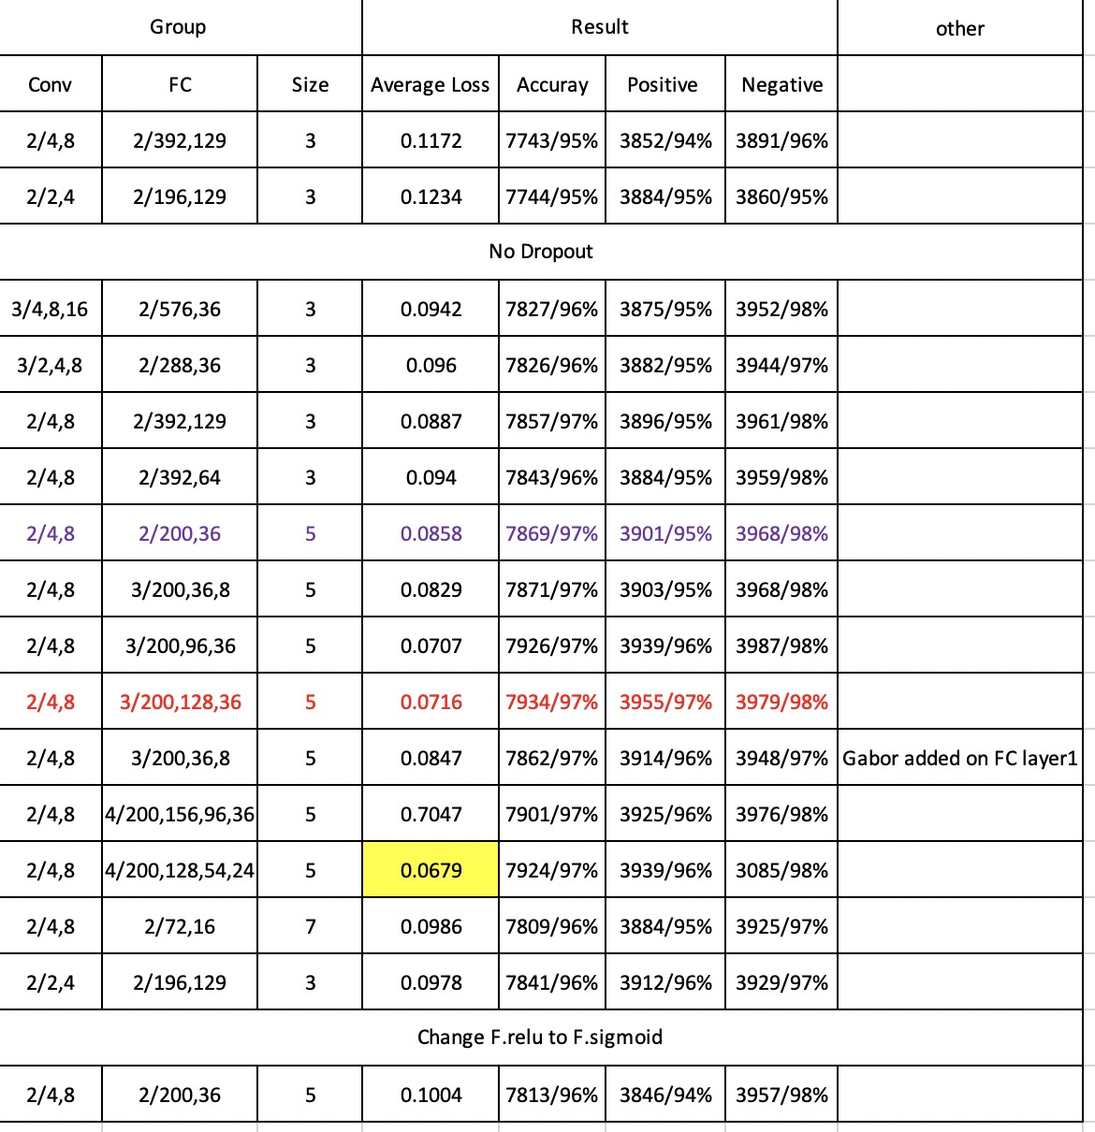

Slide 159
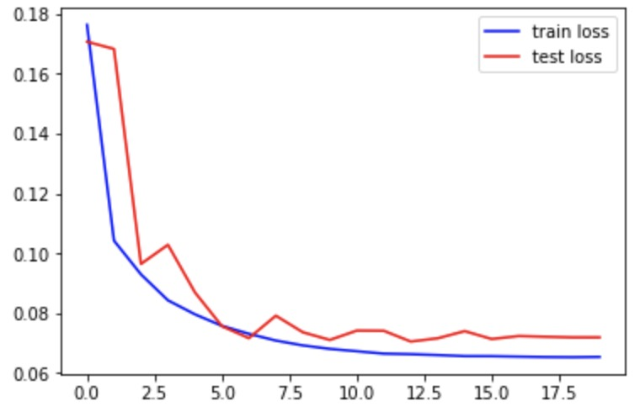
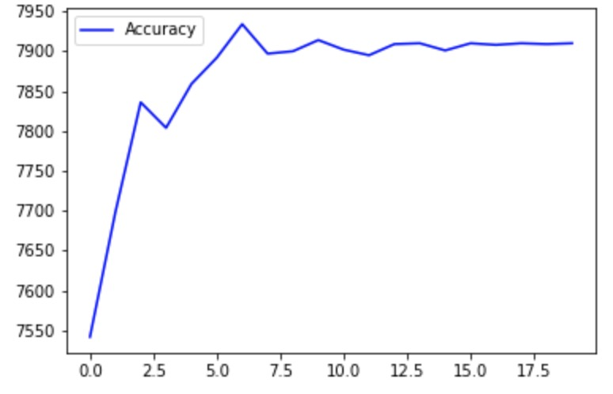
Model : Gabor + CNN (2 layers of convolution with 4,8, filter size is 5, 3 layers of fully connected with200,128,36)
Accuracy
loss
Epoch
Epoch

Slide 160
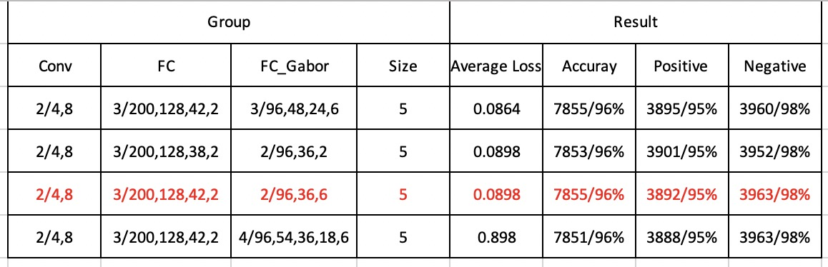
FC_PC_CNN

Slide 161
Result
DEC. 8th
Notes:
CNN+Gabor+CNN实验2,4/4,8 and gabor

Slide 162
Model : Gabor + mean&std + 2 * FC(25, 8, 2)
Epoch1:
Test set: Average loss: 0.1677, Accuracy: 7602/8141 (93%), Positive accuracy: 3688/4091 (90%), Negative accuracy: 3914/4050 (97%), f1 score: 0.9346
Epoch2:
Test set: Average loss: 0.1524, Accuracy: 7660/8141 (94%), Positive accuracy: 3820/4091 (93%), Negative accuracy: 3840/4050 (95%), f1 score: 0.9409
Epoch3
Test set: Average loss: 0.1599, Accuracy: 7627/8141 (94%), Positive accuracy: 3701/4091 (90%), Negative accuracy: 3926/4050 (97%), f1 score: 0.9377
Epoch4:
Test set: Average loss: 0.1409, Accuracy: 7680/8141 (94%), Positive accuracy: 3811/4091 (93%), Negative accuracy: 3869/4050 (96%), f1 score: 0.9435
Epoch5:
Test set: Average loss: 0.1496, Accuracy: 7657/8141 (94%), Positive accuracy: 3733/4091 (91%), Negative accuracy: 3924/4050 (97%), f1 score: 0.9412
Epoch6:
Test set: Average loss: 0.1444, Accuracy: 7668/8141 (94%), Positive accuracy: 3767/4091 (92%), Negative accuracy: 3901/4050 (96%), f1 score: 0.9422
Epoch7:
Test set: Average loss: 0.1404, Accuracy: 7680/8141 (94%), Positive accuracy: 3788/4091 (93%), Negative accuracy: 3892/4050 (96%), f1 score: 0.9436
Epoch8:
Test set: Average loss: 0.1371, Accuracy: 7687/8141 (94%), Positive accuracy: 3793/4091 (93%), Negative accuracy: 3894/4050 (96%), f1 score: 0.9444
Epoch9:
Test set: Average loss: 0.1404, Accuracy: 7682/8141 (94%), Positive accuracy: 3780/4091 (92%), Negative accuracy: 3902/4050 (96%), f1 score: 0.9439
Epoch10:
Test set: Average loss: 0.1387, Accuracy: 7691/8141 (94%), Positive accuracy: 3794/4091 (93%), Negative accuracy: 3897/4050 (96%), f1 score: 0.9449
Notes:
Test set: Average loss: 0.1387, Accuracy: 7691/8141 (94%), Positive accuracy: 3794/4091 (93%), Negative accuracy: 3897/4050 (96%), f1 score: 0.9449

Slide 163
Epoch11:
Test set: Average loss: 0.1409, Accuracy: 7685/8141 (94%), Positive accuracy: 3779/4091 (92%), Negative accuracy: 3906/4050 (96%), f1 score: 0.9443
Epoch12:
Test set: Average loss: 0.1381, Accuracy: 7689/8141 (94%), Positive accuracy: 3789/4091 (93%), Negative accuracy: 3900/4050 (96%), f1 score: 0.9447
Epoch13:
Test set: Average loss: 0.1383, Accuracy: 7688/8141 (94%), Positive accuracy: 3785/4091 (93%), Negative accuracy: 3903/4050 (96%), f1 score: 0.9446
Epoch14:
Test set: Average loss: 0.1391, Accuracy: 7688/8141 (94%), Positive accuracy: 3784/4091 (92%), Negative accuracy: 3904/4050 (96%), f1 score: 0.9446
Epoch15:
Test set: Average loss: 0.1382, Accuracy: 7690/8141 (94%), Positive accuracy: 3788/4091 (93%), Negative accuracy: 3902/4050 (96%), f1 score: 0.9449
Epoch16:
Test set: Average loss: 0.1382, Accuracy: 7690/8141 (94%), Positive accuracy: 3789/4091 (93%), Negative accuracy: 3901/4050 (96%), f1 score: 0.9448
Epoch17:
Test set: Average loss: 0.1378, Accuracy: 7690/8141 (94%), Positive accuracy: 3791/4091 (93%), Negative accuracy: 3899/4050 (96%), f1 score: 0.9448
Epoch18:
Test set: Average loss: 0.1379, Accuracy: 7690/8141 (94%), Positive accuracy: 3791/4091 (93%), Negative accuracy: 3899/4050 (96%), f1 score: 0.9448
Epoch19:
Test set: Average loss: 0.1380, Accuracy: 7691/8141 (94%), Positive accuracy: 3790/4091 (93%), Negative accuracy: 3901/4050 (96%), f1 score: 0.9450
Epoch20:
Test set: Average loss: 0.1379, Accuracy: 7690/8141 (94%), Positive accuracy: 3790/4091 (93%), Negative accuracy: 3900/4050 (96%), f1 score: 0.9448
Notes:
Test set: Average loss: 0.1379, Accuracy: 7690/8141 (94%), Positive accuracy: 3790/4091 (93%), Negative accuracy: 3900/4050 (96%), f1 score: 0.9448

Slide 164
Model : Gabor + mean&std + 3 * FC(25, 12, 6, 2)
Epoch1:
Test set: Average loss: 0.1562, Accuracy: 7620/8141 (94%), Positive accuracy: 3736/4091 (91%), Negative accuracy: 3884/4050 (96%), f1 score: 0.9364
Epoch2:
Test set: Average loss: 0.1495, Accuracy: 7661/8141 (94%), Positive accuracy: 3812/4091 (93%), Negative accuracy: 3849/4050 (95%), f1 score: 0.9411
Epoch3
Test set: Average loss: 0.1454, Accuracy: 7676/8141 (94%), Positive accuracy: 3813/4091 (93%), Negative accuracy: 3863/4050 (95%), f1 score: 0.9429
Epoch4:
Test set: Average loss: 0.1101, Accuracy: 7768/8141 (95%), Positive accuracy: 3932/4091 (96%), Negative accuracy: 3836/4050 (95%), f1 score: 0.9543
Epoch5:
Test set: Average loss: 0.1382, Accuracy: 7688/8141 (94%), Positive accuracy: 3786/4091 (93%), Negative accuracy: 3902/4050 (96%), f1 score: 0.9446
Epoch6:
Test set: Average loss: 0.1311, Accuracy: 7715/8141 (95%), Positive accuracy: 3823/4091 (93%), Negative accuracy: 3892/4050 (96%), f1 score: 0.9478
Epoch7:
Test set: Average loss: 0.1353, Accuracy: 7700/8141 (95%), Positive accuracy: 3765/4091 (92%), Negative accuracy: 3935/4050 (97%), f1 score: 0.9463
Epoch8:
Test set: Average loss: 0.1333, Accuracy: 7710/8141 (95%), Positive accuracy: 3790/4091 (93%), Negative accuracy: 3920/4050 (97%), f1 score: 0.9474
Epoch9:
Test set: Average loss: 0.1303, Accuracy: 7712/8141 (95%), Positive accuracy: 3813/4091 (93%), Negative accuracy: 3899/4050 (96%), f1 score: 0.9475
Epoch10:
Test set: Average loss: 0.1299, Accuracy: 7721/8141 (95%), Positive accuracy: 3823/4091 (93%), Negative accuracy: 3898/4050 (96%), f1 score: 0.9485
Notes:
Test set: Average loss: 0.1299, Accuracy: 7721/8141 (95%), Positive accuracy: 3823/4091 (93%), Negative accuracy: 3898/4050 (96%), f1 score: 0.9485

Slide 165
Epoch11:
Test set: Average loss: 0.1310, Accuracy: 7717/8141 (95%), Positive accuracy: 3813/4091 (93%), Negative accuracy: 3904/4050 (96%), f1 score: 0.9481
Epoch12:
Test set: Average loss: 0.1283, Accuracy: 7734/8141 (95%), Positive accuracy: 3834/4091 (94%), Negative accuracy: 3900/4050 (96%), f1 score: 0.9501
Epoch13:
Test set: Average loss: 0.1294, Accuracy: 7722/8141 (95%), Positive accuracy: 3811/4091 (93%), Negative accuracy: 3911/4050 (97%), f1 score: 0.9487
Epoch14:
Test set: Average loss: 0.1279, Accuracy: 7728/8141 (95%), Positive accuracy: 3821/4091 (93%), Negative accuracy: 3907/4050 (96%), f1 score: 0.9494
Epoch15:
Test set: Average loss: 0.1284, Accuracy: 7726/8141 (95%), Positive accuracy: 3813/4091 (93%), Negative accuracy: 3913/4050 (97%), f1 score: 0.9492
Epoch16:
Test set: Average loss: 0.1279, Accuracy: 7729/8141 (95%), Positive accuracy: 3819/4091 (93%), Negative accuracy: 3910/4050 (97%), f1 score: 0.9496
Epoch17:
Test set: Average loss: 0.1286, Accuracy: 7726/8141 (95%), Positive accuracy: 3813/4091 (93%), Negative accuracy: 3913/4050 (97%), f1 score: 0.9492
Epoch18:
Test set: Average loss: 0.1285, Accuracy: 7725/8141 (95%), Positive accuracy: 3813/4091 (93%), Negative accuracy: 3912/4050 (97%), f1 score: 0.9491
Epoch19:
Test set: Average loss: 0.1285, Accuracy: 7728/8141 (95%), Positive accuracy: 3812/4091 (93%), Negative accuracy: 3916/4050 (97%), f1 score: 0.9495
Epoch20:
Test set: Average loss: 0.1283, Accuracy: 7725/8141 (95%), Positive accuracy: 3813/4091 (93%), Negative accuracy: 3912/4050 (97%), f1 score: 0.9491
Notes:
Test set: Average loss: 0.1283, Accuracy: 7725/8141 (95%), Positive accuracy: 3813/4091 (93%), Negative accuracy: 3912/4050 (97%), f1 score: 0.9491

Slide 166
Model : Gabor + mean&std + 4 * FC(25, 16, 10, 6, 2)
Epoch1:
Test set: Average loss: 0.4458, Accuracy: 6744/8141 (83%), Positive accuracy: 2717/4091 (66%), Negative accuracy: 4027/4050 (99%), f1 score: 0.8512
Epoch2:
Test set: Average loss: 0.1611, Accuracy: 7613/8141 (94%), Positive accuracy: 3655/4091 (89%), Negative accuracy: 3958/4050 (98%), f1 score: 0.9366
Epoch3
Test set: Average loss: 0.1466, Accuracy: 7688/8141 (94%), Positive accuracy: 3896/4091 (95%), Negative accuracy: 3792/4050 (94%), f1 score: 0.9444
Epoch4:
Test set: Average loss: 0.1101, Accuracy: 7768/8141 (95%), Positive accuracy: 3932/4091 (96%), Negative accuracy: 3836/4050 (95%), f1 score: 0.9543
Epoch5:
Test set: Average loss: 0.1408, Accuracy: 7684/8141 (94%), Positive accuracy: 3732/4091 (91%), Negative accuracy: 3952/4050 (98%), f1 score: 0.9447
Epoch6:
Test set: Average loss: 0.1276, Accuracy: 7730/8141 (95%), Positive accuracy: 3807/4091 (93%), Negative accuracy: 3923/4050 (97%), f1 score: 0.9498
Epoch7:
Test set: Average loss: 0.1286, Accuracy: 7725/8141 (95%), Positive accuracy: 3816/4091 (93%), Negative accuracy: 3909/4050 (97%), f1 score: 0.9491
Epoch8:
Test set: Average loss: 0.1281, Accuracy: 7733/8141 (95%), Positive accuracy: 3809/4091 (93%), Negative accuracy: 3924/4050 (97%), f1 score: 0.9501
Epoch9:
Test set: Average loss: 0.1263, Accuracy: 7746/8141 (95%), Positive accuracy: 3826/4091 (94%), Negative accuracy: 3920/4050 (97%), f1 score: 0.9517
Epoch10:
Test set: Average loss: 0.1254, Accuracy: 7739/8141 (95%), Positive accuracy: 3833/4091 (94%), Negative accuracy: 3906/4050 (96%), f1 score: 0.9507
Notes:
Test set: Average loss: 0.1254, Accuracy: 7739/8141 (95%), Positive accuracy: 3833/4091 (94%), Negative accuracy: 3906/4050 (96%), f1 score: 0.9507

Slide 167
Epoch11:
Test set: Average loss: 0.1268, Accuracy: 7734/8141 (95%), Positive accuracy: 3812/4091 (93%), Negative accuracy: 3922/4050 (97%), f1 score: 0.9502
Epoch12:
Test set: Average loss: 0.1260, Accuracy: 7737/8141 (95%), Positive accuracy: 3819/4091 (93%), Negative accuracy: 3918/4050 (97%), f1 score: 0.9506
Epoch13:
Test set: Average loss: 0.1263, Accuracy: 7733/8141 (95%), Positive accuracy: 3818/4091 (93%), Negative accuracy: 3915/4050 (97%), f1 score: 0.9501
Epoch14:
Test set: Average loss: 0.1256, Accuracy: 7741/8141 (95%), Positive accuracy: 3828/4091 (94%), Negative accuracy: 3913/4050 (97%), f1 score: 0.9510
Epoch15:
Test set: Average loss: 0.1262, Accuracy: 7739/8141 (95%), Positive accuracy: 3816/4091 (93%), Negative accuracy: 3923/4050 (97%), f1 score: 0.9509
Epoch16:
Test set: Average loss: 0.1255, Accuracy: 7737/8141 (95%), Positive accuracy: 3823/4091 (93%), Negative accuracy: 3914/4050 (97%), f1 score: 0.9505
Epoch17:
Test set: Average loss: 0.1253, Accuracy: 7742/8141 (95%), Positive accuracy: 3829/4091 (94%), Negative accuracy: 3913/4050 (97%), f1 score: 0.9511
Epoch18:
Test set: Average loss: 0.1256, Accuracy: 7738/8141 (95%), Positive accuracy: 3822/4091 (93%), Negative accuracy: 3916/4050 (97%), f1 score: 0.9507
Epoch19:
Test set: Average loss: 0.1255, Accuracy: 7740/8141 (95%), Positive accuracy: 3826/4091 (94%), Negative accuracy: 3914/4050 (97%), f1 score: 0.9509
Epoch20:
Test set: Average loss: 0.1256, Accuracy: 7736/8141 (95%), Positive accuracy: 3820/4091 (93%), Negative accuracy: 3916/4050 (97%), f1 score: 0.9504
Notes:
Test set: Average loss: 0.1256, Accuracy: 7736/8141 (95%), Positive accuracy: 3820/4091 (93%), Negative accuracy: 3916/4050 (97%), f1 score: 0.9504

Slide 168
Model : Gabor + mean&std + 5 * FC(25, 20, 15, 10, 5, 2)
Epoch1:
Test set: Average loss: 0.1484, Accuracy: 7648/8141 (94%), Positive accuracy: 3789/4091 (93%), Negative accuracy: 3859/4050 (95%), f1 score: 0.9396
Epoch2:
Test set: Average loss: 0.1369, Accuracy: 7666/8141 (94%), Positive accuracy: 3780/4091 (92%), Negative accuracy: 3886/4050 (96%), f1 score: 0.9419
Epoch3
Test set: Average loss: 0.1715, Accuracy: 7594/8141 (93%), Positive accuracy: 3597/4091 (88%), Negative accuracy: 3997/4050 (99%), f1 score: 0.9353
Epoch4:
Test set: Average loss: 0.1288, Accuracy: 7725/8141 (95%), Positive accuracy: 3755/4091 (92%), Negative accuracy: 3970/4050 (98%), f1 score: 0.9497
Epoch5:
Test set: Average loss: 0.1198, Accuracy: 7757/8141 (95%), Positive accuracy: 3843/4091 (94%), Negative accuracy: 3914/4050 (97%), f1 score: 0.9529
Epoch6:
Test set: Average loss: 0.1275, Accuracy: 7719/8141 (95%), Positive accuracy: 3824/4091 (93%), Negative accuracy: 3895/4050 (96%), f1 score: 0.9483
Epoch7:
Test set: Average loss: 0.1264, Accuracy: 7725/8141 (95%), Positive accuracy: 3851/4091 (94%), Negative accuracy: 3874/4050 (96%), f1 score: 0.9489
Epoch8:
Test set: Average loss: 0.1247, Accuracy: 7736/8141 (95%), Positive accuracy: 3803/4091 (93%), Negative accuracy: 3933/4050 (97%), f1 score: 0.9506
Epoch9:
Test set: Average loss: 0.1224, Accuracy: 7741/8141 (95%), Positive accuracy: 3836/4091 (94%), Negative accuracy: 3905/4050 (96%), f1 score: 0.9510
Epoch10:
Test set: Average loss: 0.1211, Accuracy: 7756/8141 (95%), Positive accuracy: 3829/4091 (94%), Negative accuracy: 3927/4050 (97%), f1 score: 0.9529
Notes:
Test set: Average loss: 0.1211, Accuracy: 7756/8141 (95%), Positive accuracy: 3829/4091 (94%), Negative accuracy: 3927/4050 (97%), f1 score: 0.9529

Slide 169
Epoch11:
Test set: Average loss: 0.1226, Accuracy: 7737/8141 (95%), Positive accuracy: 3833/4091 (94%), Negative accuracy: 3904/4050 (96%), f1 score: 0.9505
Epoch12:
Test set: Average loss: 0.1206, Accuracy: 7745/8141 (95%), Positive accuracy: 3842/4091 (94%), Negative accuracy: 3903/4050 (96%), f1 score: 0.9514
Epoch13:
Test set: Average loss: 0.1203, Accuracy: 7752/8141 (95%), Positive accuracy: 3838/4091 (94%), Negative accuracy: 3914/4050 (97%), f1 score: 0.9523
Epoch14:
Test set: Average loss: 0.1219, Accuracy: 7742/8141 (95%), Positive accuracy: 3821/4091 (93%), Negative accuracy: 3921/4050 (97%), f1 score: 0.9512
Epoch15:
Test set: Average loss: 0.1210, Accuracy: 7749/8141 (95%), Positive accuracy: 3824/4091 (93%), Negative accuracy: 3925/4050 (97%), f1 score: 0.9521
Epoch16:
Test set: Average loss: 0.1213, Accuracy: 7747/8141 (95%), Positive accuracy: 3824/4091 (93%), Negative accuracy: 3923/4050 (97%), f1 score: 0.9518
Epoch17:
Test set: Average loss: 0.1207, Accuracy: 7747/8141 (95%), Positive accuracy: 3831/4091 (94%), Negative accuracy: 3916/4050 (97%), f1 score: 0.9518
Epoch18:
Test set: Average loss: 0.1208, Accuracy: 7747/8141 (95%), Positive accuracy: 3831/4091 (94%), Negative accuracy: 3916/4050 (97%), f1 score: 0.9518
Epoch19:
Test set: Average loss: 0.1208, Accuracy: 7747/8141 (95%), Positive accuracy: 3831/4091 (94%), Negative accuracy: 3916/4050 (97%), f1 score: 0.9518
Epoch20:
Test set: Average loss: 0.1210, Accuracy: 7745/8141 (95%), Positive accuracy: 3829/4091 (94%), Negative accuracy: 3916/4050 (97%), f1 score: 0.9515
Notes:
Test set: Average loss: 0.1210, Accuracy: 7745/8141 (95%), Positive accuracy: 3829/4091 (94%), Negative accuracy: 3916/4050 (97%), f1 score: 0.9515

Slide 170
Model : Gabor + mean&std + 2 * CONV(4, 8, size 5)
+5 * FC(225, 128, 64, 16, 6, 2)
Epoch1:
Test set: Average loss: 0.1291, Accuracy: 7689/8141 (94%), Positive accuracy: 3794/4091 (93%), Negative accuracy: 3895/4050 (96%), f1 score: 0.9447
Epoch2:
Test set: Average loss: 0.1351, Accuracy: 7686/8141 (94%), Positive accuracy: 3955/4091 (97%), Negative accuracy: 3731/4050 (92%), f1 score: 0.9447
Epoch3
Test set: Average loss: 0.1083, Accuracy: 7771/8141 (95%), Positive accuracy: 3877/4091 (95%), Negative accuracy: 3894/4050 (96%), f1 score: 0.9546
Epoch4:
Test set: Average loss: 0.1151, Accuracy: 7779/8141 (96%), Positive accuracy: 3799/4091 (93%), Negative accuracy: 3980/4050 (98%), f1 score: 0.9561
Epoch5:
Test set: Average loss: 0.0977, Accuracy: 7816/8141 (96%), Positive accuracy: 3867/4091 (95%), Negative accuracy: 3949/4050 (98%), f1 score: 0.9602
Epoch6:
Test set: Average loss: 0.0876, Accuracy: 7863/8141 (97%), Positive accuracy: 3896/4091 (95%), Negative accuracy: 3967/4050 (98%), f1 score: 0.9660
Epoch7:
Test set: Average loss: 0.0851, Accuracy: 7865/8141 (97%), Positive accuracy: 3930/4091 (96%), Negative accuracy: 3935/4050 (97%), f1 score: 0.9661
Epoch8:
Test set: Average loss: 0.0871, Accuracy: 7860/8141 (97%), Positive accuracy: 3899/4091 (95%), Negative accuracy: 3961/4050 (98%), f1 score: 0.9656
Epoch9:
Test set: Average loss: 0.0874, Accuracy: 7862/8141 (97%), Positive accuracy: 3895/4091 (95%), Negative accuracy: 3967/4050 (98%), f1 score: 0.9658
Epoch10:
Test set: Average loss: 0.0834, Accuracy: 7883/8141 (97%), Positive accuracy: 3912/4091 (96%), Negative accuracy: 3971/4050 (98%), f1 score: 0.9684
Notes:
Test set: Average loss: 0.0834, Accuracy: 7883/8141 (97%), Positive accuracy: 3912/4091 (96%), Negative accuracy: 3971/4050 (98%), f1 score: 0.9684

Slide 171
Epoch11:
Test set: Average loss: 0.0845, Accuracy: 7887/8141 (97%), Positive accuracy: 3925/4091 (96%), Negative accuracy: 3962/4050 (98%), f1 score: 0.9688
Epoch12:
Test set: Average loss: 0.0838, Accuracy: 7880/8141 (97%), Positive accuracy: 3920/4091 (96%), Negative accuracy: 3960/4050 (98%), f1 score: 0.9680
Epoch13:
Test set: Average loss: 0.0839, Accuracy: 7881/8141 (97%), Positive accuracy: 3909/4091 (96%), Negative accuracy: 3972/4050 (98%), f1 score: 0.9682
Epoch14:
Test set: Average loss: 0.0834, Accuracy: 7879/8141 (97%), Positive accuracy: 3915/4091 (96%), Negative accuracy: 3964/4050 (98%), f1 score: 0.9679
Epoch15:
Test set: Average loss: 0.0838, Accuracy: 7879/8141 (97%), Positive accuracy: 3916/4091 (96%), Negative accuracy: 3963/4050 (98%), f1 score: 0.9679
Epoch16:
Test set: Average loss: 0.0831, Accuracy: 7882/8141 (97%), Positive accuracy: 3912/4091 (96%), Negative accuracy: 3970/4050 (98%), f1 score: 0.9683
Epoch17:
Test set: Average loss: 0.0832, Accuracy: 7879/8141 (97%), Positive accuracy: 3918/4091 (96%), Negative accuracy: 3961/4050 (98%), f1 score: 0.9679
Epoch18:
Test set: Average loss: 0.0838, Accuracy: 7881/8141 (97%), Positive accuracy: 3913/4091 (96%), Negative accuracy: 3968/4050 (98%), f1 score: 0.9681
Epoch19:
Test set: Average loss: 0.0836, Accuracy: 7885/8141 (97%), Positive accuracy: 3913/4091 (96%), Negative accuracy: 3972/4050 (98%), f1 score: 0.9686
Epoch20:
Test set: Average loss: 0.0835, Accuracy: 7881/8141 (97%), Positive accuracy: 3914/4091 (96%), Negative accuracy: 3967/4050 (98%), f1 score: 0.9681
Notes:
Test set: Average loss: 0.0835, Accuracy: 7881/8141 (97%), Positive accuracy: 3914/4091 (96%), Negative accuracy: 3967/4050 (98%), f1 score: 0.9681

Slide 172
Model : Gabor + mean&std + 2 * CONV(4, 8, size 5)
+3 * FC(225, 64, 16, 2)
Epoch1:
Test set: Average loss: 0.1258, Accuracy: 7742/8141 (95%), Positive accuracy: 3820/4091 (93%), Negative accuracy: 3922/4050 (97%), f1 score: 0.9512
Epoch2:
Test set: Average loss: 0.1020, Accuracy: 7815/8141 (96%), Positive accuracy: 3917/4091 (96%), Negative accuracy: 3898/4050 (96%), f1 score: 0.9599
Epoch3
Test set: Average loss: 0.1070, Accuracy: 7771/8141 (95%), Positive accuracy: 3853/4091 (94%), Negative accuracy: 3918/4050 (97%), f1 score: 0.9547
Epoch4:
Test set: Average loss: 0.1004, Accuracy: 7818/8141 (96%), Positive accuracy: 3875/4091 (95%), Negative accuracy: 3943/4050 (97%), f1 score: 0.9604
Epoch5:
Test set: Average loss: 0.0977, Accuracy: 7816/8141 (96%), Positive accuracy: 3867/4091 (95%), Negative accuracy: 3949/4050 (98%), f1 score: 0.9602
Epoch6:
Test set: Average loss: 0.0996, Accuracy: 7814/8141 (96%), Positive accuracy: 3850/4091 (94%), Negative accuracy: 3964/4050 (98%), f1 score: 0.9601
Epoch7:
Test set: Average loss: 0.0958, Accuracy: 7827/8141 (96%), Positive accuracy: 3879/4091 (95%), Negative accuracy: 3948/4050 (97%), f1 score: 0.9615
Epoch8:
Test set: Average loss: 0.0937, Accuracy: 7830/8141 (96%), Positive accuracy: 3909/4091 (96%), Negative accuracy: 3921/4050 (97%), f1 score: 0.9618
Epoch9:
Test set: Average loss: 0.0886, Accuracy: 7845/8141 (96%), Positive accuracy: 3914/4091 (96%), Negative accuracy: 3931/4050 (97%), f1 score: 0.9637
Epoch10:
Test set: Average loss: 0.0947, Accuracy: 7827/8141 (96%), Positive accuracy: 3879/4091 (95%), Negative accuracy: 3948/4050 (97%), f1 score: 0.9615
Notes:
Test set: Average loss: 0.0947, Accuracy: 7827/8141 (96%), Positive accuracy: 3879/4091 (95%), Negative accuracy: 3948/4050 (97%), f1 score: 0.9615

Slide 173
Epoch11:
Test set: Average loss: 0.0914, Accuracy: 7842/8141 (96%), Positive accuracy: 3892/4091 (95%), Negative accuracy: 3950/4050 (98%), f1 score: 0.9634
Epoch12:
Test set: Average loss: 0.0930, Accuracy: 7845/8141 (96%), Positive accuracy: 3884/4091 (95%), Negative accuracy: 3961/4050 (98%), f1 score: 0.9638
Epoch13:
Test set: Average loss: 0.0917, Accuracy: 7853/8141 (96%), Positive accuracy: 3887/4091 (95%), Negative accuracy: 3966/4050 (98%), f1 score: 0.9648
Epoch14:
Test set: Average loss: 0.0907, Accuracy: 7845/8141 (96%), Positive accuracy: 3901/4091 (95%), Negative accuracy: 3944/4050 (97%), f1 score: 0.9637
Epoch15:
Test set: Average loss: 0.0908, Accuracy: 7846/8141 (96%), Positive accuracy: 3897/4091 (95%), Negative accuracy: 3949/4050 (98%), f1 score: 0.9638
Epoch16:
Test set: Average loss: 0.0902, Accuracy: 7848/8141 (96%), Positive accuracy: 3899/4091 (95%), Negative accuracy: 3949/4050 (98%), f1 score: 0.9641
Epoch17:
Test set: Average loss: 0.0909, Accuracy: 7847/8141 (96%), Positive accuracy: 3895/4091 (95%), Negative accuracy: 3952/4050 (98%), f1 score: 0.9640
Epoch18:
Test set: Average loss: 0.0907, Accuracy: 7848/8141 (96%), Positive accuracy: 3897/4091 (95%), Negative accuracy: 3951/4050 (98%), f1 score: 0.9641
Epoch19:
Test set: Average loss: 0.0907, Accuracy: 7846/8141 (96%), Positive accuracy: 3896/4091 (95%), Negative accuracy: 3950/4050 (98%), f1 score: 0.9638
Epoch20:
Test set: Average loss: 0.0906, Accuracy: 7847/8141 (96%), Positive accuracy: 3897/4091 (95%), Negative accuracy: 3950/4050 (98%), f1 score: 0.9640
Notes:
Test set: Average loss: 0.0906, Accuracy: 7847/8141 (96%), Positive accuracy: 3897/4091 (95%), Negative accuracy: 3950/4050 (98%), f1 score: 0.9640

Slide 174
Model : Gabor + mean&std + 3 * CONV(2, 4, 8, size 3)
+5 * FC(313, 128, 64, 16, 6, 2)
Epoch1:
Test set: Average loss: 0.1724, Accuracy: 7594/8141 (93%), Positive accuracy: 3866/4091 (95%), Negative accuracy: 3728/4050 (92%), f1 score: 0.9330
Epoch2:
Test set: Average loss: 0.1306, Accuracy: 7751/8141 (95%), Positive accuracy: 3902/4091 (95%), Negative accuracy: 3849/4050 (95%), f1 score: 0.9521
Epoch3
Test set: Average loss: 0.1221, Accuracy: 7757/8141 (95%), Positive accuracy: 3852/4091 (94%), Negative accuracy: 3905/4050 (96%), f1 score: 0.9529
Epoch4:
Test set: Average loss: 0.1184, Accuracy: 7763/8141 (95%), Positive accuracy: 3889/4091 (95%), Negative accuracy: 3874/4050 (96%), f1 score: 0.9536
Epoch5:
Test set: Average loss: 0.1199, Accuracy: 7756/8141 (95%), Positive accuracy: 3832/4091 (94%), Negative accuracy: 3924/4050 (97%), f1 score: 0.9529
Epoch6:
Test set: Average loss: 0.1176, Accuracy: 7747/8141 (95%), Positive accuracy: 3823/4091 (93%), Negative accuracy: 3924/4050 (97%), f1 score: 0.9518
Epoch7:
Test set: Average loss: 0.1190, Accuracy: 7756/8141 (95%), Positive accuracy: 3831/4091 (94%), Negative accuracy: 3925/4050 (97%), f1 score: 0.9529
Epoch8:
Test set: Average loss: 0.1158, Accuracy: 7757/8141 (95%), Positive accuracy: 3847/4091 (94%), Negative accuracy: 3910/4050 (97%), f1 score: 0.9529
Epoch9:
Test set: Average loss: 0.1186, Accuracy: 7759/8141 (95%), Positive accuracy: 3805/4091 (93%), Negative accuracy: 3954/4050 (98%), f1 score: 0.9535
Epoch10:
Test set: Average loss: 0.1130, Accuracy: 7766/8141 (95%), Positive accuracy: 3839/4091 (94%), Negative accuracy: 3927/4050 (97%), f1 score: 0.9541
Notes:
Test set: Average loss: 0.1130, Accuracy: 7766/8141 (95%), Positive accuracy: 3839/4091 (94%), Negative accuracy: 3927/4050 (97%), f1 score: 0.9541

Slide 175
Epoch11:
Test set: Average loss: 0.1127, Accuracy: 7762/8141 (95%), Positive accuracy: 3853/4091 (94%), Negative accuracy: 3909/4050 (97%), f1 score: 0.9535
Epoch12:
Test set: Average loss: 0.1119, Accuracy: 7766/8141 (95%), Positive accuracy: 3841/4091 (94%), Negative accuracy: 3925/4050 (97%), f1 score: 0.9541
Epoch13:
Test set: Average loss: 0.1137, Accuracy: 7766/8141 (95%), Positive accuracy: 3841/4091 (94%), Negative accuracy: 3925/4050 (97%), f1 score: 0.9541
Epoch14:
Test set: Average loss: 0.1119, Accuracy: 7772/8141 (95%), Positive accuracy: 3861/4091 (94%), Negative accuracy: 3911/4050 (97%), f1 score: 0.9547
Epoch15:
Test set: Average loss: 0.1129, Accuracy: 7768/8141 (95%), Positive accuracy: 3845/4091 (94%), Negative accuracy: 3923/4050 (97%), f1 score: 0.9543
Epoch16:
Test set: Average loss: 0.1121, Accuracy: 7770/8141 (95%), Positive accuracy: 3859/4091 (94%), Negative accuracy: 3911/4050 (97%), f1 score: 0.9545
Epoch17:
Test set: Average loss: 0.1122, Accuracy: 7771/8141 (95%), Positive accuracy: 3851/4091 (94%), Negative accuracy: 3920/4050 (97%), f1 score: 0.9547
Epoch18:
Test set: Average loss: 0.1122, Accuracy: 7773/8141 (95%), Positive accuracy: 3855/4091 (94%), Negative accuracy: 3918/4050 (97%), f1 score: 0.9549
Epoch19:
Test set: Average loss: 0.1122, Accuracy: 7772/8141 (95%), Positive accuracy: 3855/4091 (94%), Negative accuracy: 3917/4050 (97%), f1 score: 0.9548
Epoch20:
Test set: Average loss: 0.1123, Accuracy: 7772/8141 (95%), Positive accuracy: 3853/4091 (94%), Negative accuracy: 3919/4050 (97%), f1 score: 0.9548
Notes:
Test set: Average loss: 0.1123, Accuracy: 7772/8141 (95%), Positive accuracy: 3853/4091 (94%), Negative accuracy: 3919/4050 (97%), f1 score: 0.9548

Slide 176
summary

Slide 177
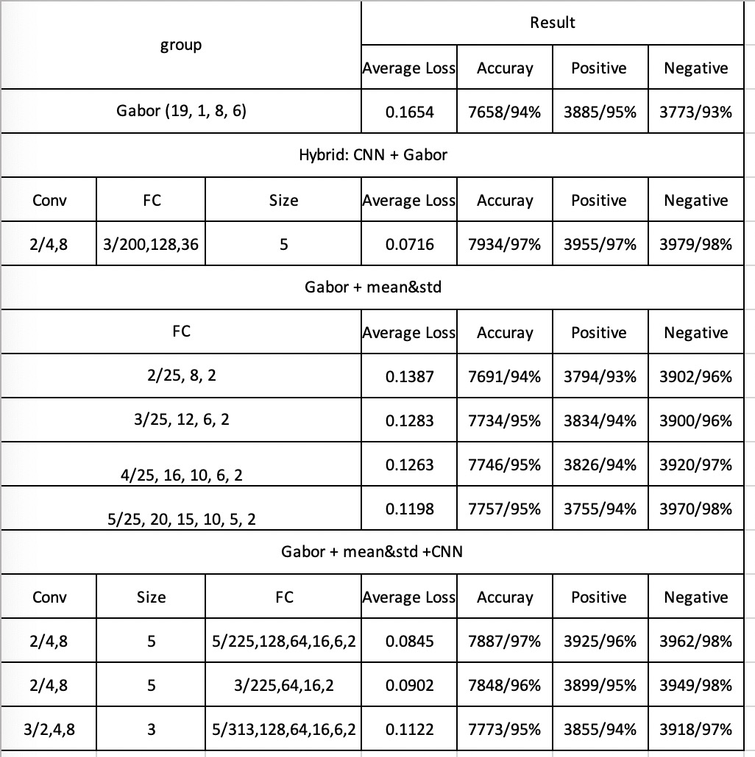

Slide 178
Result
DEC. 16th
Notes:
CNN+Gabor+CNN实验2,4/4,8 and gabor

Slide 179
Model : Gabor + 2 * CONV(2, 4, 8, size 3)
+3 * FC(72, 36, 16, 2), MaxPooling after each layer
Epoch1:
Test set: Average loss: 0.1448, Accuracy: 7664/8141 (94%), Positive accuracy: 3673/4091 (90%), Negative accuracy: 3991/4050 (99%), f1 score: 0.9430
Epoch2:
Test set: Average loss: 0.1121, Accuracy: 7788/8141 (96%), Positive accuracy: 3949/4091 (97%), Negative accuracy: 3839/4050 (95%), f1 score: 0.9567
Epoch3
Test set: Average loss: 0.1155, Accuracy: 7767/8141 (95%), Positive accuracy: 3833/4091 (94%), Negative accuracy: 3934/4050 (97%), f1 score: 0.9543
Epoch4:
Test set: Average loss: 0.1042, Accuracy: 7799/8141 (96%), Positive accuracy: 3855/4091 (94%), Negative accuracy: 3944/4050 (97%), f1 score: 0.9582
Epoch5:
Test set: Average loss: 0.1078, Accuracy: 7787/8141 (96%), Positive accuracy: 3839/4091 (94%), Negative accuracy: 3948/4050 (97%), f1 score: 0.9568
Epoch6:
Test set: Average loss: 0.1053, Accuracy: 7796/8141 (96%), Positive accuracy: 3833/4091 (94%), Negative accuracy: 3963/4050 (98%), f1 score: 0.9579
Epoch7:
Test set: Average loss: 0.0978, Accuracy: 7814/8141 (96%), Positive accuracy: 3878/4091 (95%), Negative accuracy: 3936/4050 (97%), f1 score: 0.9599
Epoch8:
Test set: Average loss: 0.1001, Accuracy: 7811/8141 (96%), Positive accuracy: 3847/4091 (94%), Negative accuracy: 3964/4050 (98%), f1 score: 0.9597
Epoch9:
Test set: Average loss: 0.0986, Accuracy: 7816/8141 (96%), Positive accuracy: 3863/4091 (94%), Negative accuracy: 3953/4050 (98%), f1 score: 0.9603
Epoch10:
Test set: Average loss: 0.0994, Accuracy: 7808/8141 (96%), Positive accuracy: 3853/4091 (94%), Negative accuracy: 3955/4050 (98%), f1 score: 0.9593
Notes:
Test set: Average loss: 0.0994, Accuracy: 7808/8141 (96%), Positive accuracy: 3853/4091 (94%), Negative accuracy: 3955/4050 (98%), f1 score: 0.9593

Slide 180
Epoch11:
Test set: Average loss: 0.0993, Accuracy: 7813/8141 (96%), Positive accuracy: 3849/4091 (94%), Negative accuracy: 3964/4050 (98%), f1 score: 0.9600
Epoch12:
Test set: Average loss: 0.0971, Accuracy: 7820/8141 (96%), Positive accuracy: 3870/4091 (95%), Negative accuracy: 3950/4050 (98%), f1 score: 0.9607
Epoch13:
Test set: Average loss: 0.0972, Accuracy: 7814/8141 (96%), Positive accuracy: 3859/4091 (94%), Negative accuracy: 3955/4050 (98%), f1 score: 0.9600
Epoch14:
Test set: Average loss: 0.0963, Accuracy: 7819/8141 (96%), Positive accuracy: 3867/4091 (95%), Negative accuracy: 3952/4050 (98%), f1 score: 0.9606
Epoch15:
Test set: Average loss: 0.0969, Accuracy: 7820/8141 (96%), Positive accuracy: 3864/4091 (94%), Negative accuracy: 3956/4050 (98%), f1 score: 0.9607
Epoch16:
Test set: Average loss: 0.0966, Accuracy: 7821/8141 (96%), Positive accuracy: 3868/4091 (95%), Negative accuracy: 3953/4050 (98%), f1 score: 0.9608
Epoch17:
Test set: Average loss: 0.0967, Accuracy: 7821/8141 (96%), Positive accuracy: 3867/4091 (95%), Negative accuracy: 3954/4050 (98%), f1 score: 0.9609
Epoch18:
Test set: Average loss: 0.0971, Accuracy: 7819/8141 (96%), Positive accuracy: 3860/4091 (94%), Negative accuracy: 3959/4050 (98%), f1 score: 0.9607
Epoch19:
Test set: Average loss: 0.0965, Accuracy: 7821/8141 (96%), Positive accuracy: 3867/4091 (95%), Negative accuracy: 3954/4050 (98%), f1 score: 0.9609
Epoch20:
Test set: Average loss: 0.0967, Accuracy: 7822/8141 (96%), Positive accuracy: 3865/4091 (94%), Negative accuracy: 3957/4050 (98%), f1 score: 0.9610
Notes:
Test set: Average loss: 0.0967, Accuracy: 7822/8141 (96%), Positive accuracy: 3865/4091 (94%), Negative accuracy: 3957/4050 (98%), f1 score: 0.9610

Slide 181
Model : Gabor + 2 * CONV(2, 4, 8, size 3)
+2 * FC(72,16, 2), MaxPooling after each layer
Epoch1:
Test set: Average loss: 0.1372, Accuracy: 7698/8141 (95%), Positive accuracy: 3737/4091 (91%), Negative accuracy: 3961/4050 (98%), f1 score: 0.9464
Epoch2:
Test set: Average loss: 0.1187, Accuracy: 7776/8141 (96%), Positive accuracy: 3939/4091 (96%), Negative accuracy: 3837/4050 (95%), f1 score: 0.9553
Epoch3
Test set: Average loss: 0.1099, Accuracy: 7779/8141 (96%), Positive accuracy: 3859/4091 (94%), Negative accuracy: 3920/4050 (97%), f1 score: 0.9556
Epoch4:
Test set: Average loss: 0.1061, Accuracy: 7800/8141 (96%), Positive accuracy: 3949/4091 (97%), Negative accuracy: 3851/4050 (95%), f1 score: 0.9582
Epoch5:
Test set: Average loss: 0.1078, Accuracy: 7787/8141 (96%), Positive accuracy: 3839/4091 (94%), Negative accuracy: 3948/4050 (97%), f1 score: 0.9568
Epoch6:
Test set: Average loss: 0.1038, Accuracy: 7798/8141 (96%), Positive accuracy: 3859/4091 (94%), Negative accuracy: 3939/4050 (97%), f1 score: 0.9580
Epoch7:
Test set: Average loss: 0.1047, Accuracy: 7799/8141 (96%), Positive accuracy: 3864/4091 (94%), Negative accuracy: 3935/4050 (97%), f1 score: 0.9581
Epoch8:
Test set: Average loss: 0.1018, Accuracy: 7808/8141 (96%), Positive accuracy: 3873/4091 (95%), Negative accuracy: 3935/4050 (97%), f1 score: 0.9592
Epoch9:
Test set: Average loss: 0.1023, Accuracy: 7811/8141 (96%), Positive accuracy: 3874/4091 (95%), Negative accuracy: 3937/4050 (97%), f1 score: 0.9596
Epoch10:
Test set: Average loss: 0.1002, Accuracy: 7813/8141 (96%), Positive accuracy: 3877/4091 (95%), Negative accuracy: 3936/4050 (97%), f1 score: 0.9598
Notes:
Test set: Average loss: 0.1002, Accuracy: 7813/8141 (96%), Positive accuracy: 3877/4091 (95%), Negative accuracy: 3936/4050 (97%), f1 score: 0.9598

Slide 182
Epoch11:
Test set: Average loss: 0.0991, Accuracy: 7815/8141 (96%), Positive accuracy: 3883/4091 (95%), Negative accuracy: 3932/4050 (97%), f1 score: 0.9600
Epoch12:
Test set: Average loss: 0.0995, Accuracy: 7814/8141 (96%), Positive accuracy: 3884/4091 (95%), Negative accuracy: 3930/4050 (97%), f1 score: 0.9599
Epoch13:
Test set: Average loss: 0.0987, Accuracy: 7815/8141 (96%), Positive accuracy: 3884/4091 (95%), Negative accuracy: 3931/4050 (97%), f1 score: 0.9600
Epoch14:
Test set: Average loss: 0.1013, Accuracy: 7809/8141 (96%), Positive accuracy: 3872/4091 (95%), Negative accuracy: 3937/4050 (97%), f1 score: 0.9593
Epoch15:
Test set: Average loss: 0.0983, Accuracy: 7815/8141 (96%), Positive accuracy: 3889/4091 (95%), Negative accuracy: 3926/4050 (97%), f1 score: 0.9600
Epoch16:
Test set: Average loss: 0.0997, Accuracy: 7817/8141 (96%), Positive accuracy: 3883/4091 (95%), Negative accuracy: 3934/4050 (97%), f1 score: 0.9603
Epoch17:
Test set: Average loss: 0.0997, Accuracy: 7816/8141 (96%), Positive accuracy: 3883/4091 (95%), Negative accuracy: 3933/4050 (97%), f1 score: 0.9601
Epoch18:
Test set: Average loss: 0.0995, Accuracy: 7816/8141 (96%), Positive accuracy: 3883/4091 (95%), Negative accuracy: 3933/4050 (97%), f1 score: 0.9601
Epoch19:
Test set: Average loss: 0.0991, Accuracy: 7816/8141 (96%), Positive accuracy: 3885/4091 (95%), Negative accuracy: 3931/4050 (97%), f1 score: 0.9601
Epoch20:
Test set: Average loss: 0.0997, Accuracy: 7815/8141 (96%), Positive accuracy: 3882/4091 (95%), Negative accuracy: 3933/4050 (97%), f1 score: 0.9600
Notes:
Test set: Average loss: 0.0997, Accuracy: 7815/8141 (96%), Positive accuracy: 3882/4091 (95%), Negative accuracy: 3933/4050 (97%), f1 score: 0.9600

